Slide 1
Behavioral Design Patterns
Morteza Yousefi
University Of Science & Technology Of Mazandaran
yousefi@ustmb.ac.ir

Slide 2
Outline
Template Method
Mediator
Observer
Strategy
Chain of Responsibility
State
Iterator
Memento

Slide 3
Template Method
Intent
Encapsulates an algorithm by creating a template for it.
Defines the skeleton of an algorithm as a set of steps.
Some methods of the algorithm have to be implemented by the subclasses – these are abstract methods in the super class.
The subclasses can redefine certain steps of the algorithm without changing the algorithm’s structure.
Some steps of the algorithm are concrete methods defined in the super class.

Slide 4
Template Method(cont’d)
Coffee Recipe
  Boil some water
  Brew coffee in boiling water
  Pour coffee in cup
  Add sugar and milk
Tea Recipe
  Boil some water
  Brew tea in boiling water
  Pour tea in cup
  Add sugar
Suppose you are required to implement a system to maintain this

Slide 5
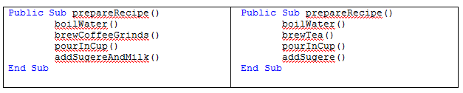
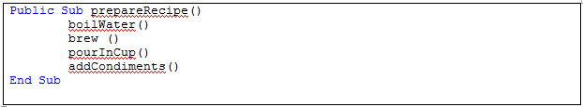
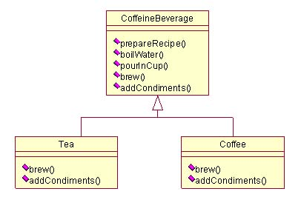
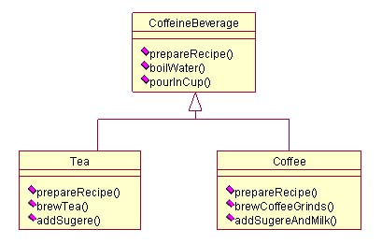
Template Method(cont’d)

Slide 6
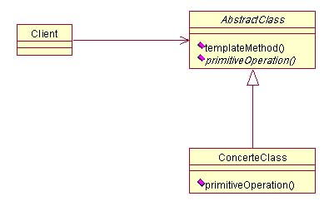
Template Method(cont’d)
Template Pattern Structure

Slide 7
Template Method(cont’d)
Advantages of the New Approach
A single class protects and controls the algorithm, namely, CaffeineBeverage.
The superclass facilitates reuse of methods.
Code changes will occur in only one place.
Other beverages can be easily added.

Slide 8
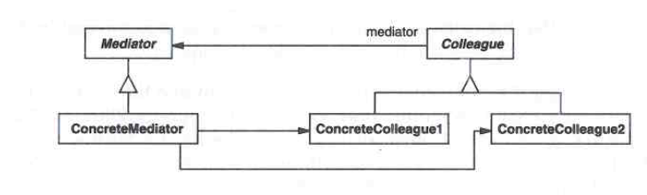
Mediator
Intent
Define an object that encapsulates how a set of objects interact. Mediator promotes loose coupling by keeping objects from referring to each other explicitly, and it lets you vary their interaction independently.

Slide 9
Mediator(cont’d)
1. When you select one of the names in the left-hand list box, it is copied into the text field for editing, and the Copy button is enabled.
2. When you click on Copy, that text is added to the right hand list box, and the Clear button is enabled.
3. If you click on the Clear button, the right hand list box and the text field are cleared, the list box is deselected and the two buttons are again disabled.

Slide 10
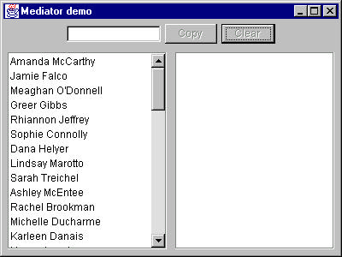
Mediator(cont’d)
An Example System

Slide 11
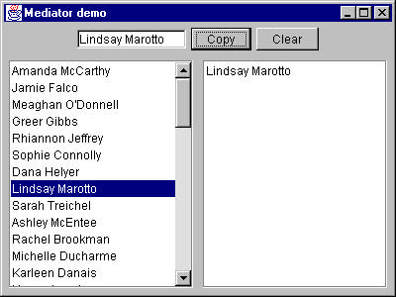
Mediator(cont’d)

Slide 12
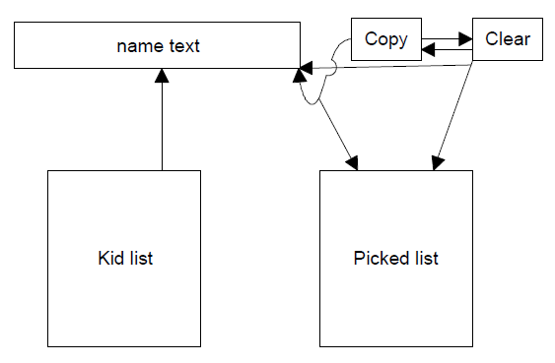
Mediator(cont’d)
Interactions between Controls
The interactions between the visual controls are pretty complex , Each visual object needs to know about two or more others

Slide 13
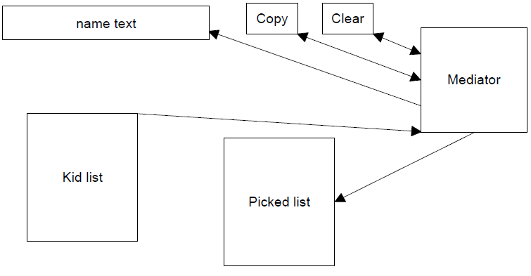
Mediator(cont’d)
The advantage of the Mediator is clear-- it is the only class that knows of the other classes, and thus the only one that would need to be changed if one of the other classes changes or if other interface control classes are added.

Slide 14
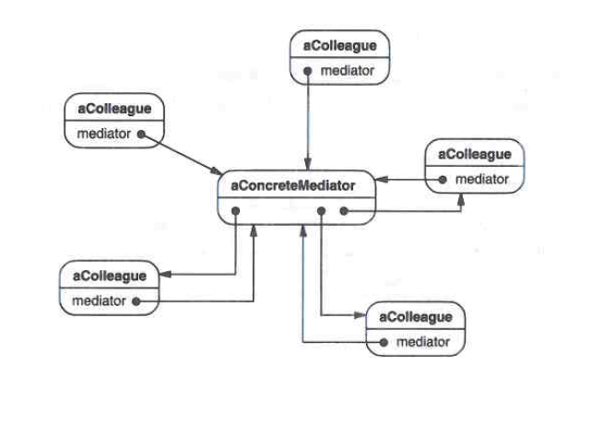
Mediator(cont’d)
Consequences of the Mediator Pattern
  simplify to change the program
  Increase Reusability

Slide 15
Observer
Intent
Define a one-to-many dependency between objects so that when one object changes state, all its dependents are notified and updated automatically.
The object that changes state is called the subject and the other objects are the observers.

Slide 16
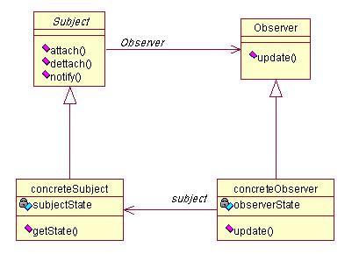
Observer(cont’d)
Subject should have an interface for Registering, Unregistering, and Notifying
Subject should send data to Observers
Observer should define an interface to receive message from Subject

Slide 17
Observer(cont’d)
Consequences Loose Coupling
Subjects and observers are loosely coupled.
The subject only knows the observer interface and not its implementation.
Observers can be added and removed at any time.
In adding new observers the subject does not need to be modified.
Subjects and observers can be reused independently.
Changes to the subject or observer will not affect the other.

Slide 18
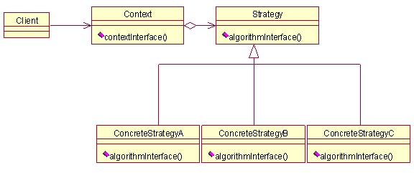
Strategy
Intent
Define a family of algorithms, encapsulate each one, and make them interchangeable. Strategy lets the algorithm vary independently from clients that use it.

Slide 19
Chain of Responsibility
Intent
Avoid coupling the sender of a request to its receiver by giving more than one object a chance to handle the request. Chain the receiving objects and pass the request along the chain until an object handles it.
Management Level | Order Cost
Legation Manager | 25000
Area manager | 100000
Deputy | 200000
chief | 400000

Slide 20
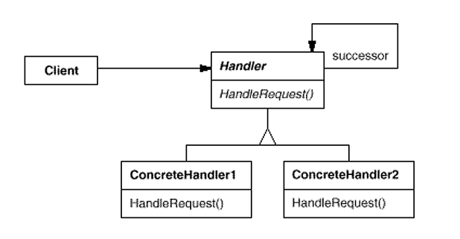
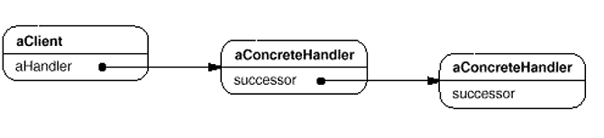
Chain of Responsibility(cont’d)
Reduced coupling
Added flexibility in assigning responsibilities to objects
Receipt isn't guaranteed

Slide 21
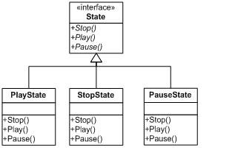
state
Intent
Allow an object to alter its behavior when its internal state changes. The object will appear to change its class.

Slide 22
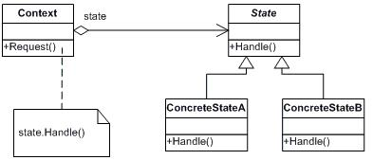
State(cont’d)
It localizes state-specific behavior and partitions behavior for different states
It makes state transitions explicit
State objects can be shared

Slide 23
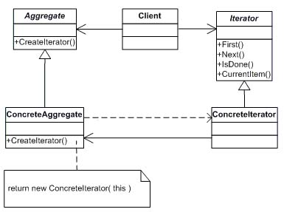
Iterator
Intent
Provide a way to access the elements of an aggregate object sequentially without exposing its underlying representation.

Slide 24
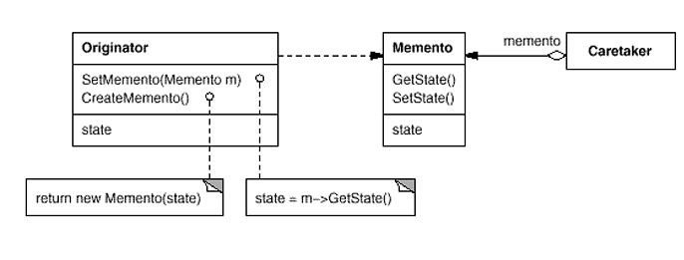
Memento
Intent
Without violating encapsulation, capture and externalize an object's internal state so that the object can be restored to this state later.

Slide 25
Refrence
[1 Erich Gamma, Richard Helm, Ralph Johnson, John Vlissides "Design Patterns Elements of Reusable Object-Oriented Software Addison-Wesley Pub Co"; 1st edition (January 15, 1995)
[2] Head First Design Patterns, Freeman and Freeman, O'Reilly, 2004

Slide 26

Thanks for your Attention
Questions??

