Slide 1
CORBA Component Model
(CCM)
Seminar of Component Base Software Engineering course
By: Elham Hormozi
University of Science & Technology Mazandaran Babol
e-mail: software_el@yahoo.com

Slide 2
CORBA
Common Object Request Broker Architecture
Since 1989, the Object Management Group (OMG) has
been standardizing an open middleware specification to
support distributed applications.
A powerful language-independent and platform-
independent technology
Supports multiple implementation languages
  For Example: Java & C++

Slide 3
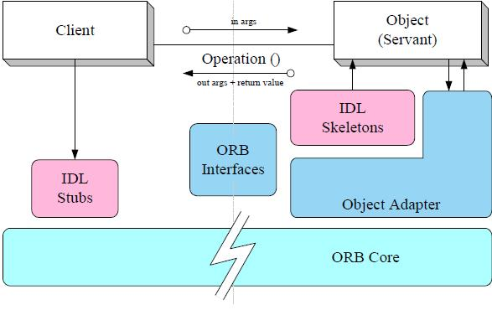
CORBA Object Model
ORBs (Object Request Broker)
– A distributed software bus for
communication among
middleware services and applications
– To manage communication
– Mediate messages between objects
IDL (Interface Definition Language)
– IDL is the standard notation for
defining software interfaces.
– Component implementations support
Stubs (Client Side) and Skeletons (Server Sides)
– To implement the inter-process communication
– Encode and decode the messages through the ORB

Slide 4
Limitations of CORBA
No standard way to deploy object implementations.
Limited extension of object functionality.
Availability of CORBA Object Services is not defined in
advance.
No standard object life cycle management.

Slide 5
Middleware
Infrastructure layer located between applications and OS
  Support services for interaction of components
  Compose reusable services
  Specify a reusable/ standard infrastructure needed to configure
  & deploy components throughout a distributed system
Support standard interfaces and protocols

Slide 6
CORBA Component Model (CCM)
To address the limitations with the earlier CORBA object model, the OMG
adopted the CCM to extend the CORBA Object Model
Extends the CORBA object model by defining services
Such as Transaction, Security, Persistent state, and Event Notification services
CCM services enable application developers to implement, manage,
configure, and deploy components in a standard environment
Supports multiple implementation languages:
  For Example: Java, Cobol, Ada, Small talk, Microsoft COM/DCOM

Slide 7
CORBA Component Model (CCM)(cont.)
CCM is an ideal component platform
  It is standardized
  It supports multiple interfaces
  It standardizes deployment and configuration of components
An architecture for defining components and their interactions
  From client-side to server-side components
Provides standard run-time environment for components
  Application Server
  Containers

Slide 8
CCM Component
A unit of composition with specified interfaces
Can be deployed independently and is subject to composition by
several parties.
CCM components are the basic building blocks in a CCM system
Could supports multiple interfaces
Each component instance is created and managed by a
unique component home

Slide 9
Mechanisms of PORTS
CCM components provide four types of mechanisms
called ports to interact with other CORBA programming
artifacts, such as clients or collaborating components
These port mechanisms specify required interfaces that a
component exposes to clients

Slide 10
PORTS
Attributes = Configurable properties
Facets = Offered operation interfaces
Receptacles = Required operation interfaces
Event Sinks = Consumed events
Event Sources = Produced events

Slide 11
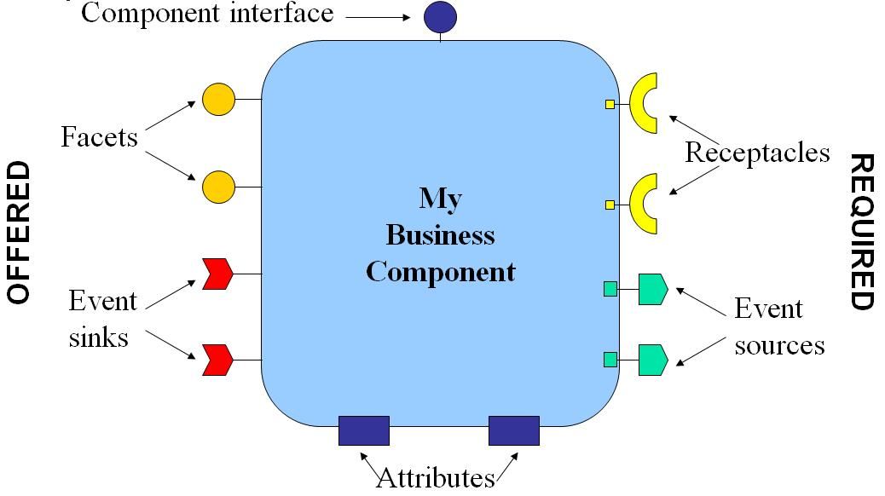
A CORBA Component
These new port mechanisms significantly enhance
component reusability when compared to the traditional
CORBA object model.

Slide 12
Types of CCM Components
Service Components:.
  It is created and destroyed by the particular CCM Client that it is
  associated with
  It's lifetime is restricted to that of one single operation request
  Service components do not survive a System shutdown
Session Components:
  Similar to Service Components but:
  There are two types of Session Components:
      Stateless Session Components
      Stateful Session Components
Process Components:
  May however be shared by multiple CCM Clients.
  Their states can be persisted and stored.
  Hence the can survive System Shutdowns.

Slide 13
The Container Model
Act the interface between a CORBA component and the outside as world
A CCM client never accesses a CORBA component directly
Provides simplified interfaces for CORBA Services
  - Security, Transactions, Persistence, and Events notification
A container encapsulates a component implementation and
provides a run-time environment for the component it manages

Slide 14
Portable Object Adaptor (POA)
Component implementations depend upon the standard CORBA
Portable Object Adapter (POA) to dispatch coming client requests
to their corresponding servants
The CCM component model implementation uses the
Component description to create and configure the POA hierarchy
automatically and to locate the common services defined by CCM
Container creates its own POA for all the interfaces it manages.

Slide 15
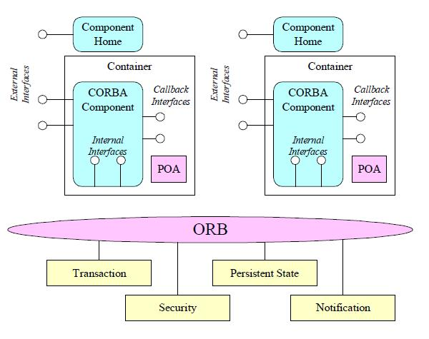
The CCM's Container Programming Model
Components are implemented as
DLLs
Containers are Standard interfaces for
packaging & deploying components
It defines a set of interface APIs that
simplify task of developing and/or
configuring CORBA applications.

Slide 16
Types of Containers :
Persistent Containers :
  Their states are saved between invocations.
Transient Containers :
  They are non- persistent components whose states are not
saved at all.

Slide 17
Managing of Lifetime
CCM containers also manage the lifetime of component
servants.
A CCM provider defines a ServantLocator that is responsible
for supporting these policies.
When a ServantLocator is installed, a POA delegates the
responsibility of activating and deactivating` servants to it.

Slide 18
Development Support Mechanisms for CCM
Components can be deployed in component servers that have no advance
knowledge of how to configure and instantiate these deployed
components.
Components need generic interfaces to assist component servers that
install and manage them.
CCM components can interact with external entities, such as services
provided by an ORB, other components, or clients via ports.

Slide 19
Packaging & Deploying Components
In large-scale distributed systems, the packaging and deploying of
components can become complicated.
To simplify the effort of developing components, CCM defines
standard techniques.
CCM describes components, and their dependencies using Open
Software Description (OSD), which is an XML Document Type
Definition (DTD) defined by the WWW Consortium.
Components are packaged in assembly files and package descriptors
are XML documents conforming to the OSD DTD that describe the
contents of an assembly file and their dependencies.

Slide 20
A Day in the Life of a Component
A component is specified
A component is implemented
A component must be packaged
A component may be assembled with other components
Components and assemblies are be deployed

Slide 21
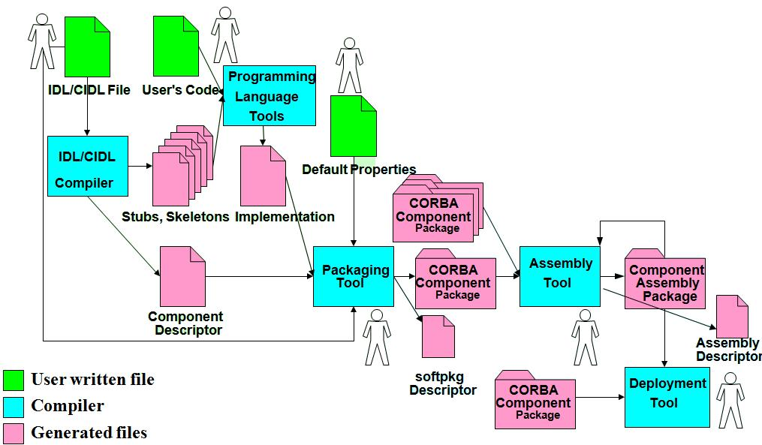
The CCM Big Picture
designers
implementer
packager
deployer

Slide 22
CCM Compared to EJB, COM, & .NET
Like Sun Microsystems’ Enterprise Java Beans (EJB)
  CORBA components created & managed by homes
  Run in containers that manage system services transparently
  Hosted by generic application component servers
  But can be written in more languages than Java
Like Microsoft’s Component Object Model (COM)
  Have several input & output interfaces per component
  Component
  But has more effective support for distribution & QoS properties
Like Microsoft’s .NET Framework
  Could be written in different programming languages
  Could be packaged to be distributed
  But runs on more platforms than just Microsoft Windows

Slide 23
Conclusion
  CCM can be extended to support other non-functional
  properties, such as QoS properties
  The CCM specification is large and complex. Therefore, ORB
  providers have only started implementing the specification
  recently.
  The CCM programming model is thus suitable for proven
  technologies and existing services to develop the next-generation
  of highly scalable distributed applications.

Slide 24
References
[1] Wang, Schmidt, O’Ryan ‘CORBA Component Model’ www.cs.wustl.edu/~schmidt/cbse
[2] Object Management Group, Inc., CORBA Success Stories, 2000.
URL: http://www.corba.org/success.htm
[3] N. Wang et. al., Applying Reflective Middleware Techniques to Optimize a QoS- enabled CORBA Component Model Implementation, 24th Computer Software and Applications Conference, Taipei, Taiwan, 2000a.
[4] Jeff Mischkinsky, "CORBA 3.0 New Components chapters,“ OMG TC Document
ptc/99-10-04, October
[5] Gopalan Suresh Raj "Enterprise Java Computing-Applications and Architecture"
(Cambridge University Press, June '99) and "The Awesome Power
of JavaBeans" (Manning, July'98), (http://www.execpc.com/~gopalan)

Slide 25
CORBA Component Model
(CCM)
GOOD LUCK
07.01.2010

