Slide 1
Introduction to Component-Based Approaches for Embedded Systems
Class Seminar
Mehdi Cheshomi
University of Science and Technology Mazandaran, Babol,
mcheshomi@ustmb.ac.ir
24 Dec 2009

Slide 2
Outline
Motivation
  Embedded system’s characteristics
  Why component-based embedded systems?
Problems and Challenges
  Traditional methodologies and models’ weakness on embedded systems

Slide 3
Outline(Cont.)
Embedded system’s computation models
  Extended data flow
Embedded system’s component models
  RT-CORBA
Summary

Slide 4
Embedded System’s Characteristics
Tight integration between hardware and software
  Difficult to model and implement software separately from hardware
  Monolithic
Timing requirements
  Latency(Response time)
    Soft real-time: QoS
    Hard real-time: Correctness
  Deadline

Slide 5
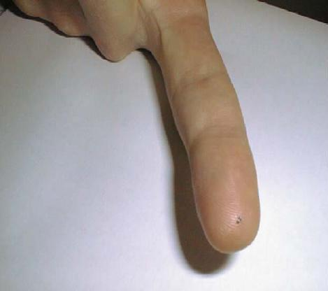
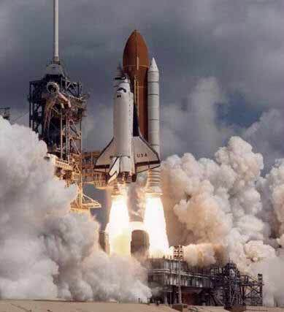

Embedded System’s Characteristics(Cont.)
Vast variety
  Heterogeneity
  Non-standard interface
Figure 1. small and large embedded system

Slide 6
Embedded System’s Characteristics(Cont.)
Concurrency
  Description languages(VHDL, Esterel,…)
Reactivation with physical world
  Simultaneous events
Long life
Limitations
  CPU, memory, power consumption, physical space

Slide 7
Embedded Software and Software Engineering
Physicality of embedded software
  Principal of embedded system
    Interaction with world
    Not data transformation
Embedded software is written by
  The engineers
    Expert in application domain
    With a good understanding of the target architectures and the physical world
  Not computer scientists

Slide 8
Embedded Software and Software Engineering(Cont.)
Abstraction view
  Alan Turing machine
  Weak tendency to embedded software
    Lack of rich development tools
    Assembly code instead of OOM, polymorphic types, and …

Slide 9
Why Component-Based Embedded Systems?
Vast requirement for using embedded systems.(cars, airplanes, robots,…)
  Most computer systems are embedded systems
Increasing complexity
  More features(network, auto update, …)
  More efficient and high level design
Need standards for embedded software

Slide 10
Why Component-Based Embedded Systems?(Cont.)
Design and development tools
Verification
Maintenance
Reusability

Slide 11
Traditional Methodologies and Embedded Systems
Extra-functional parameters cannot be fully met(QoS, timing, resource consumption)
Software sequentiality vs real world concurrency
Access control

Slide 12
Traditional Methodologies and Embedded Systems(Cont.)
Special entites
  Infinite computation
  A process is a component?
    Mutexes and semaphores are part of component or framework?
    Combination of 2 components makes a component
    Combination of 2 process makes a process!?
    Interface complexity

Slide 13
Model of Computation
Model of Computation
Set rules that define how interaction between components can occur
  Data Flow
  Discrete Events
  Synchronous/Reactive
  Process Network

Slide 14
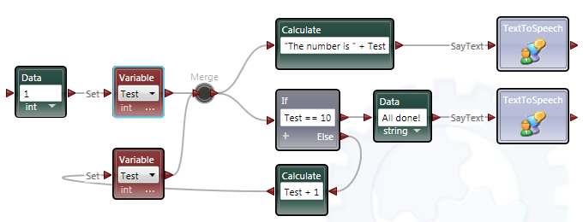
Extended Data Flow
Data flow
  Node: actor
  Arc: represents flow of data
  Like : Labview, Microsoft robotics developer studio
  Used in DSP(Digital Signal Processing)
Figure 2. DataFlow sample. [Microsoft]

Slide 15
Extended Data Flow
  Powerful in parallel computation
    Concurrency
  Lack of synchronism
Extended data flow
  Solves synchronism problem
    Buffer

Slide 16
Component Model
The component model
  Defines standards for implementation, documentation and employment of components
  Illustrates interface definition
  ProCom
  PECOS
  Rubus
  RT-CCM

Slide 17
Real-Time CORBA
CORBA
  Common Object Request Broker Architecture
  Uses ORB as proxy between Client and Server
  ORB can create priority connection for real-time request

Slide 18
Summary
Embedded systems have special characteristics
Need for component-based embedded systems
Existing component model must be changed for embedded systems requirement
A complete component model for embedded systems doesn’t exist yet

Slide 19
Bibliography
[Wiklander09] J.Wiklander, J. Eliasson, A. Kruglyak, P. Lindgren, J. Nordlander., 2009. ” Enabling Component-Based Design for Embedded Real-Time Software”. Journal of Computers, Vol 4, No 12 (Dec), pp.1309-1321.
[Paseti99] A.Pasetti and W.Pree., 1999, “The Component Software Challenge for Real-Time Systems”, Proceedings of the 1st International Workshop on Real-Time Mission-Critical Systems, 30 Nov -1 Dec, Scottsdale, AZ, USA.
[Lee02] E.A.Lee,, 2002, “Embedded Software”, Advances in Computers (M. Zelkowitz, editor), vol. 56, Academic Press, London.
[Polato06] I.Polato, A.M.Silva Filho., 2006, ”A Component-based Approach to Embedded Software Design”. Electronic Notes in Theoretical Computer Science,pp.255-273
[Crnkovic04] I.Crnkovic.,2004. “Component-based approach for embedded systems”, in Proceedings of the Ninth International Workshop on Component-Oriented Programming, June 15, 2004 at ECOOP 2004, Oslo, Norway, June 14–18.
[Polato05] I.Polato, A.M. Silva Filho., 2005, “Adaptive software synthesis from extended dataflow specifications”, Acta Sci., Technol. 27, No. 2, 143-154.
[Möller03] A.Möller, M.Åkerholm, J.Fredriksson, M.Nolin.,2003, “Software Component Technologies for Real-Time Systems” - An Industrial Perspective, WiP Session of Real-Time Systems Symposium (RTSS), Cancun, Mexico, December.
[Microsoft] Microsoft. Microsoft Robotics .http://msdn.microsoft.com/en-us/library/ bb483088.aspx, [Last access 23 dec 2009]

Slide 20
Introduction to Component-Based Approaches for Embedded Systems
Questions
?

