Slide 1
Software Engineering Techniques for the Development of
System of Systems
Seminar of
“Component Base Software Engineering”
course
By : Marzieh Khalouzadeh
University of Science and Technology
Mazandaran .Babol
31 Dec 2009

Slide 2
Outline
What is a System of Systems?
System of Systems characteristics
categorizes System of Systems
Software Engineering Techniques for System of Systems Development
A Framework for System of Systems Development

Slide 3
What is a System of Systems?
SoS (System of Systems) is a collection of task oriented or dedicated systems.
pool their resources and capabilities together to obtain a new, more complex meta-system.
offer more functionality and performance than simply the sum of the constituent systems.
SoSE (System of System Engineering ) is the methodology for defining, modeling, and analyzing System of Systems problems

Slide 4
SoS components
SoS components pursue their own, local objectives independently and in addition contributing to the global SoS objective
SoS components are often developed, procured and managed independently
SoS components could join and leave dynamically

Slide 5
SoS characteristics
Operational Independence
  The constituent systems are independently useful
  each constituent system meets a potentially different mix of user expectations and demands
  SoS are created to meet user demands that cannot be met by constituent systems acting alone

Slide 6
SoS characteristics (cont.)
Managerial Independence
  A System of Systems’ constituent systems are separately acquired and integrated
  constituent system maintains is independent of the SoS
  Component features and capabilities are typically modified on schedule

Slide 7
SoS characteristics (cont.)
Evolutionary Development
  The System of Systems does not appear fully formed
  Its development and existence is evolutionary with functions and purposes added, removed, and modified with experience

Slide 8
SoS characteristics (cont.)
Emergent Behavior
  SoS quality attributes emerge from constituent system interactions
  The system performs functions and carries out purposes that do not reside in any component system
Geographic Distribution

Slide 9
categorizes systems of systems
Directed
  built and managed to fulfill specific purposes
  Centrally managed to maintain and evolve
  Constituents independent but subordinated to centrally managed purpose

Slide 10
categorizes systems of systems (cont.)
Acknowledged
  Recognized objectives, designated manager and resources
  Constituents maintain independent ownership, objectives, funding, etc
  Changes based on collaboration between the SoS and the constituent

Slide 11
categorizes systems of systems (cont.)
Collaborative
  Constituents interact more or less voluntarily to fulfill agreed central purposes
Virtual
  Lack central management authority and centrally agreed purpose
  Rely on relatively invisible mechanisms to maintain it

Slide 12
SoS challenges
Interoperability
global-objective
longevity
dependability
security
flexibility
predictability
adaptability

Slide 13
Software Engineering Techniques for SoS Development
Service-Oriented Architectures (SOA)
  SoS development involves the integration and secure interoperation of vastly diverse technical systems.
  Thanks to their platform independence, loose coupling and support for security, SOA solutions represent strong candidates.

Slide 14
Software Engineering Techniques for SoS Development (cont.)
Policy-Based Autonomic Computing
  convey the global objectives of systems of systems as high-level policies
  development of systems that can manage themselves based on a set of high-level policies

Slide 15
Software Engineering Techniques for SoS Development (cont.)
Formal verification
It could be for verification of SoS policies
dependability management and assurance.
Model-driven development and Code generation
SoS components join and leave dynamically
collaborate with systems whose characteristics are often unknown until runtime

Slide 16
Software Engineering Techniques for SoS Development (cont.)
Component-Based Development
  integration of existing and future commercial, open-source and proprietary systems
Dynamic Reconfiguration
  adapt continually to changes in their environment, structure and objectives .

Slide 17
Software Engineering Techniques for SoS Development (cont.)
Online Machine learning
impossible to anticipate circumstances
Can not pre-programmed into a computer system
Resource Discovery
  actively seek partner systems and establish collaborations with them
  joining (and leaving) loosely coupled federations of systems on a regular basis.

Slide 18
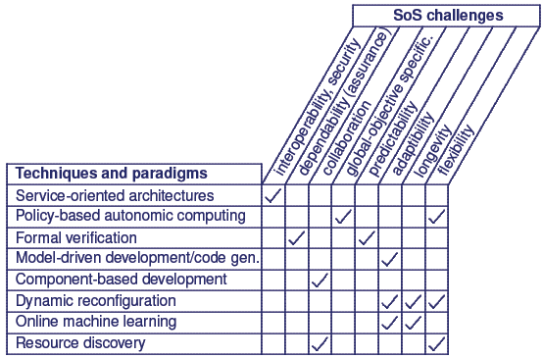
Software engineering techniques that can help address SoS challenges
Software Engineering Techniques for SoS Development (cont.)

Slide 19
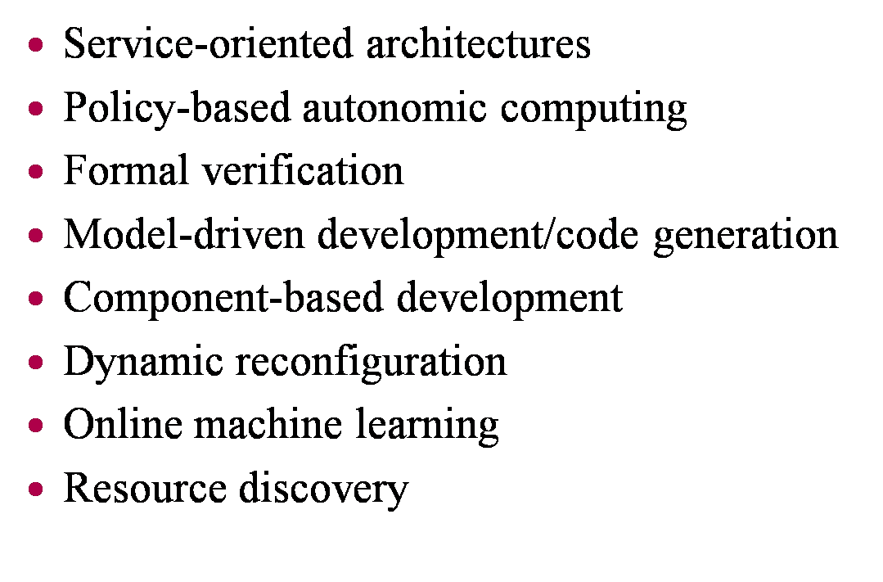
Reconfigurable policy engin
Reconfigurable policy engine

Slide 20
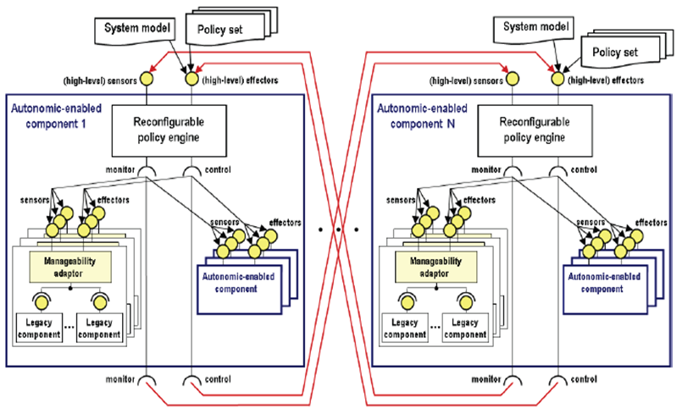
Component definition policy
Software Engineering Techniques for the Development of Systems of system
20 / 23

Slide 21
Conclusion
SoS characteristics
  Managerial independence
  Operational independence
  Emergent behavior
  Evolutionary development
  Geographic Distribution
The challenges associated with the development of System of Systems are tremendous
existing software engineering paradigms and techniques can help but unable to address the whole spectrum of challenges associated with the development of SoS.

Slide 22
Reference
[1] R.Calinescu and M.Kwiatkowska, “Software Engineering Techniques for the Development of Systems of Systems”, in the proceeding of the Monterey Workshop on the Foundations of Computer Software, Future Trends and Techniques for Development pages 86-93. September 2008
[2] j.Goodenough,” System of Systems Software Assurance”, research project for Department of Defense,2008
[3] R.Calinescu , “Implementation of a generic autonomic framework” Proceeding of the 4th International Conference on Autonomic and Autonomous Systems (ICAS’08), pages 123–129. IEEE Computer Society Press, March 2008.

Slide 23
Software Engineering Techniques for the Development of
Systems of System
The End

