Slide 1
Web Service
& Its Component-Based
Architecture Approach
Class Seminar of
“Component-Based Software Engineering”
Course
By : F. Zahmatkesh
University of Science and Technology of Mazandaran, Babol
F_zahmatkesh@ustmb.ac.ir
Jan 7,2010

Slide 2
“As long as there were no machines, programming was no problem at all; when we had a few weak computers, programming became a mild problem, and now that we have gigantic computers, programming has become a gigantic problem.” [DIJ,72]

Slide 3
Outline
  Web Service
    What is Web Service?
    Web Service Protocol Stack.
    Protocols’ Roles.
    WSDL, SOAP & UDDI Relationships.
    Web Service Definition.
    Web Service vs. Component
  Web Service Architecture Approach
    Proxy Component
      Proxy isn’t sufficient
    Broker Component
  Conclusion
  Open Issues

Slide 4
What is Web Service(WS)?
Before going to the exact definition, Let’s take a look at
  Web Service Framework.
  How Does Web Service Work?
  Web Services Platform Elements.

Slide 5
WS Framework
Service
Registry
Publish
Find
Service Provider
Service Consumer
communicate
Figure 1 : Framework of WS [4]
Notes:
Service Provider – definition of business functionality, it would like to provide
Service Registry: Ability to add/remove/alter WS description data and more importantly allow querying to find a particular type of web service.
Service consumer: based on WSDL communication with web services via SOAP messages

Slide 6
How Does WS Work?
The basic WS platform is XML + HTTP.
  XML
    Tags the data.
    Provides a language which can be used between different platforms and programming languages.
    Can express complex messages and functions.
  HTTP
    The most used Internet protocol.

Slide 7
WS Platform Elements
SOAP ,stands for
  Simple Object Access Protocol
WSDL ,stands for
  Web Services Description Language
UDDI ,stands for
  Universal Description, Discovery and Integration

Slide 8
WS Protocol Stack
UDDI:
    WS Discovery, Search, Publication and listing what services are available.
WSDL:
    Description of available Services, in fact Interface Description.
SOAP:
    XML Messaging , Encoding messages in XML format and transfer it.
HTTP:
    Transporting XML messages between client and server in Network. Also SMTP,FTP.
UDDI
WSDL
SOAP
HTTP
Figure 2 : WS Stak[4]

Slide 9
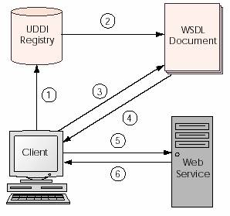
Protocols’ Roles
Client queries Registry to locate Service.
Registry refers client to WSDL Document.
Client accesses WSDL Document.
WSDL provides data to interact with WS.
Client sends SOAP-Message Request.
WS returns SOAP-Message Response.
Figure 3 : Role of Protocols[4]

Slide 10
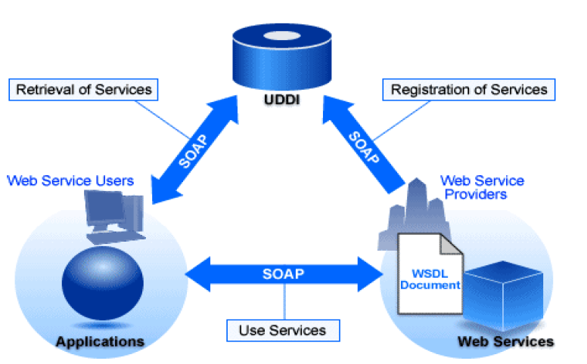
WSDL,SOAP & UDDI Relationships
Figure 4 : WSDL,SOAP & UDDI relationships [4]

Slide 11
WS Definition
The natural evolution of computing technologies has brought us object-oriented programming, component-based programming, middleware and also
  An Integration Technology called Web Service.
WS is logical evolution of software components.
Term Web Services describes
  A standardized way of integrating Web-based applications using
      XML, SOAP, WSDL and UDDI open standards over an Internet protocol backbone.

Slide 12
WS Definition(cont’d)
The W3C definition:
  “A software system designed to support interoperable machine-to-machine interaction over a network. ”
Is just Internet Application Programming Interface (API) that can be accessed over a network, and execute on a remote system hosting the requested services.
  WS isn’t tied to any OS or Programming Language.
    For example, Java can talk with Perl, Windows and Unix applications.

Slide 13
WS Definition(cont’d)
Primarily as a means for
  Businesses to communicate with each other and with clients.
Allows organizations to
  Communicate data w/o intimate knowledge of each other's IT systems behind the firewall.

Slide 14
WS vs. component- Similarities
Web Service | component | Similarities
 | (also tangible) | A unit of functionality
(via WSDL) | (via interface) | A self-describing unit
 | (packaged) | A self-contained unit
 |  | Use of Ports to connect each other
(based on UDDI) |  | Registered at a repository to enable discoverability
(message-based, via SOAP) | (Event-based via method call) | Communications among themselves
Table 1 : WS & component Similarities[1]

Slide 15
WS vs. component- Differences
Web Service | component | differences
 |  | Dependency on vendor-specific protocols
 |  | Interoperate of applications from different vendors
(reside & run at provider’s host) |  | Need to download
(only synchronous) |  | synchronous & asynchronous interaction patterns
Table 2 : WS & component Differences [1]

Slide 16
  WS Architecture Approach
How do the Web service infrastructures map to Architecture?
  Again Components give a hand.

Slide 17
Proxy Component
Location-transparency.
Hiding of communication low-level details from the programmer.
  Data encoding.
  Communication protocol used.
Solution => the application of Proxy design pattern.
The basic idea => to introduce a proxy component as an intermediate layer between the client and the servant.

Slide 18
Proxy Component(cont’d)
The proxy component resides within the address space of the client and implements exactly the same interface(s) as the servant.
Client can remain oblivious to any details related to distribution-the servant location or communication protocols used.
At runtime, the proxy acts as an interceptor.

Slide 19
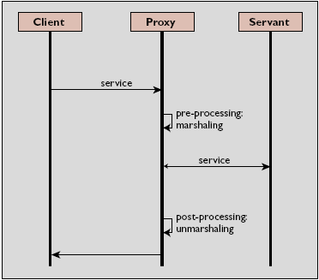
Proxy Component(cont’d)
Figure 5 : Proxy[2]

Slide 20
Proxy Component(cont’d)
Another proxy needs to be introduced on the servant side.
  The servant proxy is introduced to free the servant from knowledge such as the client location and the details of the communication protocol.
This property is often denoted as distribution transparency.

Slide 21
Proxy isn’t sufficient
Remote method invocations!
  In proxy solution, location information is separated from clients and servants by the proxy layer.
  Within the proxies, location information must be hard-coded, thus restricting location and migration transparency.
Issue of servant activation and deactivation.
  Servant implementations would be activated at sys startup and deactivated at sys shutdown.
    Idle servants between creation and removal time.
      Lead to high resource usage and low scalability.

Slide 22
Broker Component
The broker component denotes a globally available participant that maps logical servant references to physical server locations.
Broker is in charge of handling activation and deactivation issues.

Slide 23
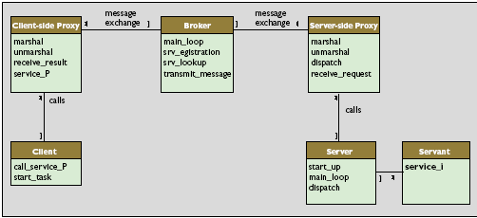
Broker Component(cont’d)
Figure 7 : Broker [2]

Slide 24
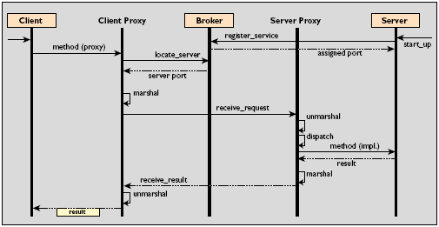
Broker Component(cont’d)
Figure 6 : Broker[2]

Slide 25
Broker Component(cont’d)
With multiple servants, the server must provide dispatch functionality to dynamically map and forward method requests to the correct servants.
Servers obtain a free port from the broker that they use to listen for incoming requests. Or they might themselves determine their communication ports.
After a communication channel is established, the message flow between client and server proxies is transmitted through this dedicated channel.

Slide 26
Conclusion
WSes are a promising technology that will increasingly help to integrate heterogeneous islands to homogeneous component-based solutions.
This evolutionary technology is solely based on the architectural concepts of OO middleware as well as on widespread and commonly accepted standards such as XML and Internet protocols.
This is why key players such as Sun Microsystems, Microsoft, IBM, BEA, and Hewlett-Packard consider Web services the major technological trend of tomorrow’s networked computing.

Slide 27
Open issues
However, developers should keep in mind that WSes are still a fast moving target and an immature technology.
  SOAP is not fully implemented.
  WSDL is open to interpretation.
  Web services lack OO concepts such as inheritance, polymorphism.
  Exchange of context information, such as user credentials, QoS properties, user preferences, or transaction information is not standardized.
  And so on.

Slide 28
References
  [1] D. Karastoyanova , A. Buchmann ,” COMPONENTS, MIDDLEWARE AND WEB SERVICES ”, In IADIS International Conference WWW/Internet 2003, Volume II, IADIS
  [2] M. Stal, “ Web Services :BEYOND COMPONENT-BASED COMPUTING ”, COMMUNICATIONS OF THE ACM October 2002/Vol. 45, No. 10
  [3] http://W3C.org , Last accessed Jan 5,2010

Slide 29
Thanks for paying attention.

