Slide 1
Tracing and a Javascript VM
Increasing the Performance of Web 3.0
Mohammad Soryani
Mazandaran University of Science and Technology
Soryani@ustmb.ac.ir

Slide 2
Outline
Introduction
Tamarin-Tracing
HLL to x86
Trace compilation
Side exits
Organizing Traces
Type specialization via traces
Results of evaluation

Slide 3
Introduction
Client side programming is increasing
Browsers are the best choice
Javascript is powerful and supported in
all browsers
- Unfortunately has a low performance

Slide 4
Tamarin-Tracing
An experimental java script virtual machine
A Trace baced just in time compiler(JIT)
Cooperation of Mozilla and Adobe

Slide 5
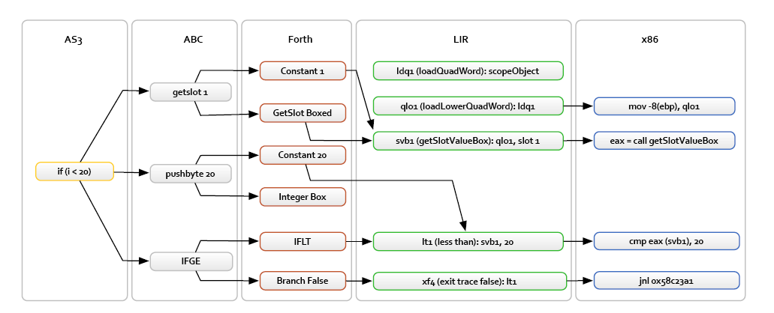
HLL To X86

Slide 6
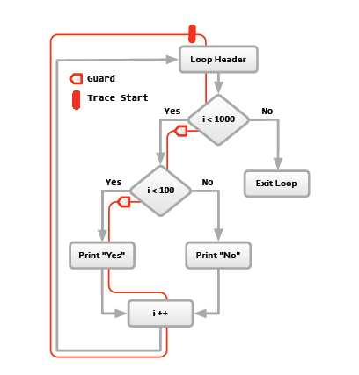
Trace Compilation

Slide 7
Side Exits

Slide 8
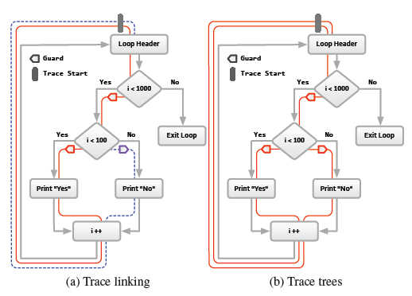
Organizing Traces

Slide 9
Type Specialization
dynamically typed languages are poor
candidates for just-in-time compilation
Javascript is dynamically typed
The type of some objects don’t change during
program execution
We try to compile javascript as a statically
typed language by assuming this for some
parts of code

Slide 10
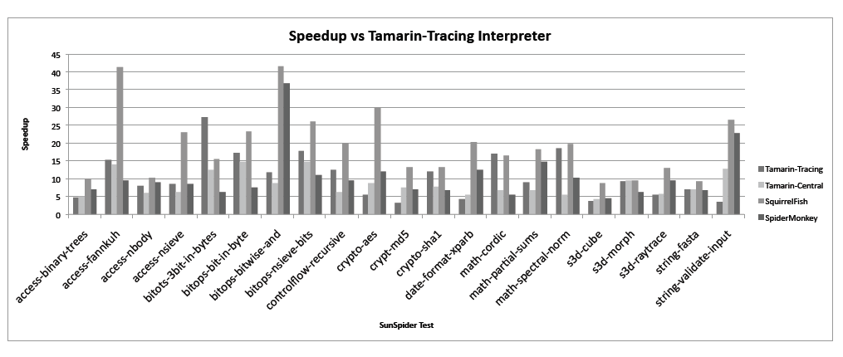
Results of Evaluation

Slide 11
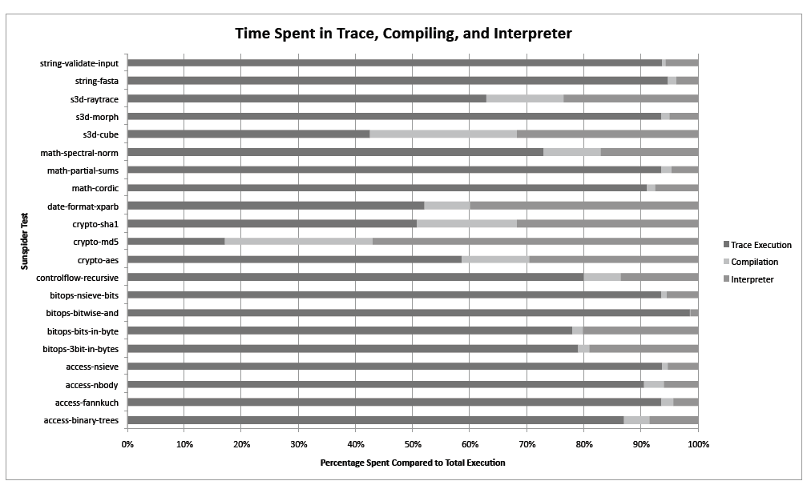
Results of Evaluation

Slide 12
Results of Evaluation

Slide 13
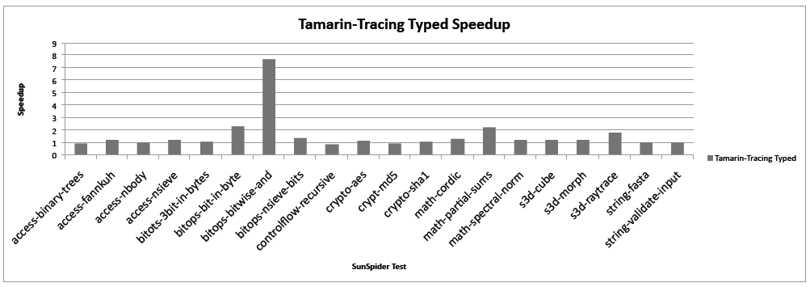
Results of Evaluation

Slide 14
References
[1] Mason Chang, Edwin Smith, Rick Reitmaier, Michael Bebenita,
Andreas Gal, Christian Wimmer, Brendan Eich, Michael Franz,
“Tracing for Web 3.0”, Proceedings of the 2009 ACM SIGPLAN/SIGOPS
international conference on Virtual execution environments ,
Washington, DC, USA, March 11-3, 2009.

