Slide 1
A Communication Virtual Machine
Seminar of “Virtual Machines” course
ALI MOGHADDAM
University of Science and Technology
Mazandaran, Babol
ali.moghaddamk@gmail.com
January 07, 2010

Slide 2
Preview
• Communication
• Stovepipe Approach
­ Problems
• A motivating example
• Communication Virtual Machine
­ Four major tasks for serve the users’
Communication needs
­ CVM Architecture

Slide 3
Preview(cont)
• Communication Modeling Language
­ X-CML
­ G-CML
• A Prototypical Design of CVM
• Prototype Implementation
• Conclusion

Slide 4
Communication
• Basic function of business, government and
society.
• From general-purpose applications to
specialized applications

Slide 5
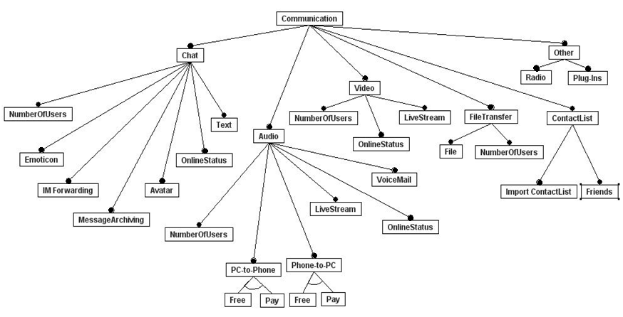
Feature Diagram^{[1]}

Slide 6
Stovepipe Approach
• What is Stovepipe?
• Problems
­ Limited separation between application needs
and logic, device types and underlying networks
­ Differences in design, architecture, API, and network/
device assumption
­ Integration

Slide 7
A motivating example
State1
state2
general practitioner
specialist
Eric
Mary
Eric
Mary
John
John
researcher

Slide 8
Feature Table^{[1]}
*Audio conferencing in Skype depends on Hardware

Slide 9
Communication Virtual Machine
• CVM design
• Model-Driven Engineering
• CVM goals
• Communication Schema
• Several major components that form the CVM
system:
­ CVM architecture
­ Communication modeling language
­ Synthesis engine
­ Communication engine
­ Network communication broker

Slide 10
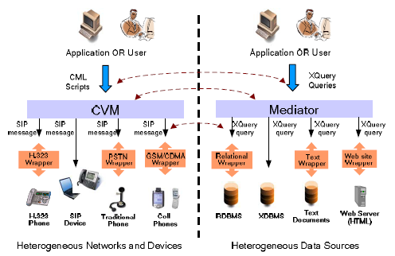
Communication Virtual Machine(cont)
• CVM role

Slide 11
Communication Virtual Machine(cont)
• Architectural principle of separation of concerns
• Four major tasks for serve the user’s
communication needs:
­ Conceive and describe the user’s
communication requirements
­ Transfer the user communication requirements
into a sequence of commands or actions
­ Provide a platform or environment in which the
said sequence of commands can be executed
­ Deliver the media or data among the communication
parties through a communication network or networks

Slide 12
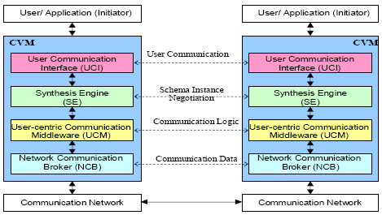
Communication Virtual Machine(cont)
• CVM layered architecture:
­ User Communication Interface(UCI)
­ Synthesis engine(SE)
­ User-Centric Communication Middleware(UCM)
­ Network Communication Broker(NCB)

Slide 13
Communication Modeling Language
• For modeling user communication requirements
• Two equivalent variants of CML:
­ XML-based (X-CML)
­ Graphical (G-CML)
• CML operates on an abstraction of the
underlying network and devices

Slide 14
Communication Modeling Language(cont)
a) G-CML
b) X-CML

Slide 15
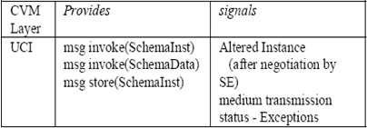
A Prototypical Design of CVM
• Follows the CVM architecture
• UCI Component:
­ communication modeling environment
­ schema transformation environment
­ repository
­ UCI-to-synthesis engine interface

Slide 16
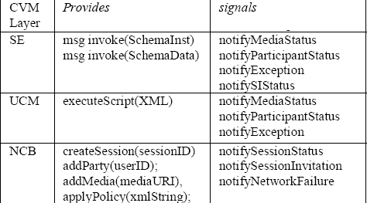
A Prototypical Design of CVM(cont)
• SE Component
­ user schema to communication
control script
• UCM Component
­ manages user
communication sessions
• NCB Component
­ high-level communication tasks can be specified

Slide 17
Prototype Implementation
• Has been implemented using the following
technology:
­ HTML
­ JavaScript
­ XHTML + Voice
­ AJAX
­ Java
- JAIN SIP
- JMF
- SER

Slide 18
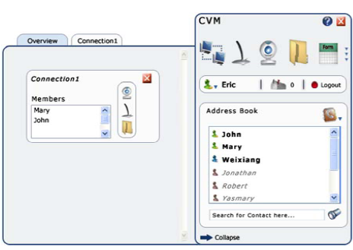
Prototype Implementation(cont)
a) Overview of active communications.
b) Details of a particular active connection.

Slide 19
Prototype Implementation(cont)
c) Integration of CVM with the iRounds system.

Slide 20
Conclusion
• Security and performance are not addressed in
this paper
• CVM represents a new paradigm for structuring
and delivering communication solutions and
services
• CVM can serve as a communication service
framework

Slide 21
Reference
[1] Communication Virtual Machine Feature Analysis & Policy Definitions, Paola
Boetner, Mansi gupta
[2] Yi Deng, et al, “A Communication Virtual
Machine”, in the proceeding of the 30th Annual
International Computer Software and Applications
Conference (COMPSAC), Chicago, September
7–21, 2006

Slide 22
A Communication Virtual Machine
QUESTIONS?

