Slide 1
Debugging operating systems with time-traveling virtual machines
Seminar of “Virtual Machines” Course
Mohammad Mahdizadeh
SM. Mahdizadeh@USTMB.ac.ir
University of Science and Technology Mazandaran-Babol
January 2010

Slide 2
Cyclic debugging
Iterate, revisit previous states
  Inspect state of the system at each point
Notes:
Put something on the slide at first. Add animation back in, only first rerun

Slide 3
Problems with cyclic debugging
OS’s execution are non-deterministic because of nondeterministic events
  Interleaving of multiple threads, interrupts, user input, network input.
  When we re-run program, bug may disappear!
OS run for long periods of time.
operating system may corrupt the state of the debugger.
  Remote kernel debuggers depend on some basic functionality in the debugged OS
    Such as reading and writing memory locations, setting and handling
breakpoints (e.g., through the serial line).
Notes:
Mention something about useful for OS’s

Slide 4
Example: NULL pointer
ptr == NULL?
Walk call stack
  Variable not modified

Slide 5
Example: NULL pointer
ptr == NULL?
ptr == NULL?
ptr == NULL?
Set a conditional watchpoint
  ptr might change often

Slide 6
Debugging with time traveling virtual machines
Provide what cyclic debugging trying to approx.
ptr = NULL!

Slide 7
Overview
Virtual machine platform
Efficient checkpoints and time travel
ReVirt: virtual machine replay system
Using time travel for debugging
Conclude

Slide 8
Debugging with time traveling virtual machines (TTVM)
We integrate time travel into a general-purpose debugger (gdb) and our virtual machine.
  Commands implemented in gdb:
    Reverse step, reverse breakpoint, reverse watchpoint (go back to the last time a variable was modified).
VM used is “User-Mode Linux”(UML)
  And we also modified UML to use real driver in Host OS.
    Actually there’re lots of bugs in device driver.
    Now we can not only debug guest kernel, and also debug device driver.

Slide 9
Time-Traveling virtual machine
TTVM re-execute deterministically by two facilities :
  Log and replay.
  In addition, checkpoint is implemented for quickly forward and backward.

Slide 10
Time-Traveling virtual machine
Log and replay (previous work)
  TTVM can be replayed deterministically by
    Start from a checkpoint.
    Replay all sources of non-determinism, for ex :
      External input from network
      Real-time clock
      The timing of interrupt
How to log a interrupt
  Data return from interrupt must be logged.
  Interval (number of instructions) between interrupt must be logged.
    Architecture support by performance counter on Pentium 4.
    Performance counter accumulate the number of executed instruction.

Slide 11
Typical OS level debugging
Requires two computers
OS state and debugger state are in same protection domain
  crashing OS may hang the debugger
kernel
debugger
application
application
operating system
operating system
debugging stub
host machine
host machine

Slide 12
Using virtual-machines for debugging
application
application
operating system
kernel
debugger
debugging stub
virtual machine monitor
[UML: includes host operating system]
host machine
Guest OS, operating system running inside virtual machine
Debugger functions without any help from target OS
Works even when guest kernel corrupted

Slide 13
Checkpoints
Save complete copy of virtual-machine state: simple but inefficient
  CPU registers
  virtual machine’s physical memory image
  virtual machine’s disk image
Instead, use copy-on-write and undo/redo logging
  Technique applied both to memory and disk
Notes:
Add bullet about disk to give heads up

Slide 14
ReVirt
Based on previous work
Re-executes any part of the prior run, instruction by instruction
Re-creates all state at any prior point in the run
Logs all sources of non-determinism
  external input (keyboard, mouse, network card, clock)
  interrupt point
Low space and time overhead
  SPECweb, PostMark, kernel compilation
  logging adds 3-12% time overhead
  logging adds 2-85 KB/sec
Notes:
Cite so people do not think we are getting credit for this

Slide 15
How to time travel backward
checkpoint 1
redo
log
undo
log

Slide 16
Using time travel to implement reverse watchpoints
checkpoint
1
2
3
4
1
2
3
4
Example: reverse watchpoint
First pass: count watchpoints
Second pass: wait for the last watchpoint before current time
Notes:
Make sure to mention that the first pass == original run because of revirt

Slide 17
Performance
Overhead with log operation
  Time overhead:
    12% time overhead for SPECweb99
    11% time overhead for kernel build
    3% time overhead for PostMark
  Space overhead:
    85 KB/sec for SPECweb99
    7 KB/sec for kernel build
    2 KB/sec for PostMark

Slide 18
Performance
Speed of “replay”
  For the three workloads, 1- 3% longer to replay than it did to log.
  For workloads with idle periods, replay can be much faster than logging.

Slide 19
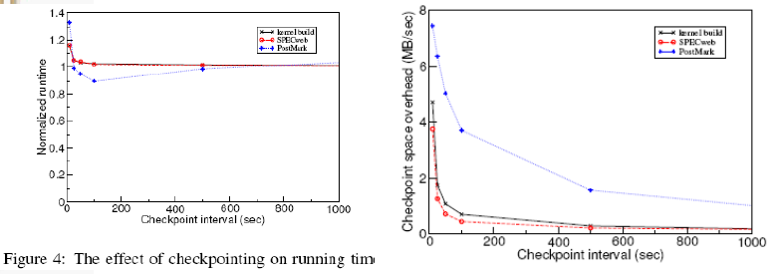
Performance

Slide 20
Experiences with TTVM
Corrupted debugging information
  TTVM still effective when stack was corrupted
Device driver bugs
  Handles long runs
  Non-determinism
Notes:
Have own slide for each point

Slide 21
Conclusions
Programmers want to debug in reverse
Current debugging techniques are poor substitutes for reverse debugging
Time traveling virtual machines efficient and effective mechanism for implementing reverse debugging

Slide 22
Reference
Debugging operating systems with time-traveling virtual machines
S. King, G. Dunlap, P. Chen
CoVirt Project, University of Michigan
USENIX Technical Conference, April 2005

