Slide 1
Network Virtualization
Morteza Yousefi
University of Science & Technology of Mazandaran
yousefi@ustmb.ac.ir

Slide 2
Outline
What is Virtualization
Network Virtualization
Network Virtualization Model
Business Model
Architecture
Design Principles
Design Goals
Related Concepts
Existing Projects
Future Works

Slide 3
What is Virtualization?
Transparent abstraction of computing platform and
resources
Multiple logical interpretations of the physical characteristics
Virtualized everything
Virtual machines: VMware, Xen
Storage virtualization: SAN
Data-center virtualization

Slide 4
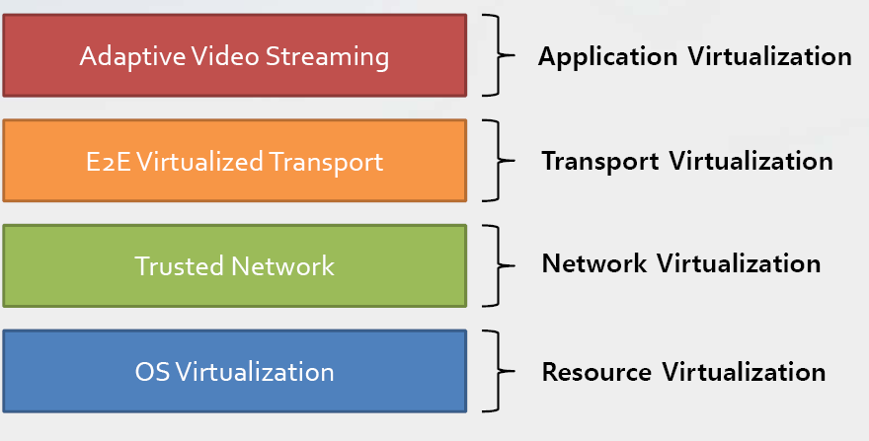
Virtualization Stack for Future Internet
Korea University, Operating Systems Lab. (http://os.korea.ac.kr)

Slide 5
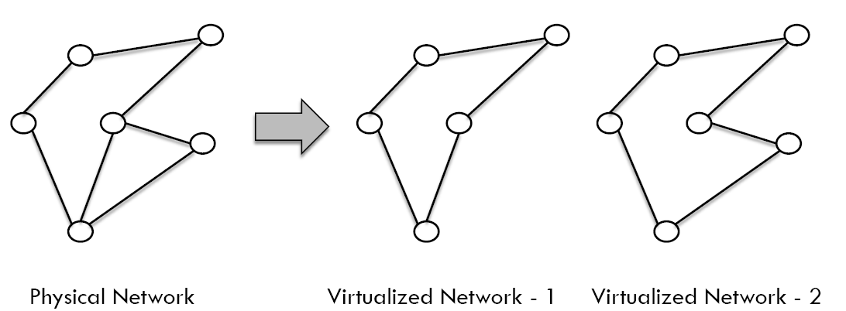
Network Virtualization for Dummies
Making a physical network appear as multiple
logical ones

Slide 6
Network Virtualization Model
Business Model
Architecture
Design Principles
Design Goals

Slide 7
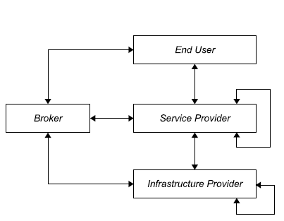
Business Model
Infrastructure Providers (InPs)
Manage underlying physical networks
Service Providers (SPs)
Create and manage virtual networks
Deploy customized end-to-end services
End Users
Buy and use services from different service
providers
Brokers
Mediators/Arbiters
Players
Relationships

Slide 8
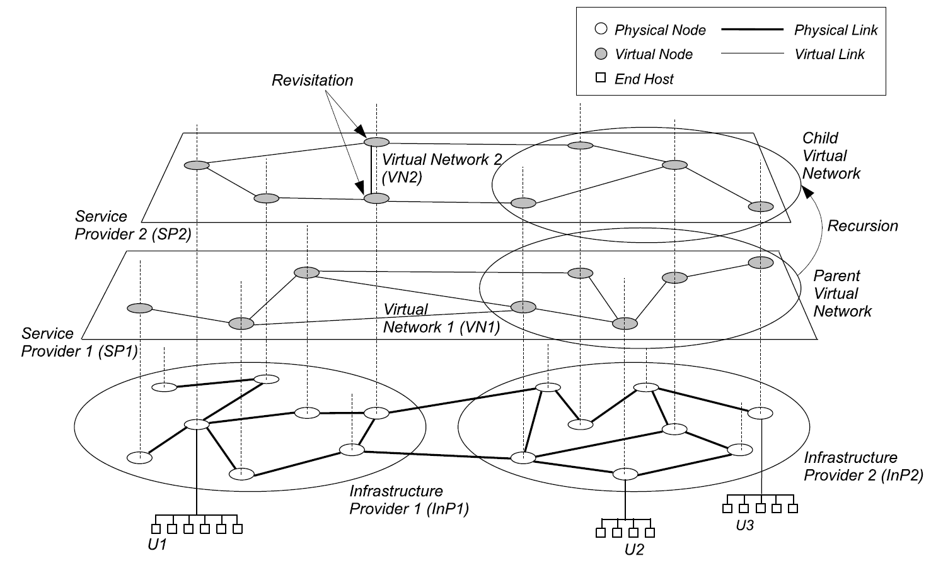
Architecture

Slide 9
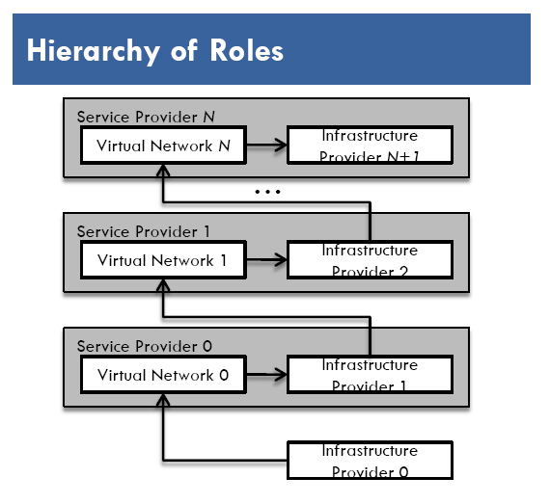
Design Principles
Concurrence of multiple heterogeneous
virtual networks
Introduces diversity
Recursion of virtual networks
Opens the door for network virtualization
economics
Inheritance of architectural attributes
Promotes value-addition
Revisitation of virtual nodes
Simplifies network operation
and management

Slide 10
Design Goals (1)
Flexibility
Service providers can choose
arbitrary network topology,
routing and forwarding functionalities,
customized control and data planes
No need for co-ordination with others
Manageability
Clear separation of policy from mechanism
Defined accountability of infrastructure and service providers
Modular management

Slide 11
Design Goals (2)
Scalability
Maximize the number of co-existing virtual networks
Increase resource utilization and amortize CAPEX and OPEX
Security, Privacy, and Isolation
Complete isolation between virtual networks
Logical and resource
Isolate faults, bugs, and misconfigurations
Secured and private

Slide 12
Design Goals (3)
Programmability
Of network elements e.g. routers
Answer “How much ” and “how”
We must find a Win-Win situation where programmability will be easy , effective and Secure at the same time
Heterogeneity
Networking technologies
Optical, sensor, wireless etc.
Virtual networks

Slide 13
Design Goals (4)
Experimental and Deployment Facility
PlanetLab, GENI, VINI
Directly deploy services in real world from the testing phase
Legacy Support
Consider the existing Internet as a member of the collection of
multiple virtual Internets
Very important to keep all concerned parties satisfied

Slide 14
Definition
Network virtualization is a networking environment that allows multiple service providers to dynamically compose multiple heterogeneous virtual networks that co-exist together in isolation from each other, and to deploy customized end-to-end services on-the-fly as well as manage them on those virtual networks for the end-users by effectively sharing and utilizing underlying network resources leased from multiple infrastructure providers.

Slide 15
Related Concepts
Virtual Private Networks (VPN)
Virtual network connecting distributed sites
Not customizable enough
Overlay Networks
Application layer virtual networks
Is flexible

Slide 16
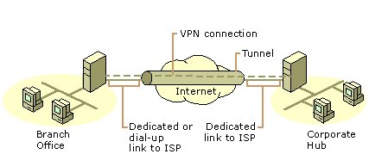
Virtual Private Network(VPN)

Slide 17
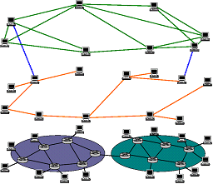
Overlay Network

Slide 18
Existing Projects(1)
Four general categories :
Networking technology
IP (X-Bone)
ATM (Tempest)
Layer of virtualization
Physical layer (UCLP)
Application layer (VIOLIN)
Link layer (VNET )
Network Layer (AGAVE)

Slide 19
Existing Projects(2)
Architectural domain
Network Management (VNRMS)
Resource Management ( Darwin)
Virtual Active Network ( NetScript )
Level of virtualization
Node virtualization (PlanetLab)
Full virtualization (Cabo)
VINI
GENI

Slide 20
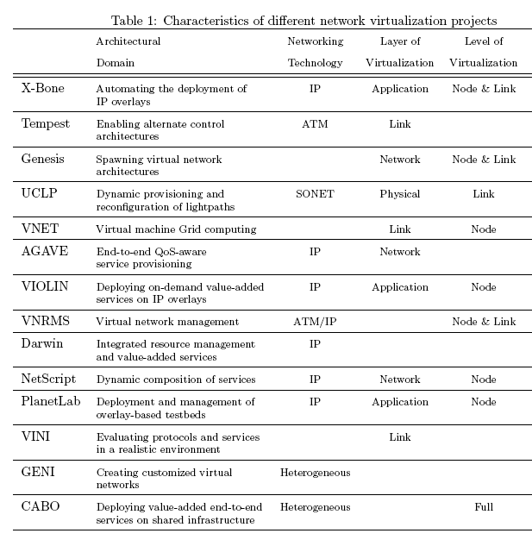

Slide 21
Future Works
Four general directions:
Instantiation
Creates virtual networks
Logistics
Runs them
Management
Manages them
Interactions
Let them flourish

Slide 22
Reference
[1] N.M. Mosharaf Kabir Chowdhury, Raouf Boutaba, “A Survey of Network Virtualization”, University of Waterloo Technical Report CS-2008-25, Oct. 2008
[2]http://publib.boulder.ibm.com/infocenter/powersys/v3r1m5/topic/iphb2/iphb2virtoverview.htm 12-01-2009

Slide 23
Thanks for your attention
Questions????

