Slide 1
Applications of Virtualization Techniques in the Mobile Phones
Class Seminar
Mehdi Cheshomi
University of Science and Technology Mazandaran, Babol,
mcheshomi@ustmb.ac.ir
17 Dec 2009

Slide 2
Outline
Motivation
Why mobile?
Why virtualization?
Why mobile virtualization?
Problems and Challenges
High growth speed and vast variety
Mobile OSes complexity

Slide 3
Outline(Cont.)
Solutions
Limitations
Special mobile characteristics
Limitations in using existing VMMs
Related works
Summary

Slide 4
Why Mobile?
IT vision:
“Information at my fingertips at any time and any place“
Mobile penetration:
In the world will be more than 75% in 2011 [BuddeComm09]
Varied services
Online banking, payment
Mobile social networking
Tencent QQ
Facebook mobile
and …

Slide 5
Why Virtualization?
Features
Isolation
Provide reliability and fault-tolerance by fully separating virtual systems
Consolidation
Reduce hardware costs by combining multiple workloads on one physical computer
Migration
Provide portability and mobility between software and hardware

Slide 6
Why mobile virtualization?
Increase computing capabilities in mobile phones
CPU
Memory
Smart phones are computer-like systems
Positive experiences
Server domain
PC domain

Slide 7
Some challenges in mobile industry
High growth speed and vast variety
Mobile makers
Have to make new mobile hardwares continually, therefore have to develop new OSes
New OSes are unreliable
Compactness in software development process returns bugs, errors, depletions,…
Backward compatibility weakness
Mobile software developers
By rapid changes in mobile Oses have to compatible their softwares with new conditions

Slide 8
Some challenges in mobile industry (Cont.)
Variety in OSes makes developer to develop several versions of a software for several platforms
Mobile owners
Face changes continually
Their old favorite softwares become unprofitable
Mobile OSes complexity
Must act as:
RTOS(for voice commutations)

Slide 9
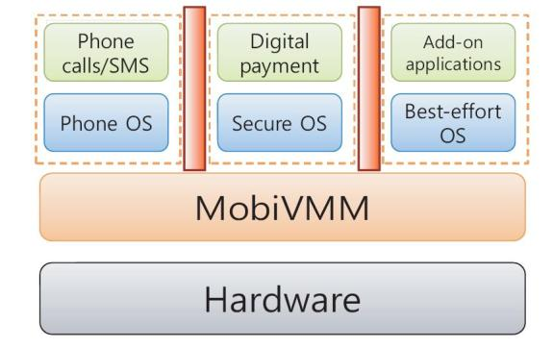
Some challenges in mobile industry (Cont.)
Secure OS
(for online banking)
GPOS
(for gaming, usual apps)
Figure 1. Mobile VMM. [Yoo08]
It is very difficult to develop and expensive!
Solution: use 2 or 3 processors
Baseband processor (for voice communications)
Application processor(for email, web browser ,…)
Multimedia processor(for video, music ,…)

Slide 10
Virtualization’s solutions
Virtualization is a software layer that sits on top of hardware
Virtualization reduces dependency between applications and hardware
Virtualization blocks the propagation of “chain of changes”

Slide 11
Virtualization’s solutions(Cont.)
By changes in hardware, top OS can remain fix
Mobile-makers make new mobile hardware without worry about changing in OSes
Time to market
Reliable OS
Reduce number of processors
Run a rich graphical environment such as Linux and modem software on single processor
Cost
Power efficiency

Slide 12
Virtualization’s solutions(Cont.)
Mobile Software developers
No worry about changing in own software when OSes changes
Develop a software that can run on several platforms
Mobile owners
Can use their old favorite softwares on own new mobile phone
Can use softwares that have been developed for other platforms(using windows mobile’s browser in Linux)

Slide 13
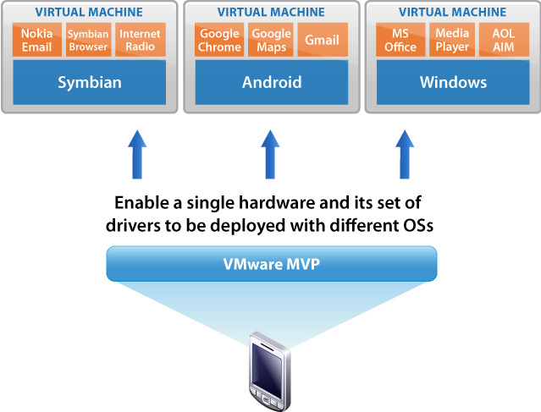
Virtualization’s solutions(Cont.)
Can change default installed mobile OS in own mobile phone
Figure 2. Multiple OS support. [Vmware09]

Slide 14
Other virtualization’s advantages
Security
Mobile operators give preference to "trusted" applications
“Privileged softwares” reduction
Motion up OS to user level
Smaller TCB(Trusted Computing Base)
Isolate and protect core phone services, sensitive information and softwares from mobile malware

Slide 15
Other virtualization’s advantages (Cont.)
Optimization
dynamic binary optimizer
Performance
Power efficiency
Persona
Persona is collection of user data (applications, pictures, videos, music, emails, bank info, credit card information, …)
Persona migration

Slide 16
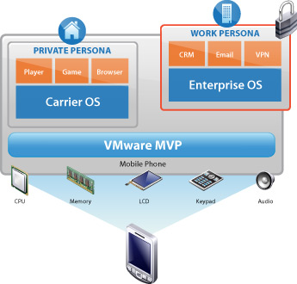
Other virtualization’s advantages (Cont.)
Several personas on single mobile phone
Figure 3. Several personas. [vmware09]

Slide 17
Other virtualization’s advantages (Cont.)
BYOD (Bring Your Own Device)
Mobile owner can use several services from multiple operators

Slide 18
Mobile virtualization and existing VMMs
Special mobile characteristics
Real time support
Resource limitation
Power efficiency
Some current VMMs are designed for management of various servers(Xen)
Not optimize for embedded applications (Xen has been optimized for I/O throughput not I/O latency)

Slide 19
Mobile virtualization and existing VMMs
Very different mobile architectures (unlike PC that is based on X86 usually)
I/O mechanisms in VMMs is interrupt based
Not suitable for real time applications
Power efficiency
Battery limitation is nightmare of mobile devices!
Limitation in using speedy CPUs and large memories

Slide 20
Mobile virtualization and existing VMMs
Existing VMMs are heavy weight
CPU
Memory
Energy management
Distributed in existing VMMs and impossible to estimate power consumption
Isolation force limitations on mobile systems(sharing)

Slide 21
Mobile virtualization and existing VMMs
Special chips
For special purposes(protection)
Combined with architecture
Not exists in PC (IMEI)
Virtualization hole
Instructions, which fail silently or show different behavior if executed under wrong privileges
ISA virtualization
Overhead
Power consumption

Slide 22
Mobile virtualization and existing VMM
heterogeny in mobile OSes
Structural (real time, general purpose)
Variety in developers

Slide 23
Full virtualization or paravirtualization?
Paravirtualization
Less overhead than full virtualization
Changing in OS
Full virtualization
More overhead than paravirtualizaton
It isn’t necessary to virtualize some things (microphone, head phone, …)
When device maker is different form OS developer
When hardware support virtualization

Slide 24
Related works
Famous virtualization companies work on mobile virtualization
Vmware
MVP (Mobile Virtualization Platform) supports OSes including Android 1.5, Linux 2.6.x, Symbian 9.3/9.4/9.5, Microsoft Windows CE 5.0/6.0, µITRON,
Open kernel labs
OKL4 Microvisor(Motorola Evoke QA4)
Virtuallogix

Slide 25
Summary
Mobile virtualization effects positively on some issues
Time to market
Cost
Functionality
Performance
And offers
Multiple OSes support for Mobile phones
Security
Reuse applications

Slide 26
Bibliography
[Yoo08] S. Yoo, Y. Liu, C. Hong, C. Yoo,and Y. Zhang, “MobiVMM: a Virtual Machine Monitor for Mobile Phones”, MobiVirt 2008 Breckenridge, CO. USA
[Heiser08] G. Heiser. The role of virtualization in embedded systems. Workshop on Isolation and Integration in Embedded Systems, IIES, 2008. Glasgow, UK. 1st
[Brakensiek008] J. Brakensiek, A. Droge, H. Hartig, A. Lackorzynski,and M. Botteck. Virtualization as an enabler for security in mobile devices. Workshop on Isolation and Integration in Embedded Systems, IIES, 2008.
[BuddeComm09] BuddeComm. March 8,2009, Global Mobile Communications - Statistics, Trends & Forecasts. http://www.budde.com.au/Research/Global-Mobile-Communications-Statistics-Trends-Forecasts.html, [last access 16 dec 2009]
[Business Week08] Business Week. April 21, 2008, Virtualization Goes Mobile, http://www.businessweek.com/technology/content/apr2008/tc20080421_235517.htm?chan=top+news_top+news+index_technology, [last access 16 dec 2009]
[VMware09] VMWare. VMware MVP (Mobile Virtualization Platform), http://www.vmware.com/products/mobile/, [last access 16 dec 2009]
[Open Kernel Labs09] Open Kernel Labs. OKL4 Microvisor, http://www.ok-labs.com/products/okl4-microvisor, [last access 16 dec 2009]

Slide 27
Applications of Virtualization Techniques in the Mobile Phones
Questions
?

