Slide 1
HONEYPOT whit virtual machine
Elham Hormozi
Mazandaran University Science & Technology
Software_el@yahoo.com

Slide 2
Overview
Definition
Advantages & Disadvantages
Types
Level of interaction
Honeyd project: A Virtual honeypot framework
Honeynet project: An Actual honeypot framework

Slide 3
What is a honeypot?
Definition:
“A honeypot is an information system resource whose value lies in unauthorized or illicit use of that resource.”
Unlike firewalls or IDS sensors, honeypots are something you want the bad guys to interact with.

Slide 4
How honeypots work?
Simple concept
A resource that expects no data, so any traffic to or
from it is most likely unauthorized activity

Slide 5
What is the value of a honeypot,? what can it do for me?
Honeypots are unique, they don't solve a specific problem.
Instead, they are a highly flexible tool with many different applications to security.
It all depends on what you want to achieve.

Slide 6
Physical & virtual honeypots
A physical honeypot is a real machine with its own IP address.
A virtual honeypot is a simulated machine with modeled behaviors, one of which is the ability to respond to network traffic.
Multiple virtual honeypots can be simulated on a single system.

Slide 7
Advantages
Small data with plenty values
New tools & tactics
Minimum requirement
Encode or IPv6
Simplicity

Slide 8
Disadvantages
Limited view :
Honeypots can only track and capture activity that directly interacts with them. Therefore honeypots will not capture attacks against other systems.
Risk :
Deploying a honeypot could create an additional risk and eventually put a whole organizations’ IT security at risk.

Slide 9
Types of honeypots
Production Honeypot
Research Honeypot

Slide 10
Production honeypot
Prevention (sticky Honeypot)
Detection
Response

Slide 11
Low- Interaction honeypots
Provide simulated Services
No operating system for attacker to access.
Information limited to transactional information and attackers activities with simulated services.

Slide 12
Advantages of low-interaction honeypots
Good starting point
Easy to install, configure, deploy and maintain
Introduce a low limited risk
Logging and analyzing is simple
only transactional information are available, no information about the attacks themselves,(e.g. time and date of an attack, protocol, source and destination IP)

Slide 13
Disadvantages of low-interaction honeypots
No real interaction for an attacker possible
Very limited logging abilities
Can only capture known attacks
Easily detectable by a skilled attacker

Slide 14
Honeyd
Honeyd written by Neils Provos in 2002
Honeyd, a lightweight framework for
creating virtual honeypots
Low-interaction virtual honeypot
Honeyd is most widely used prod. honeypot

Slide 15
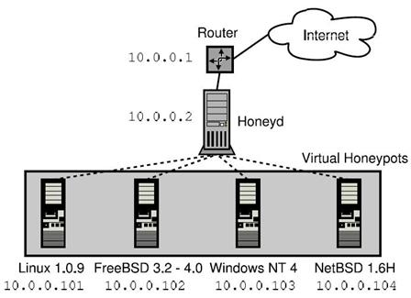
The framework allows us to
instrument thousands of IP
addresses with virtual machine
and corresponding network
services.
Honeyd receives traffic for its
virtual honeypots, via a router.
For each honeypot, Honeyd
can simulate the network
stack behavior of a different
operating system.

Slide 16
Medium- interaction honeypot
Medium-interaction honeypots generally offer
More ability to interact than a low interaction honeypot but less functionality than high-interaction solutions.
Used for production & Research honeypot goals

Slide 17
High-Interaction honeypot
Provide Actual Operating Systems
Extensive risk
Learn extensive amounts of information
Log every packet that enters and leave
honeypot

Slide 18
Honeynet Project
A honeynet is one type of high interaction honeypot
Started in 2000 by a group of volunteer security
professionals.
Allows full access to OS of honeypot.

Slide 19
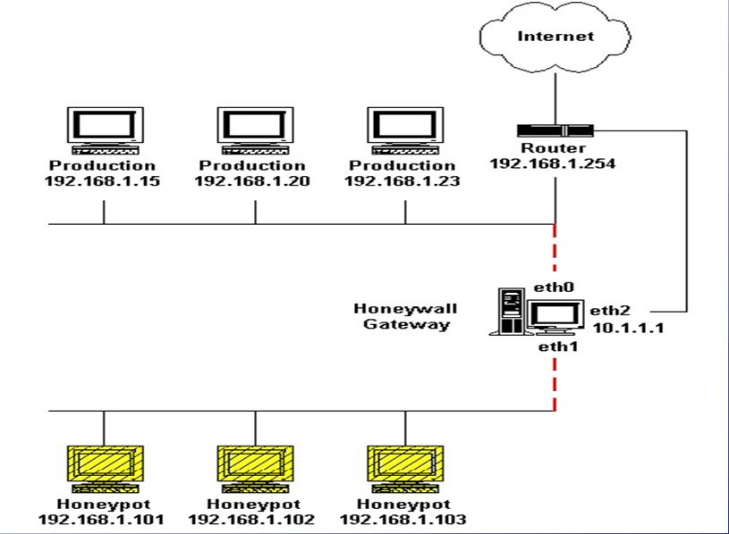

Slide 20
virtual honeynets
Virtual honeynets are one type of honeynet, specifically honeynets that run multiple operating systems on the same physical computer.
This is done using virtualization software such as VMware or User-Mode Linux.

Slide 21
Honeypots
Low Interaction
BackOfficer Friendly [5].
SPECTER [6].
Honeyd [2].
ManTrap [7].
Honeynets [1].
High Interaction

Slide 22
Which is best?
None, they all have their advantages and disadvantages. It depends on what you are attempting to achieve.

Slide 23
conclusion
Analyzing compromised honeypots supports you in getting a
certain understanding of tools, methodologies and avenues
used by attackers in the wild (may improve your own hacking
skills as well as defence strategies!)
Honeypots are a highly flexible security tool that can be used
in a variety of different deployments.
Honeypots are a quite new field of research, lot’s of work has
still to be done .

Slide 24
Refrences
[1]. Niels Provos, “Honeynet project”, October 2007.
http;//www.Honeynet.org/papers/honeynet/index.html
[2]. N. PROVOS, “Honeyd Project, A Virtual Honeypot Framework“, Proceedings of the
13 th USENIX Security Symposium San Diego, CA, USA,Aug. 2004.
http://www.honeyd.org
[3]. Honeypots: Tracking Hackers www.ip97.com/tracking-hackers.com/misc/faq.html
[4]. Lance Spitzner. Honeypots: Tracking Hackers. Addison Wesley Professional,
september 2002. http://www.usenix.org
[5]. http://www.nfr.com/products/bof/
[6]. http://www.specter.com
[7]. http://www.recourse.com

Slide 25
Honeypot The end.
Thanks for your patience
and attention!
24.12.2009

