Slide 1
Virtualizing the Datacenter Without Compromising Server Performance
Virtual Machine Course
Rofideh Hadighi
University of Science and Technology of Mazandaran,
rhadighi@ustmb.ac.ir
31 Dec 2009

Slide 2
Outline
Virtualizing the datacenter.
Good things about server virtualization.
Bad things about server virtualization.
Virtualizing while safeguarding performance.
Future perspectives.

Slide 3
Cloud computing
At MIT in the early 1960s.
Drawing of the Internet:
Hiding many servers.
Connections.
User can receive a service.
Without ever knowing:
which machine (or machines) rendered the service.
where it was located.

Slide 4
Datacenter
A data center or datacenter or datacentre or server farm:
Computer systems:
Telecommunications, storage systems.
Backup power supplies.
Environmental controls:
Air conditioning, fire suppression.
Security devices.

Slide 5
Why virtualizing the datacenter?
To solve cloud computing bottleneck.
Increasing physical servers’ processing and computing powers.
New breed of multi-core and multi-bit processors.
Unprecedented amounts of memory and disk space.

Slide 6
Why virtualizing the datacenter? (Cont`d)
Underutilized resources of physical servers in most datacenters.
Inefficient power consumption.
Excessive Total Cost of Ownership (TCO).
Scaling up organization`s IT infrastructure to accommodate for more:
Applications, workloads, users.

Slide 7
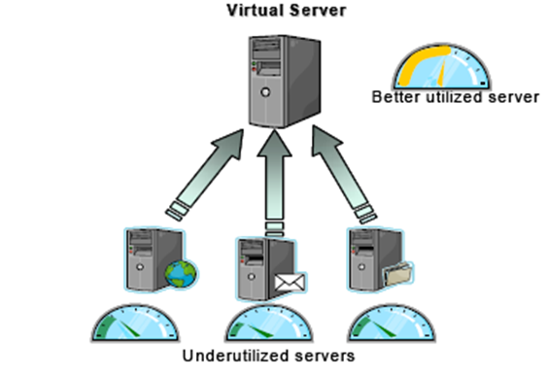
Basic concept of server virtualization
Figure1. Illustrating the basic concept of server virtualization.[1]

Slide 8
Datacenter virtualization
With virtual machine (VM):
Partitioning technique to run multiple and isolated virtual servers.
optimizing hardware usage.

Slide 9
How to virtualization?
By assigning each core one or more VMs.
physical separation of multiple VMs .
Each virtual server running a guest OS.
Guest OS presented with its virtual hardware.
VMs and shared resources are managed by hypervisor(VMM).

Slide 10
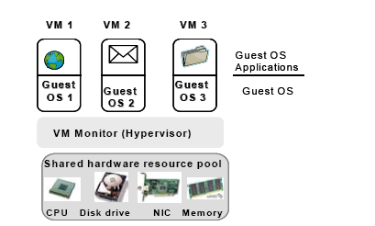
Basic concept of server virtualization
Figure2.[1]

Slide 11
Good things about server virtualization
Enhanced hardware utilization:
Consolidating underutilized servers into a fewer consolidated resources.
Agile provisioning and deployment:
Encapsulated files reside on the host machine.
readily cloned and reused.
New virtual server on an existing physical machine.
No additional hardware, software.

Slide 12
Good things about server virtualization(Cont`d)
Lower total cost of ownership(TCO)
Through consolidation.
(1)deferred purchase of new servers.
(2)lower maintenance costs.
(3)increase performance per watt.
(4)lower power, cooling and cabling requirements.
(5)lower disaster recovery costs.

Slide 13
Good things about Server Virtualization(Cont`d)
Enhanced availability :
With isolation
No effect on host with the crash of guest.
Unaware of the underlying hardware.
Easy transfer from one physical server to another.
Easy perform backup and disaster recovery.
Taking a snapshot (virtual image).

Slide 14
The bad things about server virtualization
Performance degradation:
CPU Usage, and network performance.
Storage performance.
Memory performance.
I/O bottleneck.
Scalability constraints
Security vulnerabilities

Slide 15
Virtualizing while safeguarding performance
Selective Virtualization.
Direct assignment of physical NICs to VMs.
Consolidating resources in a shared resource pool.
Management tools for virtual environments
Advances in processor and memory technologies.

Slide 16
Selective virtualization
I/O bottlenecks on hypervisor layer.
Safe to keep away from virtualization:
Latency-sensitive application (such as ERP systems).
Application which exhibit peak utilization.

Slide 17
Direct assignment of physical NICs to VMs
Address the I/O bottleneck:
Dedicate separate physical NICs to VMs.
Each VM allowed to exchange data with a dedicated physical NIC.
VMM is excluded from the I/O data path.
Direct memory access (DMA):
Maps system memory access to the target VM.

Slide 18
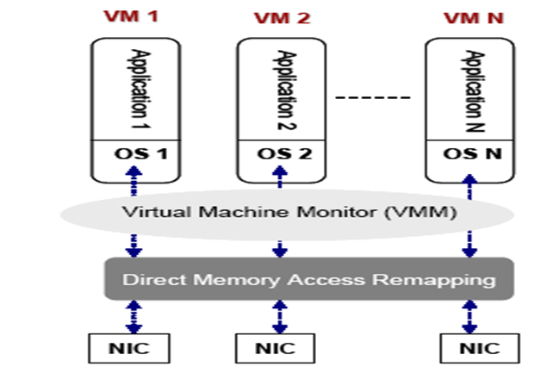
Direct assignment of physical NICs to VMs(Cont`d)
Figure3. Dedicating separate NICs to VMs.[1]

Slide 19
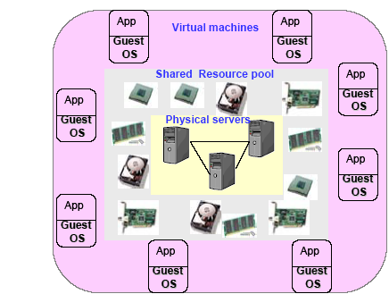
Consolidating resources in a shared resource pool
Allocate virtual machines to a resource pool.
Figure4.Multiple VMs sharing a common resource pool.[1]

Slide 20
Consolidating resources in a shared resource pool(Cont`d)
Pool offers :
Processor, memory, disk, networking resources.
Distributed resource scheduler (DSR):
Dynamically balance VM workloads.
Free-up resources.
Light workload into a fewer number
of physical severs.
Requesting additional resources.

Slide 21
Management tools for virtual environments
Intelligent management tools:
Assist in optimizing:
Allocation of physical and virtual resources to individual VMs.
Dynamic load balancing tools.
Core system components:
CPU, memory and hard disks.
Self utilization monitoring and management.
Changing workload conditions.

Slide 22
Management tools for virtual environments(Cont`d)
Virtual server management strategy:
Monitor the health of the virtual servers.
predict their failures.
Generate alerts.
Assessing beforehand:
Capacity planning.
Modeling.
Simulation.

Slide 23
Management tools for virtual environments(Cont`d)
Capacity tools:
Assist in minimizing:
Management Tools:
VKernel
Veeam FastSCP
Akorri's BalancePoint
Embotics V-Commande
VReolicator , VFoglight
PRTS Network Monitor

Slide 24
Advances in processor and memory technologies
New breed of cpu, good for bottlenecks:
Low-power.
Multi-core processors.
Advances in core micro-architectures:
more instructions per clock cycle,
Increasing throughput.

Slide 25
Advances in processor and memory technologies(Cont`d)
Support virtualization in many ways:
(1)Accelerate communication between the hypervisor and the VMs.
(2) Better support I/O virtualization.
(3) Better support to handle VM interrupts.
Advances memory access and caching mechanisms:
Reducing memory access latency.

Slide 26
Future perspectives
Enterprises consider virtualization technology:
Reduce TCO.
Recent economic downturn.
Further reduce:
Open source virtualization solutions.
More partnerships and collaborations:
Between server virtualization players and processor manufacturers.

Slide 27
Future perspectives(Cont`d)
Small and medium size business (SMB):
Entail building.
Acquiring the appropriate expertise.
Vanish extra layer of hypervisor software:
Hardware-based access mechanisms.
Address the prevailing overhead issue.
migration from software-based towards hardware-based in hypervisor.

Slide 28
Refrences
[1] F. Kamoun, “Virtualization the Datacenter without Compromising Server Performance”, ACM Ubiquity Magazine, Vol.2009, Issue9, New York, NY, USA.

