Slide 1
Cloud Benchmarking
Soroush Rostami
Advanced Topics in Information Systems
Mazandaran University of Science and Technology,
s.rostami@ustmb.ac.ir
Advisor: Mr. Hadi Salimi
February 4, 2011

Slide 2
Agenda
1
Cloud Services
2
Purpose of Benchmarking
3
Requirements to a Cloud Benchmark
4
Review of Traditional Benchmark
5
Metrics for Benchmarking
6
Challenges
7
Related Work
8
Conclusions
Page ▪ 2/18

Slide 3
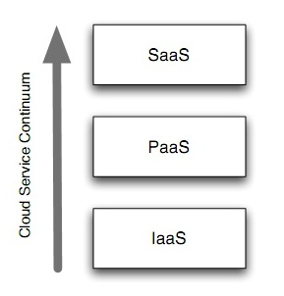
Cloud Services
Infrastructure as a Service (IaaS) [2]
Amazon EC2, S3, SQS
GoGrid
Platform as a Service (PaaS) [2]
Microsoft Azure
Google AppEngine
Software as a Service (SaaS) [2]
SalesForce
GMail
Page ▪ 3/18

Slide 4
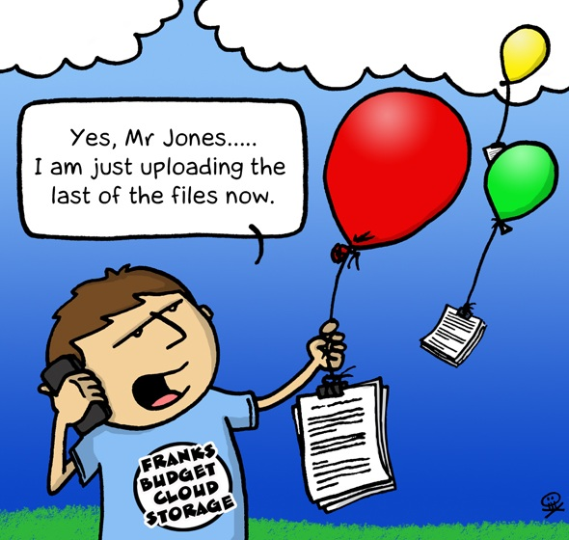
Advantage of Cloud Services
Scalability
Pay-per-use
High-availability
Fault-tolerance
Elasticity
Page ▪ 4/18

Slide 5
Purpose of Cloud Benchmarking
Implement a standard benchmark
Evaluate different systems on dynamic workloads
Focus on performance and scalability
Future additions – availability, cost, fault-tolerance
How do they compare?
Feature tradeoffs
Performance tradeoffs
Not clear!
Page ▪ 5/18

Slide 6
Requirements to a Cloud Benchmark
Features and Metrics
Scalability
Pay-per-use
Fault-tolerance
Architectures
Page ▪ 6/18

Slide 7
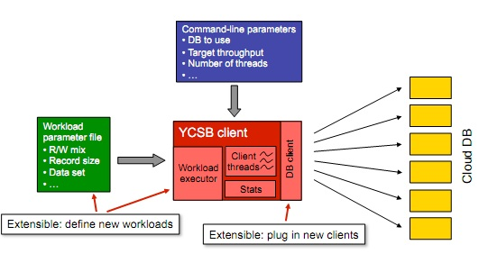
Benchmark tool
Java application [3]
Many systems have Java APIs
Other systems via HTTP/REST, JNI or other solution
Page ▪ 7/18

Slide 8
Review of Traditional Benchmark
TPC benchmark [4]
TPC-W
Primary metric is average performance of a static system
Use for e-commerce application
TPC-H
TPC-C
Page ▪ 8/18

Slide 9
Problems of TPC Benchmark
Designed for transactional database systems
Not suitable for scalable systems
Lot-size problem
Not support modern technology
Page ▪ 9/18

Slide 10
Metrics for Benchmarking
Metrics
Scalability
Cost
Peaks
Fault tolerance
Page ▪ 10/18

Slide 11
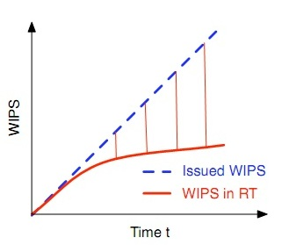
Metrics for Benchmarking (Cont.)
Scalability [1]
Calculate
Web Interactions Per Seconds (WIPS)
WIPS in Response Time (WIPS in RT)
Calculate deviates
Correlation coefﬁcient R2
Determining the parameters of a power function
Page ▪ 11/18

Slide 12
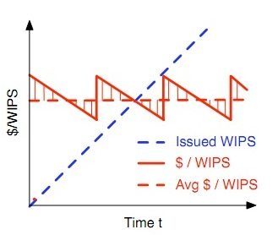
Metrics for Benchmarking (Cont.)
Cost [1]
Overall cost
Self-owned infrastructure
Software
Hardware
Administration cost
Calculate
Cost in dollars per WIPS ($/WIPS)
Average $/WIPS
Calculate deviates
Page ▪ 12/18

Slide 13
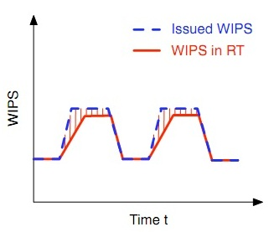
Metrics for Benchmarking (Cont.)
Peaks [1]
Calculate
WIPS
WIPS in RT
Ratio between WIPS in RT & WIPS
Calculate deviates
Be inﬂuenced by
Base load
Elevation of the peak
Page ▪ 13/18

Slide 14
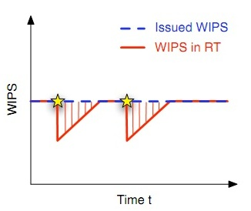
Metrics for Benchmarking (Cont.)
Fault tolerance [1]
Calculate
WIPS
WIPS in RT
Ratio between WIPS in RT & WIPS
Be inﬂuenced by
The percentage of failures
Be reportable by
Cloud providers & not users
Page ▪ 14/18

Slide 15
Challenges
Main Cloud Benchmarking challenges include:
Make the reported results comparable [1]
Scalability [2]
Cost [2]
Page ▪ 15/18

Slide 16
Related Work
Cloud Benchmark
Yahoo! Cloud Serving Benchmark [3]
Focus on serving database system
Sherpa, BigTable, Cassandra, etc
Project team
Brian Cooper, Adam Silberstein, Russell Sears
Page ▪ 16/18

Slide 17
Conclusions
The goal of benchmarking a software system is to evaluate its average performance
A new benchmark should look like that ﬁts better to the characteristics of cloud computing
Implement a ﬁrst version of a new cloud benchmark that is based on our ideas
Apply the new benchmark to different cloud architectures
Page ▪ 17/18

Slide 18
References
[1] Binnig, C., Kossmann, D., Kraska, T. and Loesing, S. How is the weather tomorrow?: towards a benchmark for the cloud. ACM, City, 2009
[2] Armbrust, M. Above the clouds: A berkeley view of cloud computing. Technical Report UCB/EECS-2009-28, City, 2009
[3] Cooper, B., Silberstein, A. Benchmarking cloud serving systems with YCSB. ACM, City, 2010
[4] TPC. TPC-W Benchmark 1.8. City, 2002.
Page ▪ 18/18

Slide 19
Thank you
and Any Questions?
?
?
?

