Slide 1
Cloud architecture
Modeling
&
Design
Vahid Balanchi (Ms)
University of Science and Technology Mazandaran, Babol
Email:Vahid.Balanchi@ustmb.ac.ir
Advisor: Hadi Salimi
Email: hsalimi@iust.ac.ir
4 Feb, 2011
Mazandaran University of Science and Technology, IRAN
Class Seminar
Advanced Topics in Information Systems
Cloud Computing

Slide 2
Agenda

Motivation
Cloud Modeling
Cloud Delivery Models
Cloud Deployment Models
Cloud Architecture
Alternative Deployment Models
Conclusion and Open Issues
Cloud Adoption Lifecycle Model

Slide 3
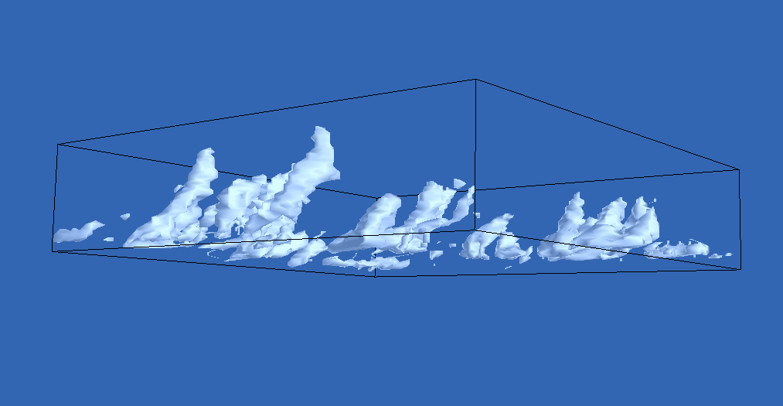
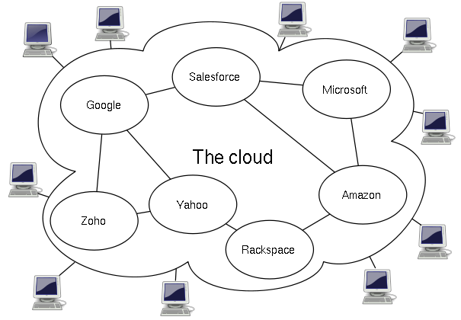
Cloud Modeling ????
Determining, mapping, and alignment of business drivers and key requirements to the range of potential cloud technical and resource patterns available. Cloud modeling forces the explicit definition of business needs, and then establishing what cloud technical patterns and resource models best suit those business requirements.

Slide 4
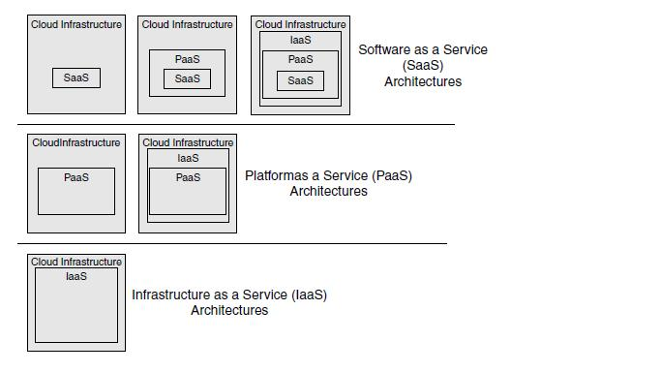
Cloud Delivery Model
SaaS
PaaS
IaaS
Amazon EC2 and S3 SunMicrosystems Cloud Services
Terremark, Dropbox
Google App Engine
Force.com (from salesforce.com)
Microsoft Azure
Zoho Suite
Apple’s MobileMe
Google Docs

Slide 5
= S+P+I The SPI Framework
To understand how the SPI framework evolved, perhaps it’s helpful to place it in context with the development of Internet Service Providers (ISPs).

Slide 6
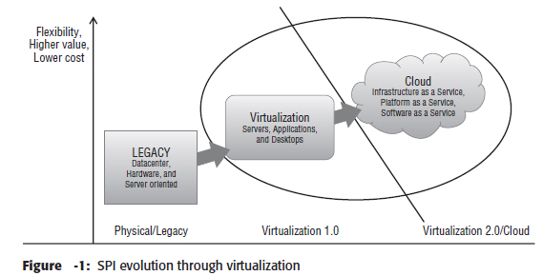
1.0 — As ISPs originally began to provide Internet services, dial-up modem
2.0 — During a period of merging and consolidation, ISPs began offering other services, such as e-mail
3.0 — The increasing demand for infrastructure to host their customers’ applications and data led to the creation of data centers
4.0 — The commoditization of collocation facilities led to the development of application service providers (ASPs).
5.0 — The ASP model eventually evolved into cloud computing

Slide 7
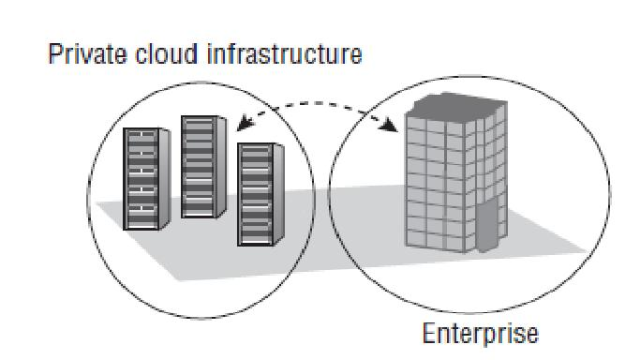
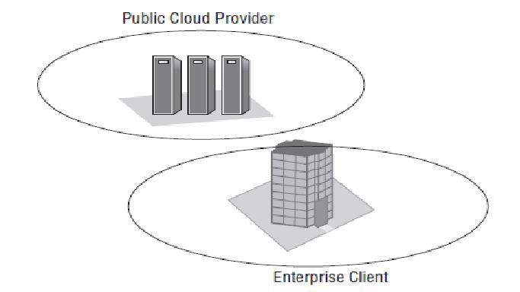
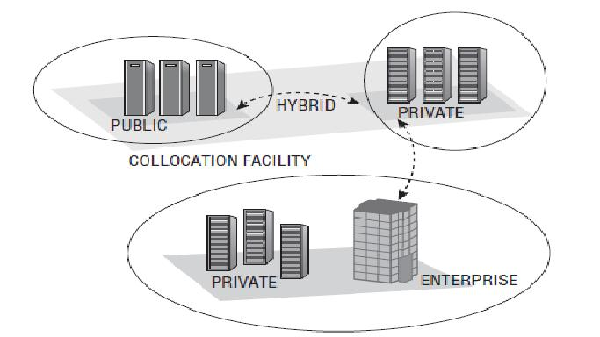
Cloud Deployment Model
Internal/private cloud
External/public cloud
Hybrid/integrated cloud
Community/vertical
GameCloud,SocialCloud,……

Slide 8
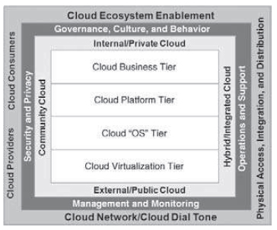
Cloud Computing Reference Model

Slide 9
Logical Architecture Model
This model includes the following eight virtualized capabilities in support of attaining cloud computing:
1. Network virtualization (NaaS)
2. Infrastructure Virtualization (IaaS)
3. Application hosting virtualization (Container aaS)
4. Platform virtualization (PaaS)
5. Data virtualization (DaaS)
6. Application virtualization (SaaS)
7. SOA/Services virtualization (SOAaaS)
8. Governance virtualization (GaaS)

Slide 10
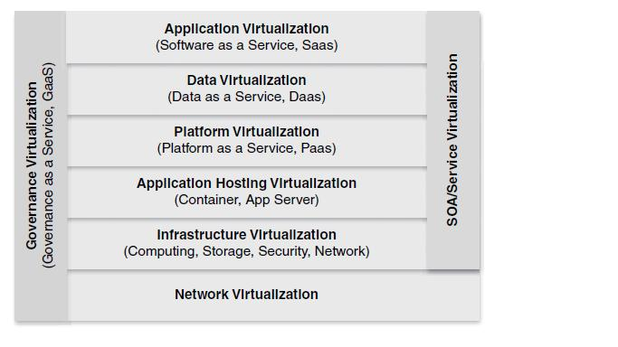
Logical Architecture Model (cont’d)

Slide 11
Alternative Deployment Models
As long as we’re looking at the SPI framework, let’s also take a quick peek at a couple of alternative deployment models, one that is based on SPI and extends it, the other a completely different view of the cloud computing architecture.

Slide 12
The Linthicum Model
Storage as a Service
Database as a Service
Information as a Service
Process as a Service
Application as a Service
Platform as a Service
Integration as a Service
Security as a Service
Management/Governance as a Service
Testing as a Service

Slide 13
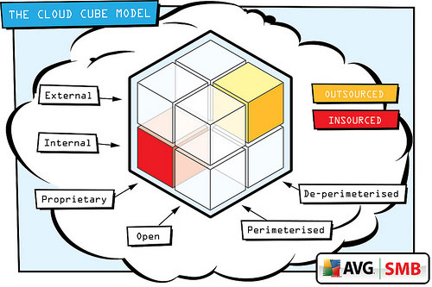
The Jericho Cloud Cube Model

Slide 14
Open Issues and Offers
Cloud Cube Model
Security, Privacy, and Trust models
Models for supporting mobility in the cloud and
mobile clouds
Maintenance and (self-)management models
Infrastructure-platform-application integration models

Slide 15
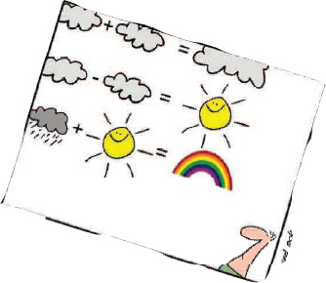
Conclusion
There are a number of choices that a client can use to take advantage of the benefits of cloud computing !
The benefi ts of using cloud computing are varied !
A lot of semi-serious definitions:
Cloud = Grid made right
Cloud = Grid may easy
Grid: from Science for Science
Cloud: from Business fro Business
Let‘s be serious…

Slide 16
Bibliography
[1] Krutz, R. and R. Vines (2010). Cloud Security: A Comprehensive Guide to Secure Cloud Computing, Wiley.
[2] Marks, E. and B. Lozano (2010). Executive's Guide to Cloud Computing, Wiley.
[3] Jericho Forum, “Cloud Cube Model: Selecting Cloud Formations for Secure Collaboration Version 1.0”, Jericho Forum Specification, April 2009.

Slide 17
Comment/Question

