Slide 1

Cloud Data Storage
.
.
}
}
.
}
Presented by: Maedeh Tashakkorian
Supervisor: Hadi Salimi
Mazandaran University of Science and Technology
m.tashakkorian@gmail.com
February, 2011

Slide 2

Outline
Motivation
Storage as a Servise (StaaS)
Cloud providers
Cloud storage challenges
Existing Systems and Services
MapReduce
References

Slide 3




Motivation
Manage Costs
Shift from capital expenditures to operational expenditures
Greater Resource Agility
Respond to business demands more effectively
Greater Business Agility
Focus on solving business problems, not on
infrastructure issues

Slide 4
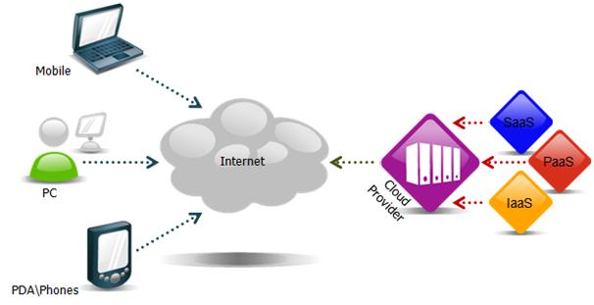
Storage as a Servise (StaaS)
A third-party provider rents space on their storage
Cost-per-gigabyte-stored or Cost-per-data-transferred model

Slide 5
Cloud providers
Google Docs
Web email providers
Flickr and Picasa
YouTube
Facebook and MySpace
MediaMax and Strongspace

Slide 6
Cloud storage challenges
Security
Reliability
Outages
Theft

Slide 7



















Existing Systems and Services
Google's Bigtable
Facebook’s Cassandra
Yahoo’s PNUTS
Amazon‘s Dynamo

Slide 8
MapReduce
What is MapReduce?
Examples
Execution Overview
Fault Tolerance

Slide 9
What is MapReduce?
A programming model
Input data is large
Want to use 1000s of CPUs
User-defined functions
simple and powerful interface
MapReduce
Provides:
Automatic parallelization and distribution
Fault-tolerance and I/O scheduling
Monitoring & status updates

Slide 10

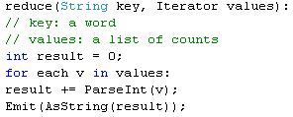
MapReduce Concept
Map
Perform a function on individual values in a data set to create a new list of values
Combine values in a data set to create a new value
Reduce

Slide 11
Examples
Distributed GREP
Count of URL Access Frequency
Reverse Web-Link Graph
Inverted Index
Distributed Sort

Slide 12
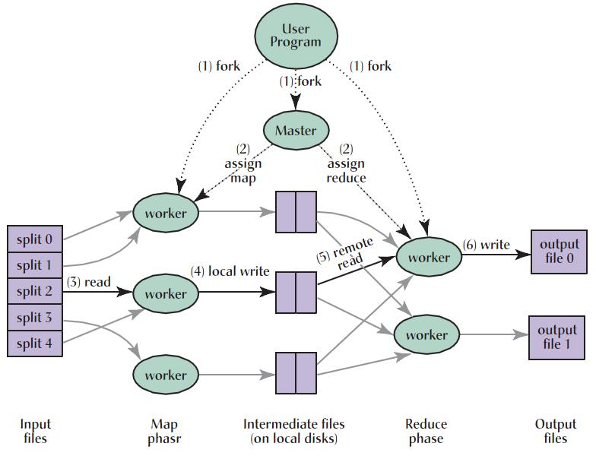
Execution Overview

Slide 13
Example for MapReduce
Page 1: the weather is good
Page 2: today is good
Page 3: good weather is good

Slide 14
Map output
Worker 1:
  (the 1), (weather 1), (is 1), (good 1).
Worker 2:
  (today 1), (is 1), (good 1).
Worker 3:
  (good 1), (weather 1), (is 1), (good 1).

Slide 15
Reduce Input
Worker 1:
  (the 1)
Worker 2:
  (is 1), (is 1), (is 1)
Worker 3:
  (weather 1), (weather 1)
Worker 4:
  (today 1)
Worker 5:
  (good 1), (good 1), (good 1), (good 1)

Slide 16
Reduce Output
Worker 1:
  (the 1)
Worker 2:
  (is 3)
Worker 3:
  (weather 2)
Worker 4:
  (today 1)
Worker 5:
  (good 4)

Slide 17
Fault Tolerance
Worker Failure
Master Failure

Slide 18

References
[1] Wu, J., L. Ping, et al. (2010). Cloud Storage as the Infrastructure of Cloud Computing, IEEE.
[2] Velte, T., A. Velte, et al. (2009). Cloud computing: a practical approach, McGraw-Hill Osborne Media.
[3] Moreno, J., D. Kossmann, et al. (2010). "A testing framework for cloud storage systems."
[4] Jin, C. and R. Buyya (2009). "MapReduce Programming Model for. NET-Based Cloud Computing." Euro-Par 2009 Parallel Processing: 417-428.
[5] DeCandia, G., D. Hastorun, et al. (2007). "Dynamo: amazon's highly available key-value store." ACM SIGOPS Operating Systems Review 41(6): 205-220.
[6] Dean, J. and S. Ghemawat (2008). "MapReduce: Simplified data processing on large clusters." Communications of the ACM 51(1): 107-113.
[7] Chang, F., J. Dean, et al. (2008). "Bigtable: A distributed storage system for structured data." ACM Transactions on Computer Systems (TOCS) 26(2): 1-26.

Slide 19
References (cont’d)
[8] (2010). "Amazon Elastic Compute Cloud (Amazon EC2)." Retrieved Jan 29, 2011, from http://aws.amazon.com/ec2/.
[9](2010). "Amazon Simple Storage Service (Amazon S3)." Retrieved Jan 29, 2011, from http://aws.amazon.com/s3/.
[10](2010). "Enterprise Cloud Storage - Nirvanix Storage Delivery Network." Retrieved Jan 29, 2011, from http://www.nirvanix.com/.
[11](2011). "BigTable - Wikipedia, the free encyclopedia." Retrieved Jan 29, 2011, from http://en.wikipedia.org/wiki/BigTable.
[12](2011). "Dedicated Server, Managed Hosting, Web Hosting by Rackspace Hosting." Retrieved Jan29, 2011, from http://www.rackspace.com/index.php.
[13](2011). "Product Overview - Google Storage for Developers - Google Code." Retrieved Jan 29, 2011, from http://code.google.com/apis/storage/docs/overview.html.
[14](2011). "salesforce.com." Retrieved Jan 29, 2011, from http://www.salesforce.com/.

