Slide 1
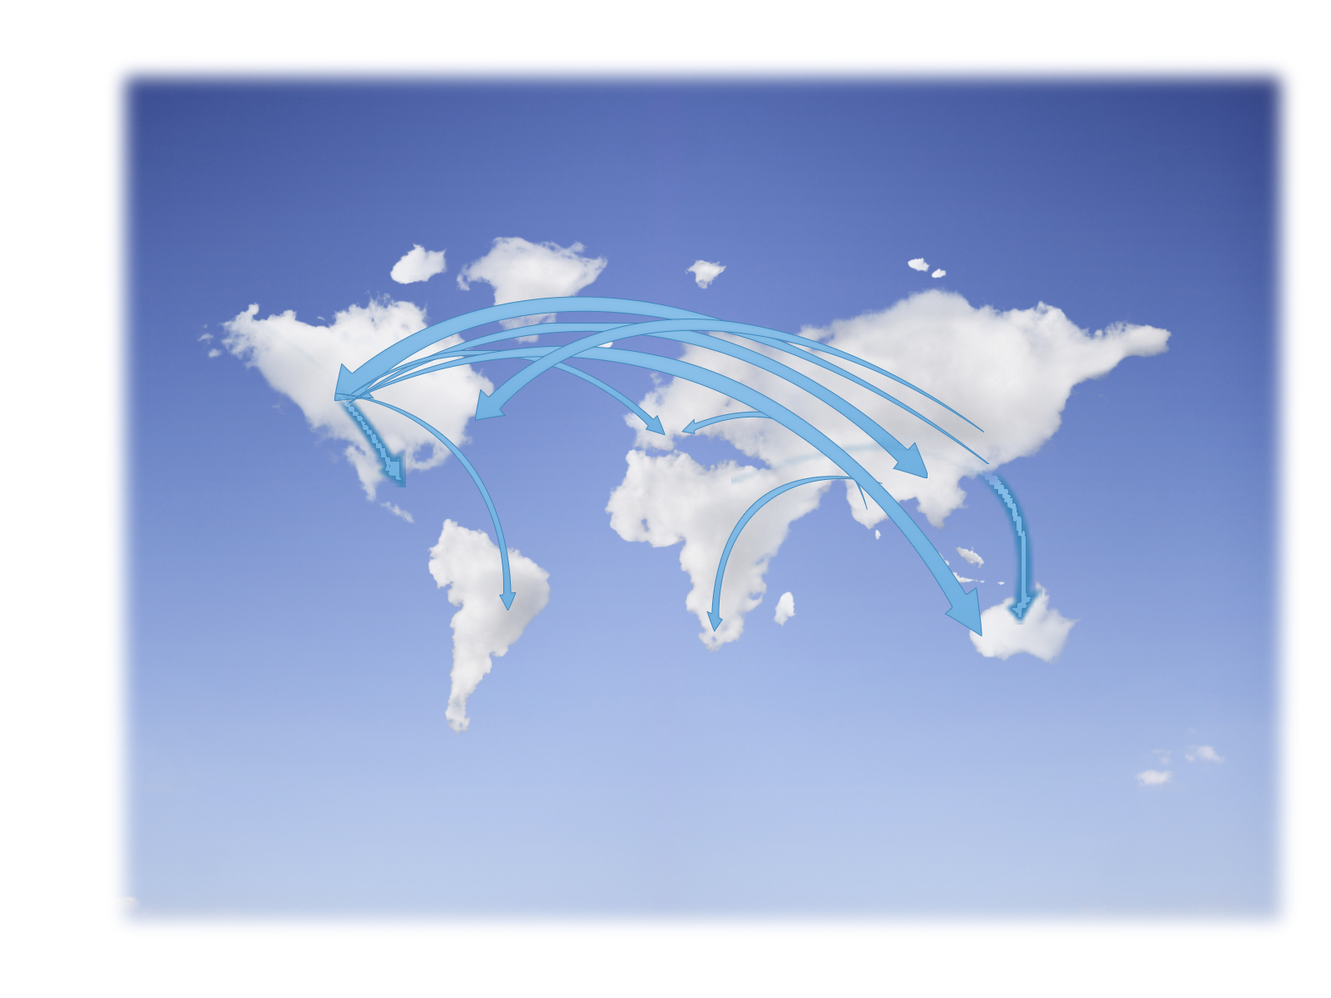
Cloud Interoperability
By:Shabboo Mohammadyani
Final Course Seminar,
Advanced Topics in Information Systems – Cloud Computing
Sh.mohammadyani@gmail.com
Mazandaran University of Science and Technology
Supervisor: Hadi Salimi

Slide 2
Outlines
Introduction
Interoperability challenges
Interoperability approaches
Related work
Conclusions
References

Slide 3
Interoperability between Clouds?
Introduction
Ability to use the Cloud services provided by multiple vendors
Ability to move data and code from one Cloud to another or back to the enterprise(portability)

Slide 4
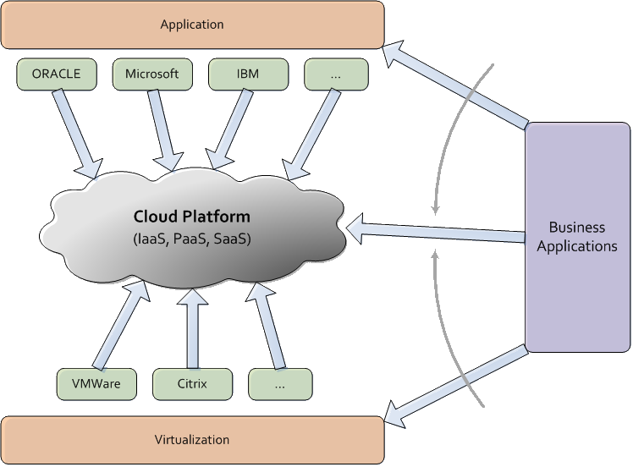
Why interoperability ?
Introduction
Organizations need:
Automatically provision services
Manage VM instances
Work with both Cloud-based and enterprise-based applications
Using a single tool set that can function across existing programs and multiple Cloud providers

Slide 5
Interoperability Challenges
Distinct hypervisor and VM technologies
Store and configure operating systems and applications differently
Use various security standards and management interfaces
Amazon EC2: XEN
Salesforce.com: VMWare
Microsoft Azure: Hyper-V

Slide 6
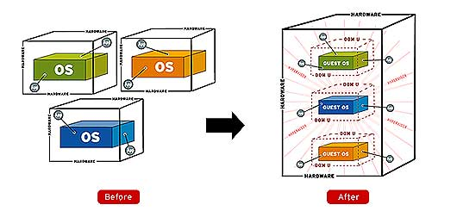
Interoperability Challenges
Distinct hypervisor and VM technologies
Store and configure operating systems and applications differently
Use various security standards and management interfaces

Slide 7
Interoperability Challenges
Distinct hypervisor and VM technologies
Store and configure operating systems and applications differently
Use various security standards and management interfaces

Slide 8
Will Cloud Computing Be Open and Interoperable?
Standard deployment packaging format
Standard Cloud security best practices
Standard common Cloud API
Develop interoperability and compliance programs
Management of Resources and Service
Catalog

Slide 9
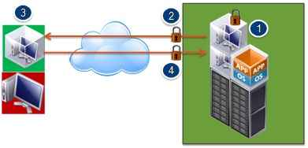
Will Cloud Computing Be Open and Interoperable?
Standard deployment packaging format
Standard Cloud security best practices
Standard common Cloud API
Develop interoperability and compliance programs
Management of Resources and Service
Catalog

Slide 10
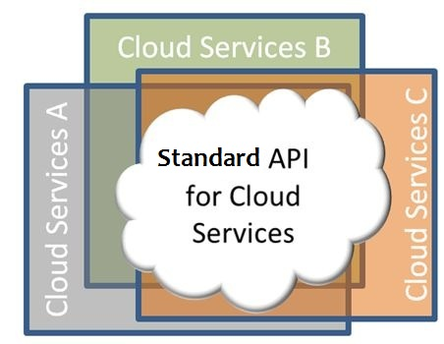
Will Cloud Computing Be Open and Interoperable?
Standard deployment packaging format
Standard Cloud security best practices
Standard common Cloud API
Develop interoperability and compliance programs
Management of Resources and Service
Catalog

Slide 11
Will Cloud Computing Be Open and Interoperable?
Standard deployment packaging format
Standard Cloud security best practices
Standard common Cloud API
Develop interoperability and compliance programs
Management of Resources and Service
Catalog

Slide 12
Interoperability Approaches
Development of interoperability standards
Unified Cloud Interface/Cloud Broker
Enterprise Cloud Orchestration Platform /Orchestration layer
DMF

Slide 13
Development of Interoperability Standards
The distributed management task force's Open Virtualization Format (OVF) standard (http://www.dmtf.org)
Open grid forum's Open Cloud Computing Interface (OCCI) (http://www.ogf.org/)

Slide 14
Unified Cloud Interface/Cloud Broker

Slide 15
Unified Cloud Interface Features
Unify various Cloud APIs
A common interface for the interaction between remote platforms, networks,…
Having a common set of Cloud definitions
The important parts are a specification and a schema
Address both the platforms as service offerings as well as infrastructure Cloud platforms

Slide 16
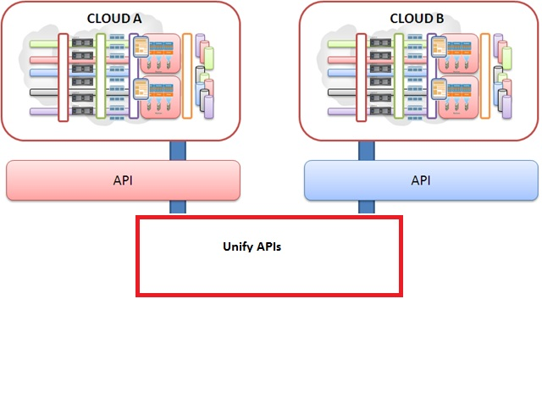
Unified Cloud Interface Features
Unify various Cloud APIs
Abstract API behind an open and standardized Cloud interface
Key driver: create an API about other APIs.

Slide 17
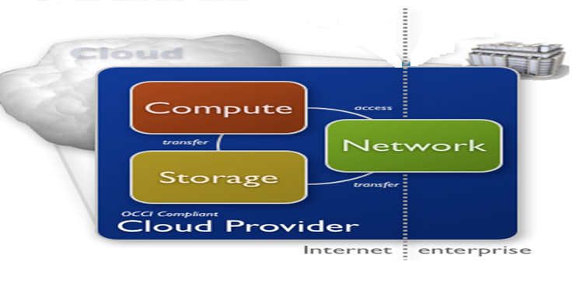
Unified Cloud Interface Features
A common interface for the interaction between remote platforms, networks, ….

Slide 18
Unified Cloud Interface Features
Unify various Cloud APIs
A common interface for the interaction between remote platforms, networks,…
Having a common set of Cloud definitions
The important parts are a specification and a schema
Address both the platforms as service offerings as well as infrastructure Cloud platforms

Slide 19
Enterprise Cloud Orchestration Platform /Orchestration Layer

Slide 20
Enterprise Cloud Orchestration Platform /Orchestration layer
Cordys delivers an enterprise Cloud orchestration platform
Rightscale provides an orchestration layer/Cloud management platform
CSC has recently announced Cloud orchestration services for Cloud services integration

Slide 21
Enterprise Cloud Orchestration Platform Features
Different Cloud service providers can register the Cloud services that they offer with the orchestration layer.
It can use user-computer interface (UCI) for interacting with different CSPs
Client uses only one single API offered by the orchestration layer

Slide 22
Enterprise Cloud Orchestration Platform Challenges
Service level management
Data volumes
Platform support
Others

Slide 23
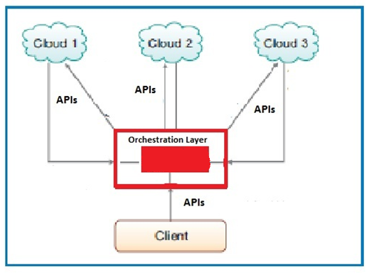
Enterprise Cloud Orchestration Platform Challenges
Service level management
Data volumes
Platform support
Others

Slide 24
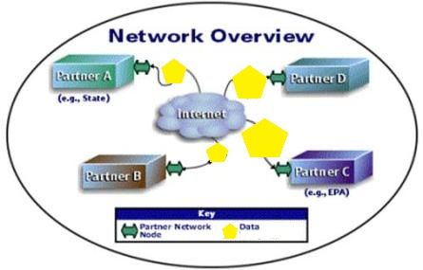
Enterprise Cloud Orchestration Platform Challenges
Service level management
Data volumes
Platform support
Others

Slide 25
Enterprise Cloud Orchestration Platform Challenges
Service level management
Data volumes
Platform support
Others

Slide 26
DMF
DMF (Data-centric Management Framework) is a Cloud orchestration programming and execution framework
DMF models resources and their state as structured data
Access and update resource data and handle exceptions

Slide 27
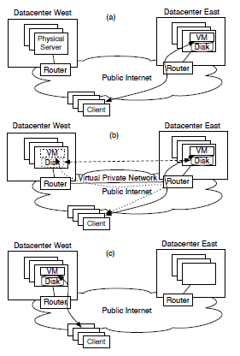
DMF Scenario
(a) Initial setup with a VM and its associated storage in Datacenter East
(b) VPN is established between the two data centers
(c) Traffic between the clients and the VM takes the direct path to Datacenter West

Slide 28
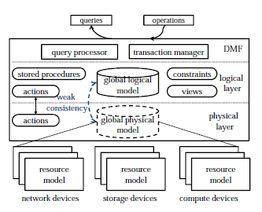
DMF
Maintains a conceptually centralized data repository of all the resources
For every resource object, there are two copies:
Primary copy at the physical layer
Secondary copy at the logical layer.
Views are used to reason about the current
Constraints specify the policies that reflect service and engineering rules

Slide 29
DMF (cont’d)
Actions are the atomic operations that the resources provide
Transactions specified in stored procedures

Slide 30
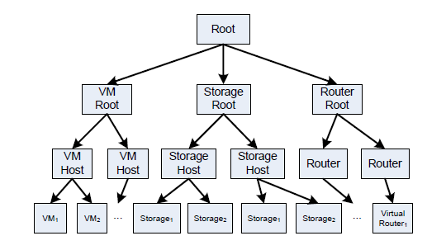
DMF Data Model
Each tree node is an object (entity)
An entity may have multiple attributes
One-to-many and one-to-one relations

Slide 31
DMF Language
The programming language of DMF is a domain-specific language for query processing and data manipulation of structured data that supports:
Views
Constraints
Actions
Stored procedures

Slide 32
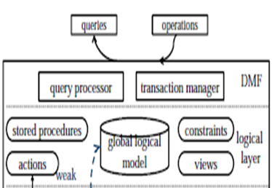
DMF Transaction
Transaction is the basic unit of orchestration in DMF
Transactions are atomic, consistent, isolated and durable and are realized in DMF as stored procedures

Slide 33
DMF (Data-centric Management Framework)
The execution of transaction occurs in two phases:
First phase:
All operations in the transaction are executed at the logical layer
At the end of this phase, all integrity constraints are checked on the logical model
Second phase:
Re-plays all the actions in the execution log, executing the physical variant of each action
If any action fails during the second phase, the transaction is aborted in both layers

Slide 34
Related Work
Development of interoperability standards: for example the distributed management task force's Open Virtualization Format (OVF) standard (http://www.dmtf.org) or open grid forum's Open Cloud Computing Interface (OCCI) (http://www.ogf.org/)
Creation of cross-cloud management tools: for example the Deltacloud open source project (http://deltacloud.org) sponsored by Red Hat or 3Tera's (now CA) AppLogic Platform (http://www.3tera.com/AppLogic/)
Provision of Cloud management services: for example this month Fujitsu Australia has begun to offer a single point of customer interaction for the provision and coordination of any type of Cloud service (http://www.fujitsu.com/au/services/infrastructure/cloud/).

Slide 35
Conclusion
There are different clouds from companies such as Microsoft, Amazon, IBM, and Google, but a lack of interoperability between them
Interoperability and standardization have huge impact on the cloud adoption and usage
Enterprises do not wish to tie their applications to specific providers’ remote infrastructure

Slide 36
References
Parameswaran, A. and A. Chaddha "Cloud Interoperability and Standardization." cloud computing: pinnacle of IT Infrastructure democratization: 19.
Changbin Liu, Y. M., Jacobus E. Van der Merwe,Mary F. Fernández (2010). "Cloud Resource Orchestration: A DataCentric Approach.", http://www.research.att.com/export/sites/att_labs/techdocs/TD_100222.pdf.
Bumpus, W. (2009). "Will Cloud Computing be Open and Interoperable?", www.dmtf.org
Higgins, S. "Addressing the challenge of cloud interoperability ", http://www.bdstrategy.com.au/cloud-computing/12-cloud-computing.
Jin, S. (2010). "A Big Cloud Challenge: Cross Stack Portability", http://blogs.vmware.com/vcloud/2010/08/a-big-cloud-challenge-cross-stack-portability.html.
Lawton, G. (September 2009). "Addressing the Challenge of Cloud-Computing Interoperability.", http://www.computer.org/portal/web/computingnow/archive/news031
Lithicum, D. "The truth about lock-in and cloud computing.", http://www.infoworld.com.
vambenepe, W. "Moving towards utity/cloud computing standards?", http://stage.vambenepe.com/

Slide 37
Questions?

