Slide 1
Cloud Operating Systems
Milad Jalalimehr
Advanced Topics in Information Systems
Mazandaran University of Science and Technology
milad.jalalimehr@gmail.com
Supervisor : Mr. Hadi Salimi
February, 2011

Slide 2
Agenda
Introduction
Definitions
Cloud Operating Systems
Paradigm
Architecture
Challenges
Current Cloud Operating Systems (Samples)
Conclusion
References
2 / 18

Slide 3
Introduction
Definitions:
Distributed System (DS)
Cloud
What is a
Cloud OS?
3 / 18

Slide 4
Why Do You Need A Cloud Operating System?
Proceed in use of computing services.
Clouds have the potential to provide novel compute capacity to the average user.
Also provides more facilities for IT professionals.
4 / 18
Notes:
Nowadays Users have proceeded from using mainframes to personal computers to laptops, and most recently, to multicore and cloud computers.
Two emergent classes of computational hardware that have the potential to provide novel compute capacity to the average user are cloud computers (CC) and multicore processors (MP) are.

Slide 5
Why Do You Need A Cloud Operating System?
(Continued)
In order for the user to effectively control all of this computational power, We need an operating system for these new hardware platforms.
5 / 18

Slide 6
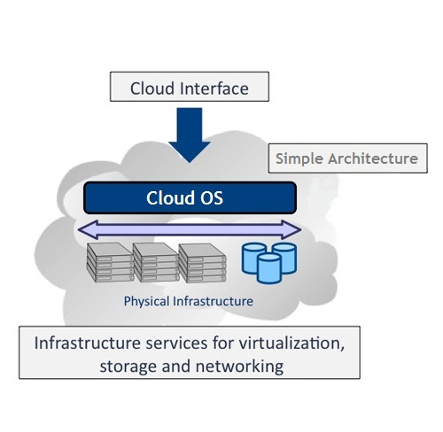
What is a Cloud Operating System?
A simple definition:
The Cloud OS manages a number of servers and hardware devices, Giving the users the impression that they are interacting with a single infinite capacity and elastic cloud.
6 / 18

Slide 7
Paradigm
Paradigm used in Cloud Operating System:
Object
Thread
Object-Thread Model
7 / 18

Slide 8
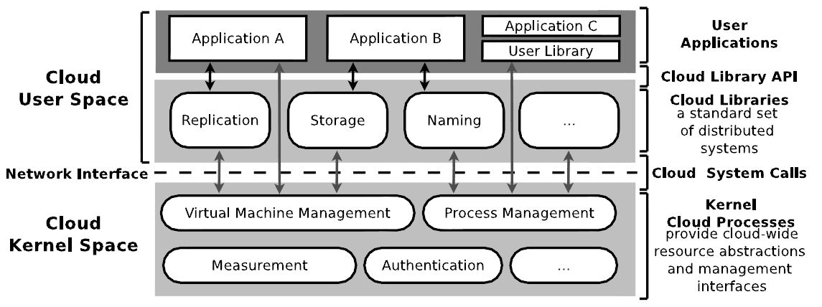
Architecture
8 / 18

Slide 9
Common Challenges
Cloud computing infrastructure presents many common challenges with respect to the operating system. Such as:
Scalability
Elasticity of Demand
Faults
9 / 18

Slide 10
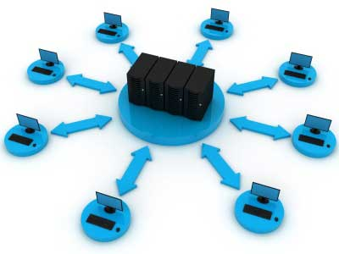
Scalability
The number of computers being added by cloud computing providers has been growing at a vast rate, driven largely by user demand for hosted computing platforms.
Cloud OS’s need to embrace scalability and make it a first order design constraint.
10 / 18
Notes:
Concurrent with the multicore revolution, cloud computing and IaaS systems have
been gaining popularity. This emerging computing paradigm has a huge potential to
transform the computing industry and programming models. The number of computers
being added by cloud computing providers has been growing at a vast rate, driven
largely by user demand for hosted computing platforms. The resources available to a
given cloud user is much higher than is available to the non-cloud user. Cloud resources
are virtually unlimited for a given user, only restricted by monetary constraints. Example
public clouds and IaaS services include Amazon’s EC2 and Rackspace’s Cloud
Server. Thus, it is clear that scalability is a major concern for future OS’s in both
single machine and cloud systems.

Slide 11
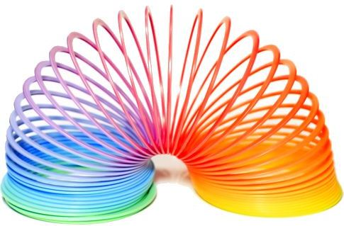
Elasticity of Demand
A major commonality between clouds is that the demand is not static.
Furthermore, the variability of demand is much higher than in previous systems and the amount of available resources can be varied over a much broader range.
11 / 18
Notes:
We define elasticity as the aspect of a system where parameters such as demand, workloads,
and available resources change dynamically over time. By definition, manycore
systems provide a large number of general-purpose, schedulable cores. Furthermore,
the load on a manycore system translates into number of cores being used. Thus the
system must manage the number of live cores to match the demand of the user. For
example, in a 1,000-core system, the demand can require from 1 to 1,000 cores. Therefore,
multicore OS’s need to manage the number of live cores in contrast to managing
whether a single core is used or idle.
In cloud systems, user demand can grow much larger than in the past. Additionally,
this demand is often not known ahead of time by the cloud user. It is often the case that
users wish to handle peak load without over-provisioning. In contrast to cluster systems
where the number of cores is fixed, cloud computing makes more resources available
on-demand than was ever conceivable in the past.
A major commonality between cloud computing and manycore systems is that the
demand is not static. Furthermore, the variability of demand is much higher than in
previous systems and the amount of available resources can be varied over a much
broader range in contrast to single-core or fixed-sized cluster systems.

Slide 12
Faults
Cloud applications usually share cloud resources with other users and applications in the cloud.
The likelihood of software faults in clouds are high, Due to the inherent difficulty of writing multithreaded applications.
12 / 18
Notes:
Managing software and hardware faults is another common challenge for future manycores
and cloud systems. In manycore systems, hardware faults are becoming more
common. As the hardware industry is continuously decreasing the size of transistors
and increasing their count on a single chip, the chance of faults is rising. With hundreds
or thousands of cores per chip, system software components must gracefully support
dying cores and bit flips. In this regard, fault tolerance in modern OS’s designed for
manycore is becoming an essential requirement.
In addition, faults in large-scale cloud systems are common. Cloud applications usually
share cloud resources with other users and applications in the cloud. Although each
users’ application is encapsulated in a virtual container (for example, a virtual machine
in an EC2 model), performance interference from other cloud users and applications
can potential impact the quality of service provided to the application.
Programming for massive systems is likely to introduce software faults. Due to the
inherent difficulty of writing multithreaded and multiprocess applications, the likelihood
of software faults in those applications is high. Furthermore, the lack of tools to
debug and analyze large software systems makes software faults hard to understand
and challenging to fix. In this respect, dealing with software faults is another common
challenge that OS programming for manycores and cloud systems share.

Slide 13
Current Cloud Operating Systems
Available Cloud Operating Systems:
VMware vSphere 4
Ubuntu Enterprise OS
And Web-Based Cloud Operating Systems
13 / 18

Slide 14
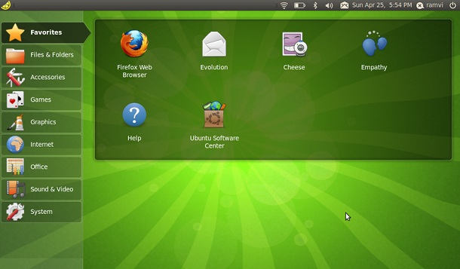
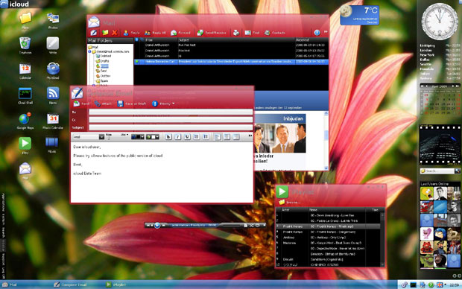
Web-Based Cloud Operating Systems
iCloud
eyeOS
Glide OS
g.ho.st
14 / 18

Slide 15
Conclusion
Design goals and chief design features:
Support for object-thread computational model
Network-transparent object invocation
Persistent storage
Sharing via objects
Automatic load balancing
15 / 18

Slide 16
References
[1] F.Pianese, P.Bosch, A.Duminuco, N.Janssens, T.Stathopoulos, M.Steiner, “ Toward a Cloud Operating System,” Network Operations and Management Symposium Workshops (NOMS Wksps), 2010.
[2] I. Foster, C. Kesselman, J. M. Nick, and S. Tuecke, “The physiology of the grid: An open grid services architecture for distributed systems integration,” in Open Grid Service Infrastructure WG, Global Grid Forum, 2002.
[3] “Amazon EC2.” [Online] http://aws.amazon.com/ec2.
[4] D. Nurmi, R. Wolski, C. Grzegorczyk, G. Obertelli, S. Soman, L. Youseff, and D. Zagorodnov, “The eucalyptus open-source cloud-computing system,” in Proc. of Cloud Computing and Its Applications, Oct. 2008.
[5] F. Chang, J. Dean, S. Ghemawat, W. C. Hsieh, D. A. Wallach, M. Burrows, T. Chandra, A. Fikes, and R. E. Gruber, “Bigtable: A distributed storage system for structured data,” in 7th USENIX Symposium on Operating Systems Design and Implementation (OSDI), 2006.
[6] S. J. Mullender, G. van Rossum, A. S. Tanenbaum, R. van Renesse, and H. van Staveren, “Amoeba: A distributed operating system for the 1990s,” IEEE Computer, vol. 23, no. 5, pp. 44–53, 1990.
[7] E. V. Hensbergen, N. P. Evans, and P. Stanley-Marbell, “A unified execution model for cloud computing,” in In Proc. of the 3rd ACM SIGOPS International Workshop on Large Scale Distributed Systems and Middleware (LADIS), 2009.
16 / 18

Slide 17
References
(Continued)
[8] E. M. Maximilien, A. Ranabahu, R. Engehausen, and L. C. Anderson, “Toward cloud-agnostic middlewares,” in Proceedings of OOPSLA ’09, (New York, NY, USA), pp. 619–626, ACM, 2009.
[9] E. K. Lua, J. Crowcroft, M. Pias, R. Sharma, and S. Lim, “A survey and comparison of peer-to-peer overlay network schemes,” IEEE Communications Survey and Tutorial, vol. 7, pp. 72–93, March 2004.
[10] SETI@Home. [Online] http://setiathome.berkeley.edu.
[11] G. Fox, D. Gannon, S.-H. Ko, S. Lee, S. Pallickara, M. Pierce, X. Qiu, X. Rao, A. Uyar, M. Wang, and W. Wu, Peer-to-Peer Grids. John Wiley and Sons Ltd, 2003.
[12] I. Foster and A. Iamnitchi, “On death, taxes, and the convergence of peer-to-peer and grid computing,” in In 2nd International Workshop on Peer-to-Peer Systems (IPTPS), pp. 118–128, 2003.
[13] N. Drost, R. van Nieuwpoort, and H. Bal, “Simple locality-aware coallocation in peer-to-peer supercomputing,” in Proceedings of the 6th IEEE/ACM CCGrid Symposium, 2006.
[14] J. Ritter, “Why gnutella can’t scale. No, really.” [Online] http://www.darkridge.com/ jpr5/doc/gnutella.html., Feb 2001.
[15] J. Albrecht, R. Braud, D. Dao, N. Topilski, C. Tuttle, A. C. Snoeren, and A. Vahdat, “Remote Control: Distributed Application Configuration, Management, and Visualization with Plush,” in Proceedings of the Twenty-first USENIX LISA Conference, November 2007.
17 / 18

Slide 18
Thanks..
Any Question?

