Slide 1
Pricing Model In Cloud Computing
By:
Hoda Mohammadi
Hoda.mohammadi66@gmail.com
Supervisor:
Mr Hadi Salimi
Mazandaran University of Science and Technolory
February 2011

Slide 2
Introduction
Pricing is an important role in the marketplace that has been considered in economics.
Two factors that impact pricing are:
Fairness
Competition

Slide 3
Pricing fairness
Pricing fairness consists of two aspects:
personal fairness Subjective
Social fairness Objective

Slide 4
Pay as you go model
Lets users to utilize a public cloud instead of using dedicated private cloud at a slice of the cost.
Allowing providers to benefit from users by serving a public cloud.
The pricing plan becomes an important bridge between users and provider

Slide 5
the desirable properties for resource allocation are:
Individual Rationality
Incentive Compatibility
Budget Balance
Pareto Efficiency

Slide 6
Two approaches for evaluations
Black Box Approach with Amazon EC2
Spring

Slide 7
Methodology on Amazon EC2
We calculate users’ expenses when they execute a task in Amazon:
Cost _{user} =Price × t
The price per virtual machine hour
The total running time of the task in hours

Slide 8
Methodology on the spring system
Spring virtualized the basic physical data center and provides virtual machines to user.
Spring have two major modules:
VMM(Virtual Machine Monitors)
An Auditor

Slide 9
Hamilton’s Estimations
we calculate the total cost of the full burdened power consumption
Cost _{full} =(ρ - P _{raw}-PUE)
The PUE value of data center
Electricity Price(dollars per kWh)
The total energy consumption of IT equipments(kWh)

Slide 10
The total provider cost :
Cost _{provider} =(Cost _{full} + Cost _{amortized}) × Scale
Total amortized server cost
Ratio of the estimated total cost to the sum of the cost of full burdened and power consumption and Cost _{amortized}

Slide 11
We estimate the amortized cost per server:
Cost _{amortized} = (C _{amortizedUnit} × t_{server})
the elapsed time on the server (hours)
the amortized cost per hour per sever

Slide 12
We estimating the energy consumption based on resource utilization:
P _{server} =P _{idle} +U _{cpu} × C₀ + U _{io} × C₁
the coefficients in the model
CPU utilization
I/O bandwidth

Slide 13
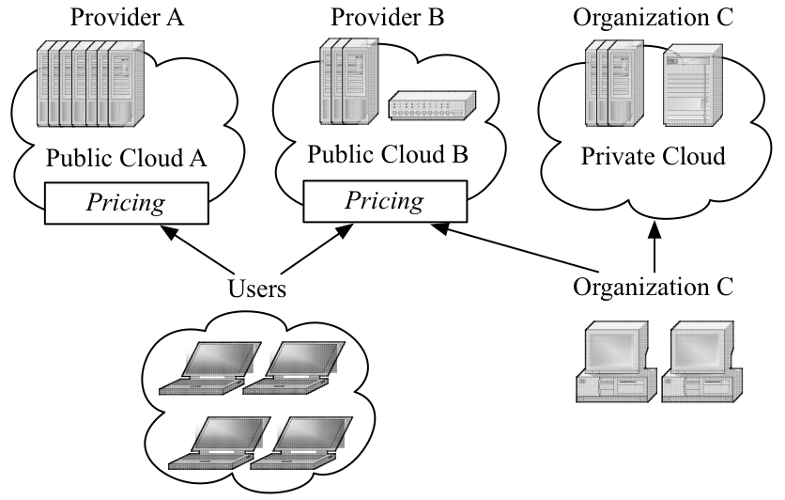
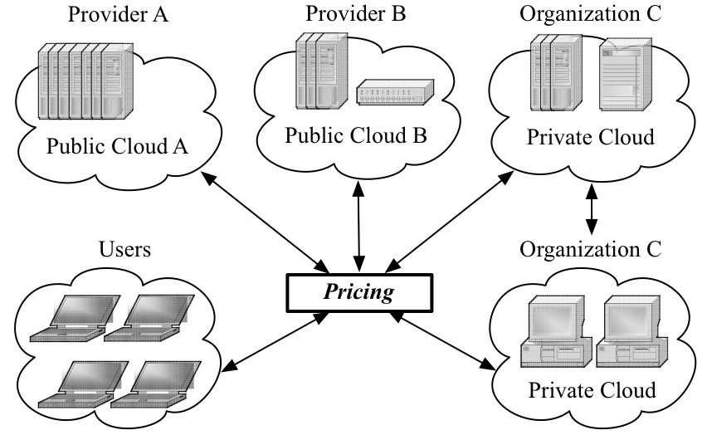
Federated Cloud vs. Standalone Cloud Service Provider
a. Standalone Cloud Service Provider
b. Federated Cloud

Slide 14
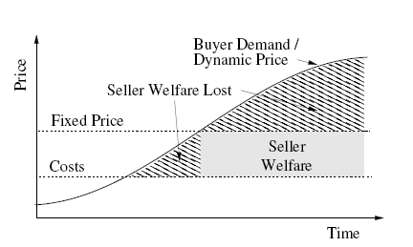
What Is Dynamic Pricing?
we discuss a strategic-proof dynamic pricing scheme suitable
for allocating resources on federated clouds, where pricing is
used to manage rational users. A rational user may represent
either an individual user, a group, or an organization,
depending on the application context
Fixed Pricing limits seller welfare

Slide 15
Pricing Mechanism
K-Pricing is an alternative pricing mechanism to proportional critical value pricing
for double-sided combinatorial auctions. The basic idea is to distribute the welfare generated by the allocation mechanism between buyers and service providers according to a factor k

Slide 16
Three Forms Of Pricing Model
Tiered Pricing Amazon's Cloud Systems
Per-Unit Pricing Data Transfer And
Memory Use, more flexibility .
Subscription-Based Pricing Pricing Model In Saas

Slide 17
Tiered Pricing
adopted by Amazon's cloud systems, where the cloud services are offered in several tiers
each tier offer fixed computing specifications

Slide 18
Per-Unit Pricing
applied to data transfers or memory usage
This model is, arguably more flexible than the
tiered pricing, as it allows the users to customize the main memory allocation of their system based on their specific applications' needs.

Slide 19
Subscription-Based Pricing
the most-widely used pricing model for SaaS
This model allows the users to predict their periodic expenses of using the cloud applications.

Slide 20
Conclusion
In this paper we proposed the market-based model on cloud computing environment.
It allows buyers to order an arbitrary composition of services to different service providers
By embracing a pricing scheme that connects providers with users, cloud computing has managed to bridge be-tween distributed systems and economics
Our preliminary study has revealed interesting issues as a
result of the tensions between users and providers and between distributed systems and economics

Slide 21
Reference
[1] Marian, Mihailescu, Yong and Teo, M. Dynamic Resource Pricing on Federated Clouds.
[2] Saure, D., Sheopuri, A., Qu, H., Jamjoom, H. and Zeevi, A. Time-Of-Use Pricing Policies for Offering Cloud Computing as a Service2010).
[3] Wang, H., Jing, Q., He, R. C. B., Qian, Z. and Zhou, L. Distributed Systems Meet Economics: Pricing in the Cloud.
[4] YEE-MING CHEN, H.-M. Y. AUTONOMOUS ADAPTIVE AGENTS FOR MARKET-BASED RESOURCE ALLOCATION OF CLOUD COMPUTING2010).
[5] Mihailescu, M. and Teo, Y. M. On Economic and Computational-efficient Resource Pricing in Large Distributed Systems2010).

Slide 22
Thank you.
Any Questions?

