Slide 1
Cloud programming models
By: Shiva Khalili
Supervisor: Hadi Salimi
Winter 2011

Slide 2
introduction
Cloud computing has caused primary changes in programming concepts.
Their aim is to utilize cloud characteristics.
Some previous programming models are being used in cloud
There is a great need for new programming models

Slide 3
outline
Map reduce
Hadoop
Twister
Oleans
Actor
Dryad
Swift

Slide 4
Programming model
Is software framework and programming language
Shapes the programming concept
Specifies how to program by special method for specific usage
Suggests programming primitives

Slide 5
Map Reduce

Slide 6
Map reduce
A framework for processing huge datasets on certain kinds of distributable problems using a large number of computers
Includes:
Map
reduce

Slide 7
Map reduce programming model
Input reader
Divides the input into appropriate size 'splits'
The framework assigns one split to each Map function
Reads data from stable storage and generates key/value pairs

Slide 8
Map reduce programming model (cont’d)
Map function
Takes an input pair
Produces a set of intermediate key/value pairs
The MapReduce library groups together all intermediate values associated with the same intermediate key

Slide 9
Map reduce programming model (cont’d)
Partition function
Each Map function output is allocated to a particular reducer by the application's partition function for sharding purposes. The partition function is given the key and the number of reducers and returns the index of the desired reduce

Slide 10
Map reduce programming model (cont’d)
Comparison function
The input for each Reduce is pulled from the machine where the Map ran and sorted using the application's comparison function

Slide 11
Map reduce programming model (cont’d)
Reduce function
Accepts an intermediate key I and a set of values for that key
merges together these values to form a possibly smaller set of values

Slide 12
Map reduce programming model (cont’d)
Output writer
The Output Writer writes the output of the Reduce to stable storage

Slide 14
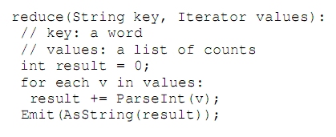
example
Problem of counting the number of occurrences of each word in a large collection of documents

Slide 15
hadoop

Slide 16
hadoop
Apache Hadoop is a software framework that supports data-intensive distributed applications under a free license
Hadoop includes these subprojects:
Hadoop common
HDFS

Slide 18
Programming model
Hadoop provides two basic programming models
The first one is:
A collection of Java classes
The application needs to extend a base class called MapReduceBase
Implement the Mapper and Reducer interfaces
Specifying the data types of the input and output data
Then registers its Mapper and Reducer classes into a Hadoop job

Slide 19
The second one is:
To use a domain language called Pig
Pig defines keywords such as FOREACH, GROUP, and GENERATE
Using Pig, a developer can write a Hadoop application in a matter of a few lines of code
map_result = FOREACH webpage GENERATE FLATTEN(count_word_occurrences(*));
key_groups = GROUP map_result BY $0;
output = FOREACH key_groups GENERATE sum_word_occurrences(*);

Slide 20
twister

Slide 21
ITERATIVE MAPREDUCE WITH TWISTER
Utilize two types of data products :
Static
Dynamic
Use many iterations until convergence
Some requires reduce output as a whole to make the decision to continue or stop iterations

Slide 22
Static vs. Variable Data
Static data:
Is used in each iteration and remain fixed throughout the computation
Variable data:
Is the computed results in each iteration and typically consumed in the next iteration
Twister introduces a “configure” phase for map and reduce tasks

Slide 23
Long Running Map/Reduce Tasks
Reading static data in each execution of the MapReduce computation is highly inefficient
This observation led us to explore the idea of using long-running (cacheable) map/reduce tasks
Side-effect-free Programming

Slide 24
Combine operation
Most iterative MapReduce computations require accessing the “combined” output of the reduce tasks to determine whether to proceed with another iteration or not
Twister introduces a new phase to MapReduce named “Combine” that acts as another level of reduction

Slide 25
Programming Extensions
Twister incorporates a set of programming extension to MapReduce
mapReduceBCast(Value value)
configureMaps(Value[]values)
configureReduce(Value[]values)

Slide 27
orleans

Slide 28
What is orleans?
A software framework for building cloud applications
Offers a simple programming model
Built around grains
Imposes restriction on concurrency

Slide 29
Grain
Logical units of computation with private state that communicate by sending messages
A service is constructed from grains running on the server
At any time ,may have zero ,one or multiple activations

Slide 30
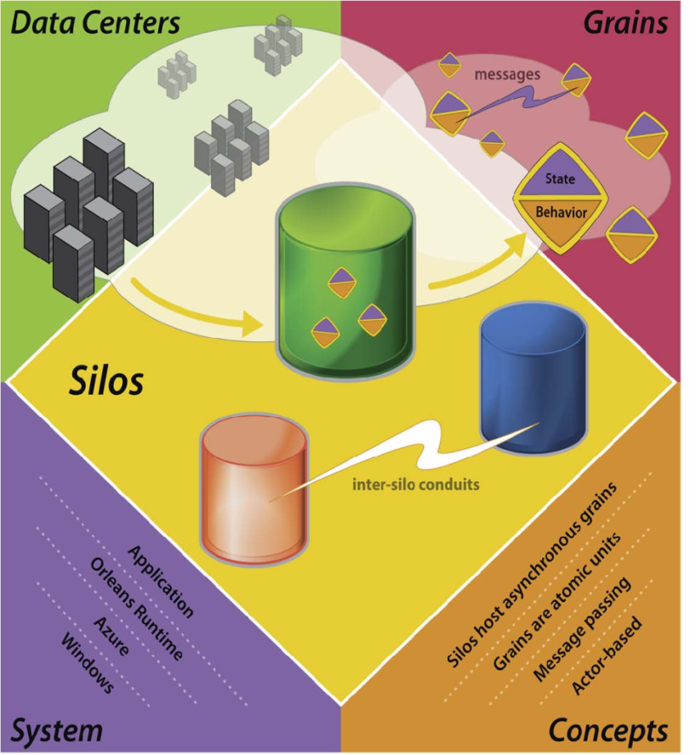
Introduction
What is its scope?
Client+cloud computing
Combine diverse client devices
Ubiquitous computing
What is the challenge?
Client + cloud computing is parallel and distributed
Should be highly available, reliable and secure
The key challenge is scale

Slide 31
Grain (cont’d)
Activation
The physical instantiation of a grain on a server
Processes an external request to completion before turning to the subsequent request
Are Completely isolated
Can not share memory or invoke each others methods directly
Can place independently on any server
Can migrate between servers

Slide 32
Grain (cont’d)
Security
Communicate only through a reference to another
A logically isolated workspace called grain domain
Delimits the set of grains it can directly access
Domains are hierarchical and nested
As an example: orleans consider a grain domain for each customer

Slide 33
Transactions
Orleans offer transactions for three reasons:
Isolate concurrent computations
Replication of data and computation
Reduce the need for explicit error handling code

Slide 34
Communications
Occurs through asynchronous messages between grains
Most messages follow request/reply pattern
May designate certain messages as event notification
In future will use single request, multile-reply pattern
Are exposed at method calls
Unlike traditional RPC model, these calls return immediately with a promise

Slide 35
Programming model

Slide 36
Asynchrony and Promises
Orleans uses promises as asynchrony primitives
Promises are fully integrated with the .NET async models.
Promises have a simple lifecycle

Slide 37
Asynchrony and Promises (cont’d)
A caller that invokes an asynchronous operation do one or more of the following:
Synchronously wait for the promise to resolve
Schedule a continuation action with the continueWith() method

Slide 38
Asynchrony and Promises (cont’d)
Return the promise, if the caller itself is an asynchronous method with a compatible return type
Join the promise with other promises, producing another promise
Explicitly ignore the outcome of promise resolution with the ignore() method

Slide 39
Grain interfaces
A grain class implements one or more public grain interfaces that define service contracts.
A grain interface is an interface that adheres to the following rules:
A grain interface must directly or indirectly inherit from the Igrain marker interface
All methods and property getters must be asynchronous
No property setters and no subscribe/unsubscribe to events

Slide 40
Grain interfaces (cont’d)
Method arguments must be grain interface types
For example:

Slide 41
Grain references
A grain reference is a proxy object that provides access to a grain
A grain reference is the only way that a client, whether another grain or a non-grain client, can access a grain
A grain reference can be in one of the three possible states: unresolved, fulfilled or broken

Slide 42
Grain state
The state of a grain is managed by the Orleans runtime
May be in the state of:
Initialization
Persistence
Replication
Migration

Slide 43
Actor model

Slide 44
Actor model
Mathematical theory of computation that treats “Actors” as the universal primitives of concurrent digital computation
Actor model:
Was influenced by programming languages Lisp and Smalltalk-72
As well as ideas for packet switching and capability-based systems

Slide 45
Actor
An Actor is a computational entity that, in response
to a message it receives, can concurrently:
send a finite number of messages to other Actors
create a finite number of new Actors
designate the behavior to be used for the next message it receives

Slide 46
Actor creation
Actors are created by evaluating a behavior abstraction
The identifier bindings when the abstraction is evaluated are gathered together into a vector of acquaintances

Slide 47
Actor primitives
Send
Send is for sending messages; send(a;v) creates a new message with receiver a and contents v and puts the message into the message delivery system
Become
become is for changing behavior; become(b) creates an anonymous actor to carry out the rest of the current computation, alters the behavior of the actor executing the become to be b, and frees that actor to accept another message.

Slide 48
Actor primitives (cont’d)
Letactor
Letactor is for actor creation. Letactor {x:= b}e creates an actor with initial behavior b, making the new address the value of the variable x. The expression e is evaluated in the extended environment.

Slide 49
Dryad

Slide 50
Dryad Overview
Dryad goals:
General-purpose execution environment for distributed, data-parallel applications
Automatic management of scheduling, distribution, fault tolerance, etc.
Computations expressed as a graph
Vertices are computations
Edges are communication channels
Each vertex has several input and output edges

Slide 51
Three main inspirator of dryad:
Shader languages developed for graphic processing units (GPUs)
Google’s Map Reduce system
Parallel databases

Slide 52
V
V
V

Slide 53
Job = Directed Acyclic Graph
Outputs
Processing
vertices
Channels
(file, pipe,
shared
memory)
Inputs
Notes:
A dryad application is composed of a collection of processing vertices (processes).
The vertices communicate with each other through channels.
The vertices and channels should always compose into a directed acyclic graph.

Slide 54
Describing a dryad graph
A simple language is designed to specify commonly-ocurring communication idioms
Currently embedded C++ as a library
Using a mixture of method calls and operator overloading
The basic object in the language is a graph
Graphs are constructed by combining simpler subgraphs using a small set of operations
All of the operations preserve the property that the resulting graph is acyclic

Slide 55
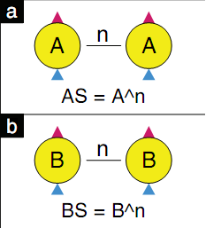
Creating new vertices
The Dryad libraries deﬁne a C++ base class from which all vertex programs inherit
Each such program has a unique textual name
Static factory
A graph can be cloned into a new graph containing k copies of its structure using the ^ operator where C = G^k is deﬁned as:

Slide 56
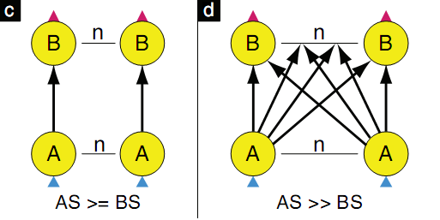
Adding graph edges
New edges are created by applying a composition operation to two existing graphs
We deﬁne two standard compositions:
A>=B
A>> B

Slide 57
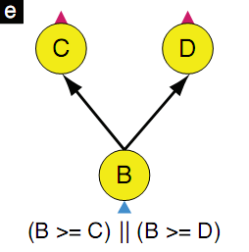
Merging two graphs
By using || operation, this language merges two graphs and create a new graph

Slide 58
An example graph builder program

Slide 59
swift

Slide 60
Using swift

Slide 61
Challenges for Parallel Scripting
Mastering the complex scripts needed to distribute tasks and data to multiple remote systems, gather results, and record the provenance of these derived results
The mechanisms to keep a petascale machine efficiently utilized using such scripts have not previously existed

Slide 62
Swift abilities
Treating file data and in-memory data in a uniform way, with a data typing and mapping model
Associating interface definitions with scripts and their internal functions, based on the data model
Supporting location-independent execution across diverse runtime environments (workstation, cluster, Grid, cloud, and petascale)
Enabling integrated, transparent provenance tracking

Slide 63
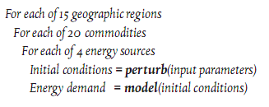
Swift semantics
Task synchronization in swift
Is based on data availability
Swift “foreach” statement

Slide 64
Collective data managemenet
Is used in any similar style of “many task computation”
Focuses on the design and implementation of a set of operations for exchanging files within scripts

Slide 65
Collective data managemenet (cont’d)
Provide primitives that the programmer can use explicitly
May already be used via custom scripts
Generally difficult to specify with sequential languages

Slide 66
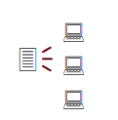
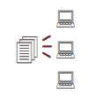
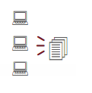
Collective data managemenet (cont’d)
Broadcast (aggregation, map):
Scatter (two-phase):
Gather (aggregation, reduce):

Slide 67
conclusion
Most of these programming models are based on parallel programming using graph theory
Some of them use new entities for their models and some of them have adopted from previous models
Recently have emerged new programming models and in future the other ones will appear

Slide 68
References
Isard M, Budiu, M Yu Y, Birrell A, Fetterly D," Dryad: distributed data-parallel programs from sequential building blocks ", ACM SIGOPS Operating Systems Review, Vol 41, No. 3, pp. 59-72, 2007
Dryad,http://research.microsoft.com/en-us/projects/Dryad/
Yeung, JHC, Tsang, CC, Tsoi, KH, Kwan, BSH, Cheung, CCC, Chan APC, Leong PHW, "Map-reduce as a Programming Model for Custom Computing Machines", Dept. of Computer Science and Engineering The Chinese University of Hong Kong, Shatin NT, Hong Kon.
Ralf Lammel, "Google’s MapReduce programming model — Revisited",Science of Computer Programming, Vol.70, pp 1-30, 2008

Slide 69
References (cont’D)
Ekanayake J, Li H, Zhang B, Gunarathne T, Bae SH, Qi, J, Fox G, "Twister: A runtime for iterative MapReduce", ACM, pp. 810-818, 2010
Hadoop’s Programming Model, http://adcalves.wordpress.com/2010/12/12/a-hadoop-primer/
Hadoop, http://hadoop.apache.org/
Hadoop,http://en.wikipedia.org/wiki/Hadoop#Job_Tracker_and_Task_Tracker:_the_MapReduce_engine
Twister, http://www.iterativemapreduce.org/

Slide 70
References (cont’D)
Bykov S, Geller A, Kliot G, Larus J, Pandy, R, Thelin J, "Orleans: A Framework for Cloud Computing".
Orleans: A Framework for Cloud Computing, http://research.microsoft.com/en-us/projects/orleans/
Agha GA, Mason IA, Smith SF, Talcott, CL, "A foundation for actor computation",Journal of Functional Programming, Vol. 7, No.01, pp.1-72, 1997.
Hewitt C, "Actor model of computation", Arxiv preprint arXiv:1008:1459.
Clinger WD, "Foundations of actor semantics", 1981

Slide 71
References (cont’D)
Beckman P, Foster I, Wilde M, "Scalable Parallel Scripting for scientific computing", spring 2010
Wilde M, Foster I, Iskra K, Beckman P, Zhang Z, Espinosa A, Hategan M, Clifford B, Raicu I, "Parallel scripting for application at petascale and beyond", Computer, Vol. 42, No.11, pp. 50-60, 2009.
Wozniak JM, Wilde M, "Case studies in storage access by loosly coupled petascale applications", ACM, 16-20, 2009.
Swift, http://www.ci.uchicago.edu/swift/index.php
Data Intensive Scalable Computing on TeraGrid: A Comparison of MapReduce and Swift, http://dsl-wiki.cs.uchicago.edu/index.php/Data_Intensive_Scalable_Computing_on_TeraGrid:_A_Comparison_of_MapReduce_and_Swift

Slide 72
Commence tomato throwing!

