Slide 1
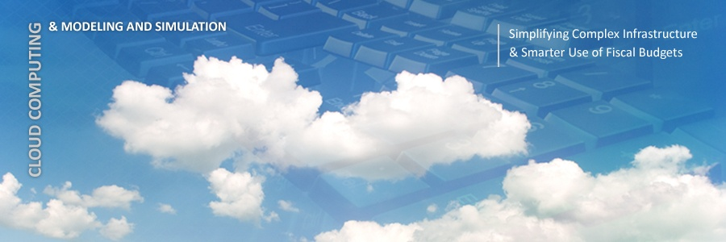
Simulation of Cloud Environments
By : Mahdieh Isfahani
isfahanimahdieh@yahoo.com
Final Seminar,
Advanced Topics in Information Systems - Cloud Computing,
Advisor: Hadi Salimi
School of Mazandaran University of Science & Technology

Slide 2
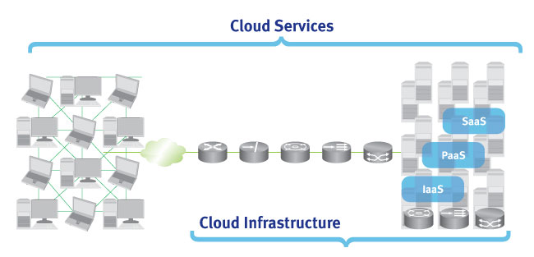
Introduction
Cloud computing delivers infrastructure, platform, and software.

Slide 3
Introduction (cont’d)
Quantifying the performance of provisioning policies in a real Cloud computing environment for different application models under transient conditions is extremely challenging.
Approach: use of simulation tools
Allowing them to:
Test their services in repeatable and controllable environment;
Tune the system bottlenecks before deploying on real clouds;

Slide 4
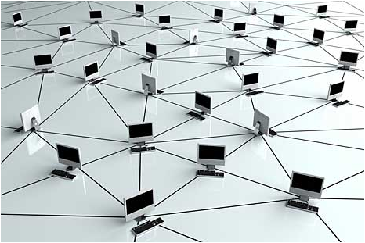
Introduction (cont’d)
CloudSim: a new, generalized, and extensible simulation framework that allows
Experimentation of emerging Cloud computing infrastructures and application services.

Slide 5
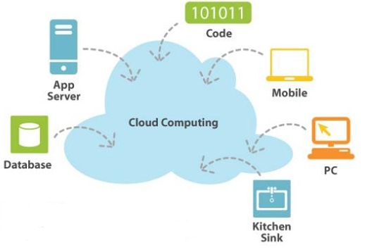
Background
Cloud computing
a type of parallel and distributed system consisting of a collection of inter-connected and virtualized computers that are dynamically provisioned, and presented as one or more unified computing resources based on service-level
agreements established
through negotiation between
the service provider and
consumers

Slide 6
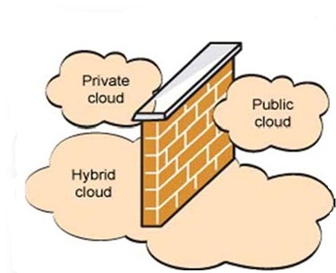
Background (cont’d)
Cloud deployment models
Hybrid cloud
Private cloud
Public cloud
Writing the software for any of the Cloud models is a complex undertaking.
Challenges: Service discovery, Monitoring, Deployment of virtual machines and Applications

Slide 7
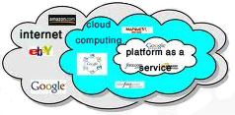
Background (cont’d)
By supplying a platform in which strategies for each element can be tested in a controlled and reproducible manner.
Simulation frameworks are important

Slide 8
Related Work
SimGrid is a generic framework for simulation of distributed applications on Grid platforms.
GangSim is a Grid simulation toolkit that provides support for modeling of Grid-based virtual organizations and resources.
GridSim is an event-driven simulation toolkit for heterogeneous Grid resources.

Slide 9
Related Work (cont’d)
None of them are able to
Isolate the multi-layer service abstractions differentiation required
Virtualized infrastructures
Modeling data-center type

Slide 10
Proposed approach
A suitable alternative is the utilization of CloudSim
It allows Cloud customers to
test their services in repeatable and controllable environment
to tune the performance bottlenecks before deploying on real Clouds.

Slide 11
Proposed approach(cont’d)
Features:
Support for modeling and simulation of large scale Cloud computing environments
A self-contained platform for modeling Clouds, service brokers, provisioning, and allocations policies
Support for simulation of network connections

Slide 12
Proposed approach(cont’d)
The primary objective of this approach is:
to provide a generalized and extensible simulation framework

Slide 13
Design and Implementation of CloudSim
CloudSim
This class models a broker, which is responsible for mediating negotiations between SaaS and Cloud providers
Network Topology
DatacenterBroker
VmmAllocationPolicy
Datacenter
DatacenterCharacteristics
DatacenterBroker
SAN Storage
VmmAllocationPolicySimple
FederatedDatacenter
CloudCoordinator
sensor
Cloudlet
VM
CloudletScheduler
BwProvisioner
Host
RamProvisioner
CloudletScheduler
Timeshared
CloudletSchedulerSpaceShared
BwProvisionerSimple
VmScheduler
RamProvisionerSimple
VmSchedulerTimeShared
VmSchedulerSpaceShared

Slide 14
Design and Implementation of CloudSim
CloudSim
Network Topology
Datacenter
VmmAllocationPolicy
Datacenter
DatacenterCharacteristics
DatacenterBroker
SAN Storage
VmmAllocationPolicySimple
FederatedDatacenter
CloudCoordinator
sensor
Cloudlet
A set of compute hosts that can either be homogeneous or heterogeneous with respect to their hardware configurations
VM
CloudletScheduler
BwProvisioner
Host
RamProvisioner
CloudletScheduler
Timeshared
CloudletSchedulerSpaceShared
BwProvisionerSimple
VmScheduler
RamProvisionerSimple
VmSchedulerTimeShared
VmSchedulerSpaceShared

Slide 15
Design and Implementation of CloudSim
CloudSim
Network Topology
DatacenterCharacteristics
VmmAllocationPolicy
Datacenter
DatacenterCharacteristics
DatacenterBroker
SAN Storage
VmmAllocationPolicySimple
FederatedDatacenter
CloudCoordinator
sensor
Cloudlet
Configuration information of data center resources.
VM
CloudletScheduler
BwProvisioner
Host
RamProvisioner
CloudletScheduler
Timeshared
CloudletSchedulerSpaceShared
BwProvisionerSimple
VmScheduler
RamProvisionerSimple
VmSchedulerTimeShared
VmSchedulerSpaceShared

Slide 16
Design and Implementation of CloudSim
CloudSim
Network Topology
VmmAllocationPolicy
VmmAllocationPolicy
Datacenter
DatacenterCharacteristics
DatacenterBroker
SAN Storage
VmmAllocationPolicySimple
FederatedDatacenter
CloudCoordinator
sensor
Cloudlet
This class represents a provisioning policy that a VM Monitor utilizes for allocating VMs to Hosts.
VM
CloudletScheduler
BwProvisioner
Host
RamProvisioner
CloudletScheduler
Timeshared
CloudletSchedulerSpaceShared
BwProvisionerSimple
VmScheduler
RamProvisionerSimple
VmSchedulerTimeShared
VmSchedulerSpaceShared

Slide 17
Design and Implementation of CloudSim
CloudSim
Network Topology
VmmAllocationPolicy
Datacenter
DatacenterCharacteristics
DatacenterBroker
SAN Storage
CloudCoordinator
VmmAllocationPolicySimple
FederatedDatacenter
CloudCoordinator
sensor
This class extends a Cloud-based data center to the federation.
Cloudlet
VM
CloudletScheduler
BwProvisioner
Host
RamProvisioner
CloudletScheduler
Timeshared
CloudletSchedulerSpaceShared
BwProvisionerSimple
VmScheduler
RamProvisionerSimple
VmSchedulerTimeShared
VmSchedulerSpaceShared

Slide 18
Design and Implementation of CloudSim
CloudSim
Network Topology
VmmAllocationPolicy
Datacenter
DatacenterCharacteristics
DatacenterBroker
This interface must be implemented to instantiate a sensor component
SAN Storage
sensor
VmmAllocationPolicySimple
FederatedDatacenter
CloudCoordinator
sensor
Cloudlet
VM
CloudletScheduler
BwProvisioner
Host
RamProvisioner
CloudletScheduler
Timeshared
CloudletSchedulerSpaceShared
BwProvisionerSimple
VmScheduler
RamProvisionerSimple
VmSchedulerTimeShared
VmSchedulerSpaceShared

Slide 19
Design and Implementation of CloudSim
CloudSim
This class contains the information for inducing network behavior in the simulation.
Network Topology
Network Topology
VmmAllocationPolicy
Datacenter
DatacenterCharacteristics
DatacenterBroker
SAN Storage
VmmAllocationPolicySimple
FederatedDatacenter
CloudCoordinator
sensor
Cloudlet
VM
CloudletScheduler
BwProvisioner
Host
RamProvisioner
CloudletScheduler
Timeshared
CloudletSchedulerSpaceShared
BwProvisionerSimple
VmScheduler
RamProvisionerSimple
VmSchedulerTimeShared
VmSchedulerSpaceShared

Slide 20
Design and Implementation of CloudSim
CloudSim
Network Topology
This class models a storage area network that is commonly ambient in Cloud-based data centers for storing large chunks of data
VmmAllocationPolicy
Datacenter
DatacenterCharacteristics
DatacenterBroker
SAN Storage
SAN Storage
VmmAllocationPolicySimple
FederatedDatacenter
CloudCoordinator
sensor
Cloudlet
VM
CloudletScheduler
BwProvisioner
Host
RamProvisioner
CloudletScheduler
Timeshared
CloudletSchedulerSpaceShared
BwProvisionerSimple
VmScheduler
RamProvisionerSimple
VmSchedulerTimeShared
VmSchedulerSpaceShared

Slide 21
Design and Implementation of CloudSim
CloudSim
Network Topology
VmmAllocationPolicy
Datacenter
DatacenterCharacteristics
DatacenterBroker
SAN Storage
Cloudlet
This class models the Cloud-based application services
VmmAllocationPolicySimple
FederatedDatacenter
CloudCoordinator
sensor
Cloudlet
VM
CloudletScheduler
BwProvisioner
Host
RamProvisioner
CloudletScheduler
Timeshared
CloudletSchedulerSpaceShared
BwProvisionerSimple
VmScheduler
RamProvisionerSimple
VmSchedulerTimeShared
VmSchedulerSpaceShared

Slide 22
Design and Implementation of CloudSim
This class models a virtual machine, which is managed and hosted by a Cloud host component.
CloudSim
Network Topology
VmmAllocationPolicy
Datacenter
DatacenterCharacteristics
DatacenterBroker
SAN Storage
VmmAllocationPolicySimple
FederatedDatacenter
CloudCoordinator
sensor
Cloudlet
VM
VM
CloudletScheduler
BwProvisioner
Host
RamProvisioner
CloudletScheduler
Timeshared
CloudletSchedulerSpaceShared
BwProvisionerSimple
VmScheduler
RamProvisionerSimple
VmSchedulerTimeShared
VmSchedulerSpaceShared

Slide 23
Design and Implementation of CloudSim
CloudSim
Network Topology
VmmAllocationPolicy
Datacenter
DatacenterCharacteristics
DatacenterBroker
SAN Storage
This class is extended by implementation of different policies that determine the share of processing power among Cloudlets in a virtual machine.
VmmAllocationPolicySimple
FederatedDatacenter
CloudCoordinator
sensor
Cloudlet
CloudletScheduler
VM
CloudletScheduler
BwProvisioner
Host
RamProvisioner
CloudletScheduler
Timeshared
CloudletSchedulerSpaceShared
BwProvisionerSimple
VmScheduler
RamProvisionerSimple
VmSchedulerTimeShared
VmSchedulerSpaceShared

Slide 24
Design and Implementation of CloudSim
CloudSim
Network Topology
VmmAllocationPolicy
Datacenter
DatacenterCharacteristics
DatacenterBroker
SAN Storage
VmmAllocationPolicySimple
FederatedDatacenter
This class models a physical resource such as a compute or storage server.
CloudCoordinator
sensor
Cloudlet
VM
CloudletScheduler
Host
BwProvisioner
Host
RamProvisioner
CloudletScheduler
Timeshared
CloudletSchedulerSpaceShared
BwProvisionerSimple
VmScheduler
RamProvisionerSimple
VmSchedulerTimeShared
VmSchedulerSpaceShared

Slide 25
Design and Implementation of CloudSim
CloudSim
Network Topology
VmmAllocationPolicy
Datacenter
DatacenterCharacteristics
DatacenterBroker
SAN Storage
VmmAllocationPolicySimple
This is an class that models the policy for provisioning of bandwidth to VMs.
FederatedDatacenter
CloudCoordinator
sensor
Cloudlet
VM
CloudletScheduler
BwProvisioner
BwProvisioner
Host
RamProvisioner
CloudletScheduler
Timeshared
CloudletSchedulerSpaceShared
BwProvisionerSimple
VmScheduler
RamProvisionerSimple
VmSchedulerTimeShared
VmSchedulerSpaceShared

Slide 26
Design and Implementation of CloudSim
CloudSim
This is an class implemented by a Host component that models the policies required for allocating processor cores to VMs.
Network Topology
VmmAllocationPolicy
Datacenter
DatacenterCharacteristics
DatacenterBroker
SAN Storage
VmmAllocationPolicySimple
FederatedDatacenter
CloudCoordinator
sensor
Cloudlet
VM
CloudletScheduler
BwProvisioner
Host
RamProvisioner
CloudletScheduler
Timeshared
CloudletSchedulerSpaceShared
VmScheduler
BwProvisionerSimple
VmScheduler
RamProvisionerSimple
VmSchedulerTimeShared
VmSchedulerSpaceShared

Slide 27
Design and Implementation of CloudSim
CloudSim
This is an abstract class that represents the provisioning policy for allocating primary memory to the VMs.
Network Topology
VmmAllocationPolicy
Datacenter
DatacenterCharacteristics
DatacenterBroker
SAN Storage
VmmAllocationPolicySimple
FederatedDatacenter
CloudCoordinator
sensor
Cloudlet
VM
CloudletScheduler
RamProvisioner
BwProvisioner
Host
RamProvisioner
CloudletScheduler
Timeshared
CloudletSchedulerSpaceShared
BwProvisionerSimple
VmScheduler
RamProvisionerSimple
VmSchedulerTimeShared
VmSchedulerSpaceShared

Slide 28
Experiments and Evaluation
Scalability and Overhead Evaluation
The tests were conducted on a machine that had two Intel Xeon Quad-core 2.27 GHz and 16 GB of RAM memory.
In the first test, all the machines
were hosted within a single
data center.
Number of hosts in both the
experiments varied from 1000
to 1,000,000.

Slide 29
Experiments and Evaluation
Scalability and Overhead Evaluation(cont’d)

Slide 30
Experiments and Evaluation
Scalability and Overhead Evaluation(cont’d)
These observations proved that CloudSim is capable for supporting a large scale simulation environment with little or no overhead as regards to initialization time and memory consumption.
Hence, CloudSim offers significant benefits as a performance testing platform when compared with real-world Cloud offerings.

Slide 31
Conclusion
Simulation-based approaches in evaluating Cloud computing systems and application behaviors offer significant benefits
They allow Cloud developers
to test performance of their provisioning and service delivery policies in a repeatable and controllable environment free of cost
to tune the performance bottlenecks before real-world deployment on commercial Clouds
To meet these requirements, we have developed the CloudSim toolkit for modeling and simulating extensible Clouds.

Slide 32
References
[1].CloudSim, Rodrigo N. Calheiros, Rajiv Ranjan, Anton Beloglazov, César A. F. De Rose, and Rajkumar Buyya,The University of Melbourne, Australia, The University of New South Wales, Sydney, Pontifical Catholic University of Rio Grande do Sul, Porto Alegre, Brazil
[2]. GridSim, Buyya,M.Murshed, Concurrency and Computation: Practice and Experience, 14(13-15), Wiley Press, Nov.-Dec., 2002.
[3]. Modeling and simulation of scalable Cloud computing environments and the CloudSim toolkit, R. Ranjan, and R. N. Calheiros. Proceedings of the Conference on High Performance Computing and Simulation (HPCS 2009), IEEE Press, New York, USA, Leipzig, Germany, June 21 - 24, 2009.
[4].Parallel and Distributed Simulation in the Cloud, Richard M. Fujimoto, Asad Waqar Malik and Alfred J. Park, School of Computational Science and Engineering, Georgia Institute of Technology, USA ,National University of Science and Technology, Pakistan , IBM T.J. Watson Research Center, Yorktown Heights, USA

Slide 33
Question and Answer
?

Slide 34
Thank you

