Slide 1
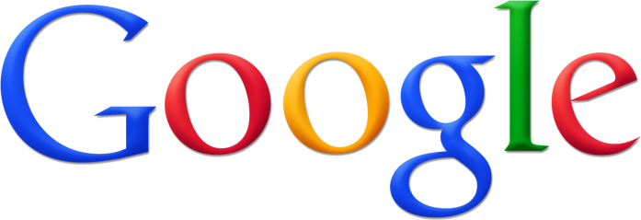
app engine
Ehsan Khodarahmi
Mazandaran University Of Science & Technology
khodarahmi@ustmb.ac.ir
January 2011

Slide 2
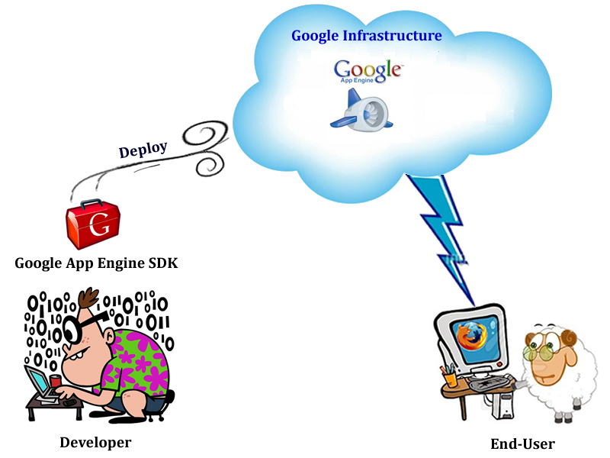
What is App Engine ?
Google App Engine is a runtime platform that provides web application hosting, data storage, and high-speed networking by running on top of Google’s massive infrastructure

Slide 3
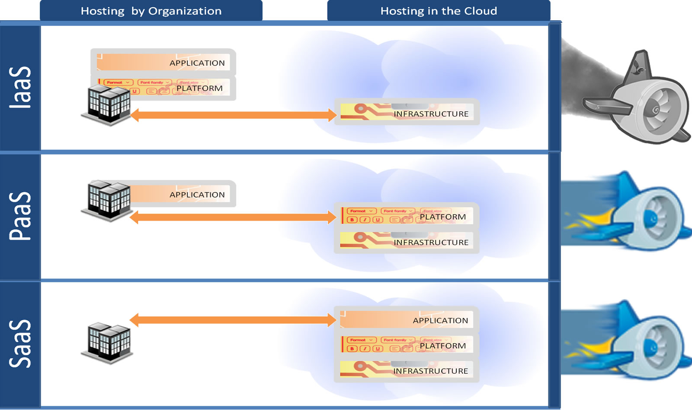
Cloudy Scope !
A PaaS that development teams and organizations may use for building public or in-house web applications that support
transactions, uniform authentication,
and robust scalability and availability
Applications created with Google App Engine that are offered as SaaS, consumed directly from the end-user’s web browsers

Slide 4
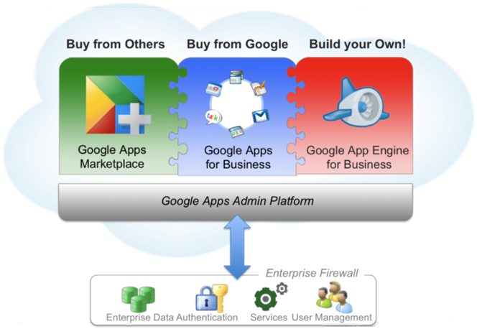
Why App Engine ?
Easy to Build
Easy to Maintain
Easy to Scale
Secure Environment
Centralized Administration
Reliability and Support
Pay as you go
Supports several programming languages (Java / Python)

Slide 5
App Engine Architecture

Slide 6
Frontends
Load Balancing
Routes the request to application servers or static file servers
Authenticates the user with Google Accounts
Interacts with end-users & doing some optimizations like compressing the response data

Slide 7
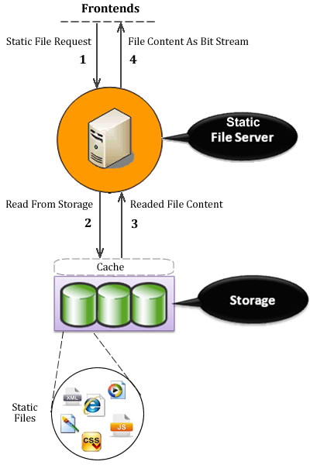
Static file servers
These servers are dedicated to the task of serving static files, with network topology and caching behavior optimized for fast delivery of resources that do not change often
When user uploads the app, static files are pushed to the static file servers

Slide 8
Application servers
Handle Requests
Manage the local resources available to the app, including CPU cycles, memory, and execution time
Ensure that apps do not consume system resources in a way that interferes with other apps
Controlling handlers behavior & performance & keep them separate

Slide 9
Application servers (Cont.)

Slide 10
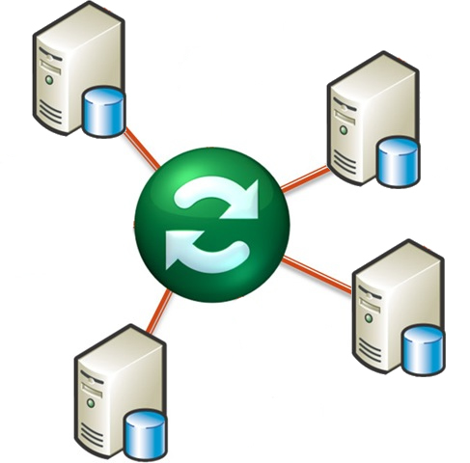
App master
Deploying new versions of application software and configuration
Synchronizing all of the frontend servers when user replaces as existing version

Slide 11
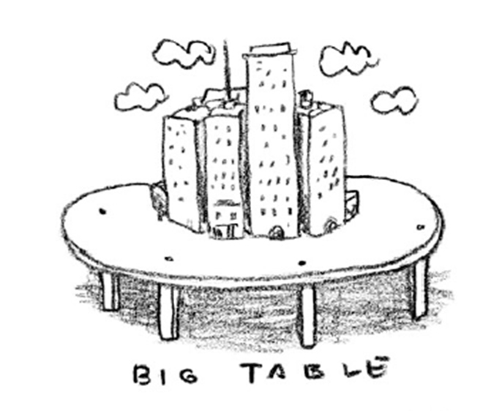
Datastore
Bigtable : A reliable, scalable persistent storage of data which is created based on GFS
Bigtable is a powerful distributed data storage service that features a query engine and transactions
Bigtable stores and performs queries over data objects, known as entities
Bigtable is strongly consistent, but it's not a relational database

Slide 12
Memcache
memcached allows you to take memory from parts of your system where you have more than you need and make it accessible to areas where you have less than you need
The memcache stores values in memory instead of on disk for faster access, so it is not persistent like the datastore
The memcache service is best used as a cache for the results of frequently performed queries or calculations

Slide 13
Other services
URL Fetch: Allows applications to access resources on the Internet, such as web services or other data
Mail: Allows applications to send email messages
Image Manipulation: Lets applications to manipulate images
Scheduled Tasks(CornJobs) and Task Queues: Allows applications to perform tasks outside of responding to web requests
XMPP: An App Engine application can send and receive instant messages to and from any XMPP-compatible instant messaging service

Slide 14
References
Programming with google app engine, Dan Sanderson, O’reilly & Google press, 2009
Using google app engine, Charles Severance, O’reilly & Google press, 2009
Developing with google app engine, Eugene Cuirana, Apress, 2009
Google App Engine Official Site, https://appengine.google.com
Google Developer’s Guide , http://code.google.com/appengine/docs/
Google App Engine General Questions, http://code.google.com/appengine/kb/general.html

