Slide 1
High Performance Computing in the Cloud
Farzaneh Rahmani
Rahmani.farzane@gmail.com
Mazandaran University of Science And Technology
Supervisor: Hadi Salimi
February, 2011

Slide 2

HPC Defenitions
A computational model in which high performance is delivered to support highly compute-intensive calculations mainly by using parallel algorithms with tightly-coupled, data-intensive inter-process communication, running on hundreds or even thousands of processors or cores
2

Slide 3

Gaps for Migration of HPC to Cloud
HPC (Traditional computing with high throughput HW and optimized SW stack)
Dynamic and adaptive workload management to fully utilize cloud resources
Cloud don’t have customized storage facilities
Broad bandwidth
latency
Cloud
Computing
Need virtualization of accelerators on the cloud
  Some HPC in Cloud offerings today
    Penguin’s HPC-as-a ServiceTM
12

Slide 4
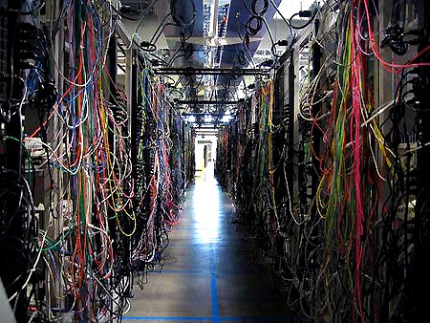
The forms of HPC:
The commodity HPC cluster
Dedicated supercomputer
HPC cloud computing
Grid computing
3

Slide 5
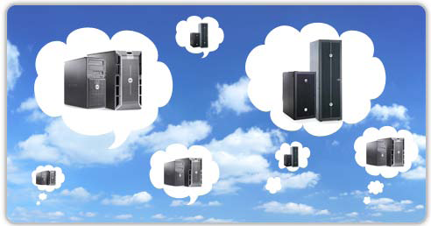
Proliferation of the Cloud
4

Slide 6

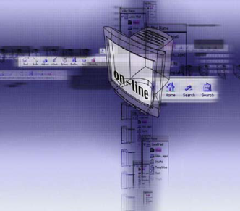
Possible usage patterns:
Processing Patterns
Memory
storage
  HPC applications need two types of permanent :
    I/O storage
    Scratch storage
networking
5

Slide 7


energy-effcient solutions are required
not only form Cloud provider but also from the environment.
CO2 emission
high energy cost
6

Slide 8
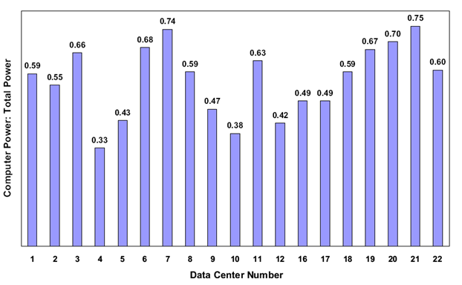
Computer Power Consumption Index
7

Slide 9





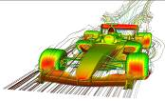
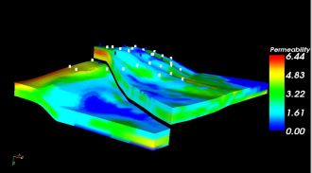


HPC & Virtualization
Cloud: Virtual Datacenter + HPC + more…
Virtualized Datacenter
VM
VM
VM
VM
Mgmt
Virtualization
Unified Fabric
Unified
Network
Cloud
Cloud
Infrastructure
Servers
Storage Arrays
Security
HPC
Network
Storage
Compute
Datacenter facilities (e.g. cooling, power)
Low-Latency
Parallel Compute
+ Services
+ Quality of Service
+ Security
Parallelized Cluster
Performance
Fabric
8

Slide 10

Power and cooling
a critical aspect when architecting a HPC system
Knowing the data center rack requirement will determine how many components can be installed in a single rack
LINPACK
Amps
9

Slide 11
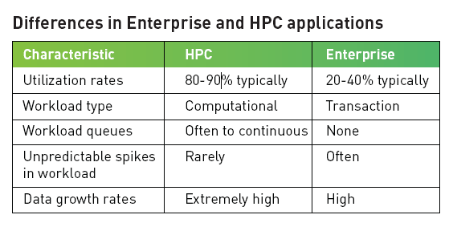
HPC Applications Differences from Enterprise Applications
10

Slide 12

Which factors limiting applicability of HPC in the Cloud?
Expanding compute power by refreshing compute resources is no longer a viable option.
HPC, applications are generally
not written to take advantage of more than one
thread of execution.
Virtualization was once touted as the savior of IT but there was a price to pay, which primarily included performance penalties
11

Slide 13

  Open Question: Is the Cloud robust enough to handle the massive computing cycles and very high system throughput needed for an effective HPC environment?
13

Slide 14

PBS Works
14

Slide 15
The PBS Works Advantage:
  Purpose-Built for HPC
  Maximum Return on Investment
How Does PBS Works Solve Today’s HPC Challenges?
15

Slide 16

Thanks for your attention!
16

Slide 17
Refrences:
[1] Garg, S., Yeo, C., Anandasivam, A. and Buyya, R. Energy-Efficient Scheduling of HPC Applications in Cloud Computing Environments. Arxiv preprint arXiv:0909.11462009).
[2] Masud, R. High Performance Computing with Clouds.
[3] Napper, J. and Bientinesi, P. Can cloud computing reach the top500? ACM, City, 2009.
[4] Youseff, L., Wolski, R., Gorda, B. and Krintz, C. Paravirtualization for HPC systems. Springer, City, 2006.
[5] Alexander, M. and Hardt, M. VHPC 2009: 4th Workshop on Virtualization in High-Performance Cloud Computing. Springer, City, 2010.
[6] Vouk, M., Sills, E. and Dreher, P. Integration of High-Performance Computing into Cloud Computing Services. Handbook of Cloud Computing2010), 255-276.
17

