Slide 1
Mobile Cloud Computing
Hossein Abdolghafar 89191133
Advisor :Dr. H.Salimi
Februray 2011

Slide 2
Contents
1
Introduction
2
Mobile Devices as a virtual cloud computing provider
3
Elastic Framework
4
Secure Session Management
5
Trust Cube

Slide 3
Introduction
Mobile phones are becoming pervasive.
There is one mobile phone every two person in the world.
Given the advances :
users start to consider a mobile phone a
personal information processing tool
users expect to execute any application
on top of a mobile device
One way to overcome this limitation is
mobile cloud computing

Slide 4
Mobile Devices as a virtual cloud computing provider
Motivation and Scenario
On an economical basis, accessing cloud computing providers is associated with two costs:
The cost of networking
The cost of using the provider’s resources
Design Considerations
Resource monitoring and management
Seamless integration with the existing cloud APIs
Activity detection to find users of the same or similar goals
A memory cache scheme to save intermediate results
….

Slide 5
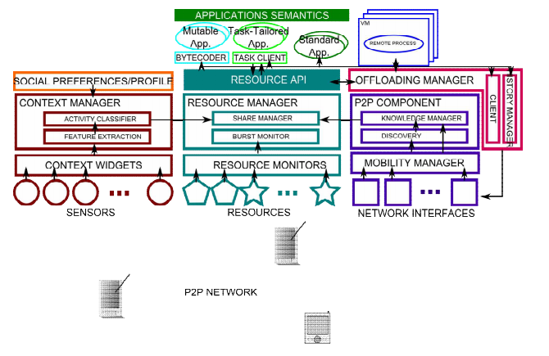
Current Implementation
Architecture

Slide 6
Elastic Framework

Slide 7
Current Implementation (cont.)
The Application Manager is in charge of launching and intercepting an application at loading time
The Resource Manager is in charge of application profiling and resource monitoring on a local device
The Context Manager wields and synchronizes contextual information from context widgets
The Offloading manager component is in charge of sending and managing jobs from the node to other remote devices

Slide 8
Current Implementation (cont.)
This project consists of two sub implementations:
Cloud computing provider client
Ad Hoc mobile cloud framework
Both are developed based on Hadoop (a cloud computing platform from Apache.)
Communication between devices is based on the Extensible Messaging and Presence Protocol (XMPP)

Slide 9
Another application platform for mobile (elastic framework)
An elastic application can consist of one or more weblets
which function independently, but communicate with each other.
Elasticity manager running on the device monitors
the resource requirements of the weblets of the application
Elasticity manager talks to an Elasticity service residing on the cloud
on which cloud node it should be launched, and how much storage should be allocated
Elasticity manager can also make decisions about:
migrating running weblets from the device to cloud
or from cloud to device

Slide 10
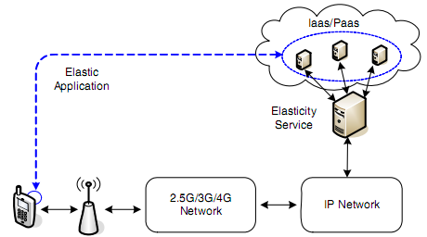
Overview of elastic application for mobile device

Slide 11
Exisiting challenges
A new application model is needed in order to
launch or migrate some parts of an application in the cloud and others on the device.
An appropriate protocol is needed between weblets during runtime to:
synchronize the state of the application
respond to state change or user actions
A set of cost objective functions are needed
which should be optimized when elastic scheduling decisions are made, such as when and where to migrate weblets
Security And Privacy

Slide 12
Elastic Framework Architecture)
A typical elastic application includes:
UI component and one or more weblets
Device elasticity manager (DEM) :
Where the application’s components (weblets) are located
Selects paths used for communication with weblets
Runs an optimizer which is responsible for determining the best application conﬁguration given costs and user goals
cloud elasticity service (CES) :
cloud manager, application manager, and sensing information collection
provides a web service, referred to as the cloud fabric interface (CFI)

Slide 13
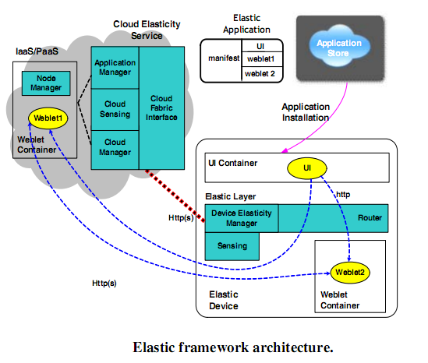
Elastic Framework Architecture Contd.

Slide 14
Elastic Application Model
Partitions of an elastic application
Each application should be partitioned into components called weblets.
A weblet’s functionality should not be affected by the location or environment where it is running.
Data dependency of weblets
An elastic application should allow reasonable data dependency between weblets
Communication protocols between weblets
Lightweight web services protocols such as REST are used in this framework

Slide 15
Threat Model
Threats to Mobile Devices
Malware targeting mobile devices e.g :
A malware can change the battery status of the device thus DEM does not make decision of ofﬂoading execution when an application is launched
Threats to Cloud Platform and Application Container
Malicious entities e.g :
Can change network and cost settings, or even cloud sensing information to confuse the CES into making decisions
Threats to Communication Channels
Code Red, and SQL Slammer
MITM (Man-In-The-Middle), DDoS (Distributed-Denial-Of-Service)

Slide 16
Security Objectives
Trustworthy weblet containers (or VMs) on both device and cloud
Weblets must be installed and execute in trusted runtime environments in all locations.
Authentication and secure session management
The elastic framework should provide a mechanism to authenticate weblets belonging to the same application and user to each other
Authorization and access control
A weblet on the cloud should adhere to the property of least privileges
Logging and auditing
Behaviors of weblets should be logged and audited routinely to prevent malicious activities

Slide 17
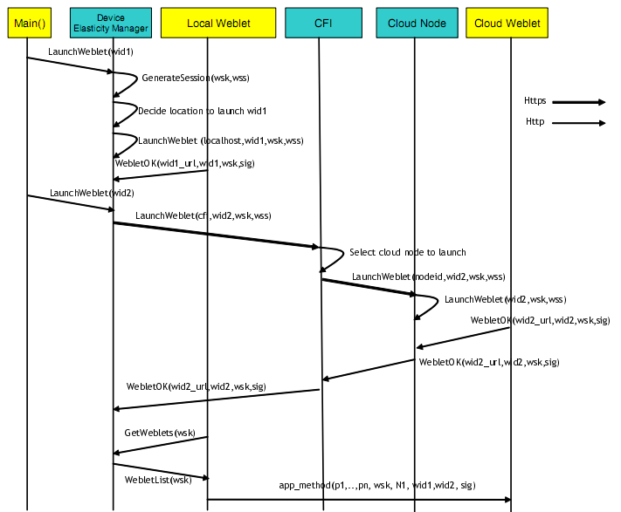
Secure Installation of Elastic Applications

Slide 18
Authorization of Weblets
Shared user credentials
A hostile environment on cloud node can save the user credentials and impersonate the user later.
Shared session information
After a device weblet authenticates with the web server, it should share ‘wsk’ and ‘wss’ with other weblets.
Using session information only on device weblet
Whenever a cloud weblet needs access to user data on external web services, it forwards the requests to the authenticated device weblet
OAuth-like [3] authentication

Slide 19
Trust Cube And Implicit Authentication

Slide 20
Trust Cube And Implicit Authentication
TrustCube assumes a federated authentication framework,such as OpenID.
Implicit authentication is used to identify users by their habits, as opposed to their belongings, memorized data, and biometrics.
The use of implicit authentication implies a policy-based authentication framework

Slide 21
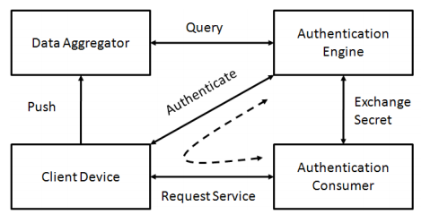
High-level Architecture
The policy includes three parts:
The access request
The information to be collected from client devices or data aggregator for this access request
Rule to generate the authentication result.

Slide 22
Implementation Approach
client side agent was developed on Android which collects two kinds of data:
First, it collects a user’s context and activities
Second, during authentication, it collects information about the phone
The service is developed in Java and deployed as an Amazon EC2 instance and encapsulated as an AMI (Amazon Machine Image)

Slide 23
Conclusion
Based on the result of executing the first framework:
The approach over small files shows that the execution of tasks is slightly slower than executing it directly on the mobile device (less than 1% slower in average)
More over multiple small files trigger memory problems (hadoop problem)
Also Cloud computing has brought new challenges and opportunities for authentication. There is increasing demand for usable authentication to access services and data for both enterprises and consumers.
There is another trend that is important to understand in the context of cloud computing and authentication: the shift in platforms from traditional PCs toward smart phones and other mobile platforms.

Slide 24
References
Amazon. http://www.amazon.com.
Gonzalo Huerta-Canepa, D. L. A Virtual Cloud Computing Provider for Mobile Devices ACM2010), 5.
Xinwen Zhang, J. S., SimonGibbs, and Anugeetha Kunjithapatham, a. S. J. Securing Elastic Applications on Mobile Devices for Cloud Computing. ACM2010.
Christensen, J. H. Using RESTful web-services and cloud computing to create next generation mobile applications. ACM2009.
I. Giurgiu, O. R., D. Juric, I. Krivulev, and G. Alonso Calling the cloud: enabling mobile phones as interfaces to cloud applications2009.
Marinelli, E. Hyrax: Cloud Computing on Mobile Devices using MapReduce. ACM2009.

Slide 25
Thank You !

