Slide 1
Mahyar Taheri Tehrani Department of Computer Science Email : mahyar.tahery@gmail.com
Survey on Cloud Computing Risk and Security Issues
Supervisor :
Mr. Hadi Salimi
Advanced Topics in Information Systems
Mazandaran University of Science and Technology
February 4, 2011

Slide 2
Definition of Cloud Computing
What is Cloud Computing.
Cloud Computing essential characteristics.
The services of Cloud Computing.
The delivery models of Cloud Computing.

Slide 3
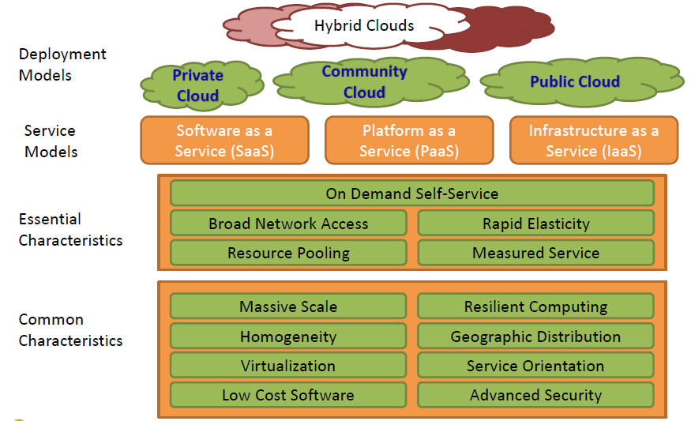
The NIST Cloud Definition Framework

Slide 4
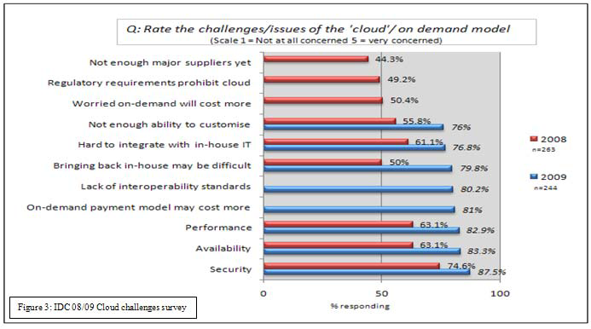
Security is the Major Issue

Slide 5
Why security is important
Cloud Computing targeted to provide better utilization of resources using virtualization techniques.
Cloud Computing moves the application software and databases to the large data centers, where the management of the data and services are not trustworthy.
Some security challenges: virtualization vulnerabilities, web application vulnerabilities, physical access issues, identity and credential management, data verification, integrity, confidentiality, loss and theft.

Slide 6
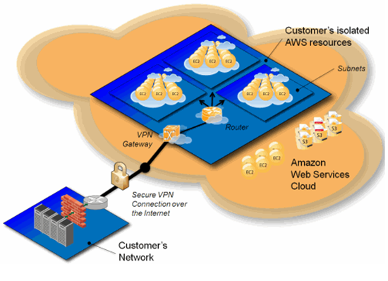
Virtual Private Cloud
Amazon Virtual Private Cloud and how it connects cloud-based resources to
existing private networks.

Slide 7
Cloud Computing Risk Issues
Privacy
Data and information on cloud are Secure!!?
Guarantee of privacy.
Hacker.
Control and monitor lawfully or unlawfully.
secret NSA program, working with AT&T, and Verizon
Information preservation
Could cloud to keep data and information forever?
Provide huge server for keeping and preservation of data.
Backup data and information of user.

Slide 8
Cloud Computing Risk Issues
Boycott
International politics.
Availability and performance
Salesforce.com not available at March 11, 2010.
Amazon services not available for tow hours.
Recovery Time Objectives(RTO).
Recovery Point Objectives(RPO).

Slide 9
Security issues in SaaS
Data security
Network security
Data locality
Data segregation
Data access
Data breaches
Backup

Slide 10
Data security
Data is stored outside the enterprise boundary.
Strong encryption techniques for data security.
Malicious users can exploit weaknesses in security.

Slide 11
Network security
All data flow over the network needs to be secured.
Use of strong network traffic encryption techniques.
Amazon Web Services (AWS), provides protection against traditional network security.

Slide 12
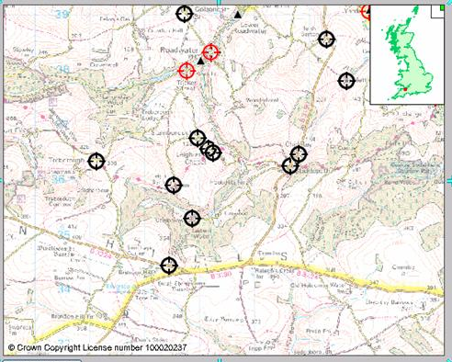
Data locality
Customer must know where the data stored.
Why is locality of data importance?
data privacy laws in various countries are different.
A secure SaaS must providing reliability on the location of the data.

Slide 13
Data access
Data access issue is related to security policies provided to the users while accessing the data.
The SaaS model must be flexible to incorporate specific policies put forward by the organization.

Slide 14
Security issues in IaaS
The security responsibilities of both the provider and the consumer.
Physical security of infrastructure and disaster management is of utmost importance.
Virtualization vulnerability
Virtualization is one of the main components of a Cloud.
Running on the same physical machine are isolated from each other is a major task of virtualization.
Current VMMs do not offer perfect isolation.

Slide 15
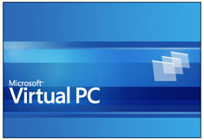
Virtualization vulnerability example
Microsoft Virtual PC and Microsoft Virtual Server could allow a guest operating system user to run code on the host or another guest operating system.
vulnerability in Xen caused due to an input validation error in tools/pygrub/src/GrubConf.py.

Slide 16
Current security solutions
Several groups and organization are interested in developing security solutions and standards for the Cloud.
European Network and Information Security Agency (ENISA), Cloud Security Alliance (CSA), National Institute of Standards and Technology (NIST), Centre for the Protection of National Infrastructure (CPNI), and, etc.

Slide 17
Conclusion
There are extreme advantages in using aCloud-based.
Customers should research about Cloud risk and security issues of Cloud infrastructures that vendors offer.
Customers should consider how to continue their business.
Public, private or virtual private Clouds.

Slide 18
Refrence
C. Wang, et al., "Ensuring data storage security in Cloud Computing," 2009, pp. 1-9.
A. Seccombe, et al., "Security guidance for critical areas of focus in Cloud Computing, v2.1," CSA (Cloud Security Alliance), USA. Disponible en, vol. 1, 2009.
V. Choudhary, "Software as a service: Implications for investment in software development," 2007, p. 209a.
C. Attanasio, "Virtual machines and data security," 1973, pp. 206-209.
[19] Amazon. (10 December 2009). Elastic Compute Cloud(EC2). Available: http://aws.amazon.com/ec2/

Slide 19
Questions?

