Slide 1
Scalability challenges in cloud computing
Supervisor:
Hadi Salimi
Peresenter:
Ali Akbar Akhavan
A.Akhavan@ustmb.ac.ir
Mazandaran University of Science & Technology
February, 2011

Slide 2
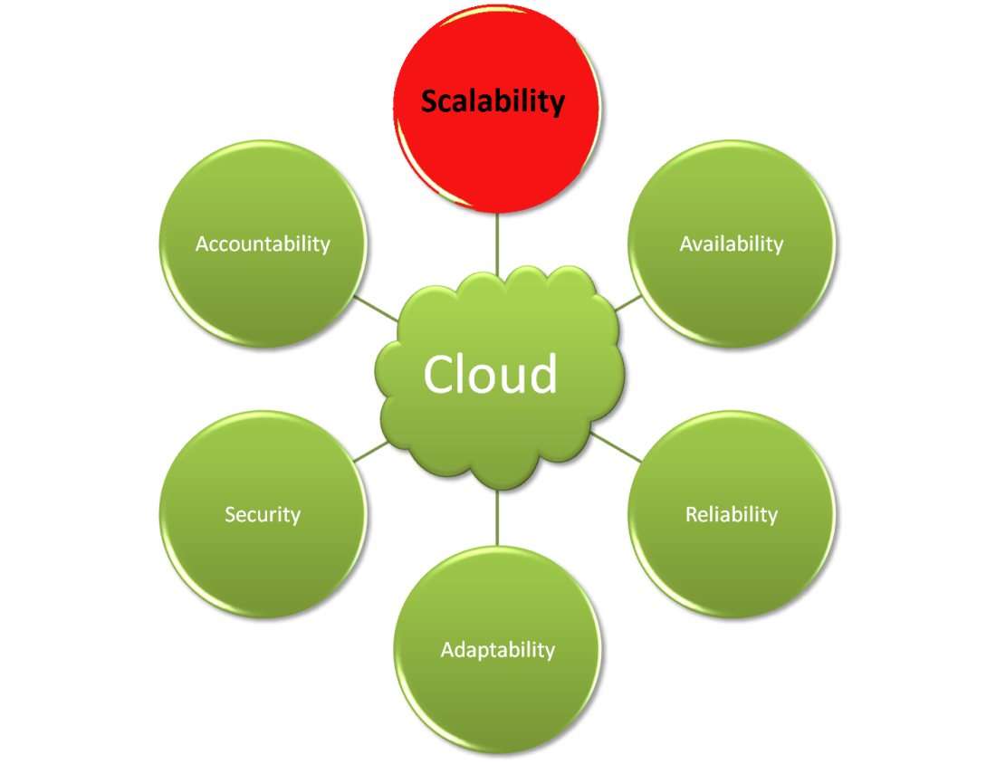
Introduction
Scalability is the ability of a particular system to fit a problem as the scope of that problem increases.[6]
Scale-up
Scale-Down

Slide 3
What elements of IT can be scaled?
Almost all elements of IT can be scaled. A few of them are shown below :
CPU% allocated for a task
Amount of on-chip memory (RAM)
Space on the hard disk
Number of application instances
Number of end users
Number of communication ports
Communication bandwidth
Number of software licenses
. . .

Slide 4
How do I detect true scalability?
True Scalability
Service Provisioning
Means Testing
Dynamism
Quality of the IT service/system

Slide 5
Three basic pillars
Cloud scalability
Virtualization
Resource sharing
Dynamic provisioning

Slide 6
Types of scalability
We consider four types of scalability here:[3]
Load scalability
The ability for a distributed system to easily expand and contract its resource pool to accommodate heavier or lighter loads (Ethernet vs. Token Ring)
Space scalability
A system or application is regarded as having space scalability if its memory requirements do not grow to intolerable levels as the number of items it supports increases (Sparse Matrixs)

Slide 7
Types of scalability (cont.)
Space-time scalability
We regard a system as having space-time scalability if it continues to function gracefully as the number of objects it encompasses increases by orders of magnitude.
Structural scalability
We think of a system as being structurally scalable if its implementation or standards do not impede the growth of the number of objects it encompasses, or at least will not do so within a chosen time frame.

Slide 8
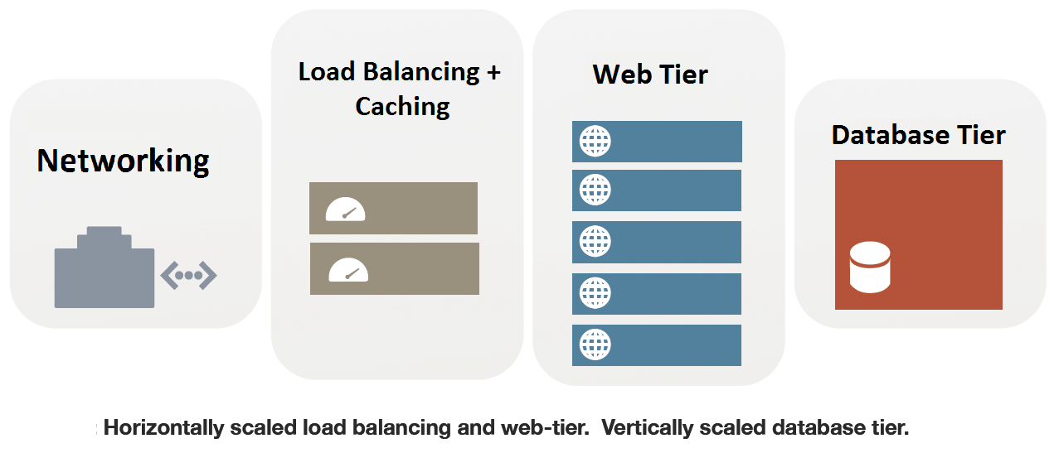
Horizontal and Vertical Scalability
Vertical scaling (up) entails adding more resources to the same computing pool
Horizontal scaling (out) requires the addition of more machines or devices to the computing platform to handle the increased demand.

Slide 9
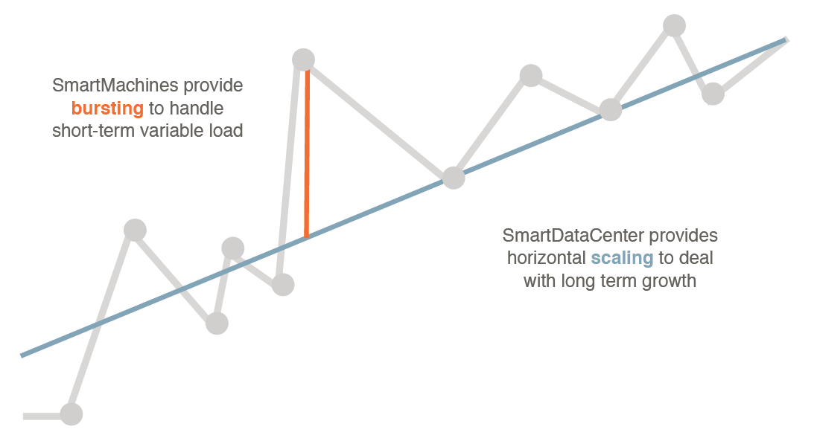
Horizontal and Vertical Scalability (cont.)

Slide 10
Administrative and Geographical Scalability
Administrative scalability: The ability for an increasing number of organizations to easily share a single distributed system.
Geographical scalability: The ability to maintain performance, usefulness, or usability regardless of expansion from concentration in a local area to a more distributed geographic pattern.

Slide 11
Practical and Theoretical Limits of Scale
Most companies cannot commit an infinite amount of money, people, or time to improving performance.
Cloud vendors also may have a limited amount of experience, personnel, or bandwidth
Every computing infrastructure is bound by a certain level of complexity and scale

Slide 12
Loosely coupled
Cloud computing applications have to be scalable, the number of each component have to to be modied on demand.
High coupling does not allow it and improves dependency and scalability problems.

Slide 13
Access a resource
Whether multiple nodes are trying to access a resource for the same reason, or perhaps two dierent tiers want the same piece of information for two dierent reasons, sharing resources can be hard.
FIFO

Slide 14
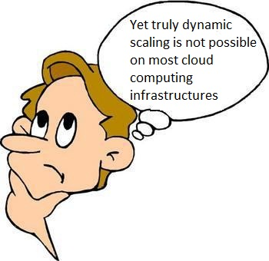

Slide 15
References
[1] “Dynamically Scaling Applications in the Cloud” ; Luis M. Vaquero , Luis Rodero Merino , Rajkumar Buyya ; ACM SIGCOMM Computer Communication Review ; January 2011
[2] “Scaling Into The Cloud” ; Jonathan Kupferman, Jeff Silverman, Patricio Jara, Jeff Browne ; University of California, Santa Barbara ; CS270 - ADVANCED OPERATING SYSTEMS
[3] “Characteristics of Scalability and Their Impact on Performance” ; André B. Bondi ; AT&T Labs ; Network Design and Performance Analysis Department ; ACM 2000
[4] “Patterns for Scalability in the Cloud” ; Fabrice Troilo , Xavier Blanc; University Bordeaux ;years 2010
[5] “DISTRIBUTED COMPUTING APPROACHES FOR SCALABILITY AND HIGH PERFORMANCE” ; MANJULA K A , KARTHIKEYAN P; International Journal of Engineering Science and Technology Vol. 2(6), 2010, 2328-2336
[6] “Handbook of Cloud Computing” ; Borko Furht , Armando Escalante ; ISBN 978-1-4419-6523- Springer New York Dordrecht Heidelberg London

