Slide 1
Security Issues in Elastic Clouds
Mojdeh Feyzi 89191134
Prof : Dr. Salimi
feyzi1366@gmail.com

Slide 2
Elasticity Definition
NIST’s deﬁnition of elasticity is :
“Capabilities can be rapidly and elastically provisioned, in some cases automatically, to quickly scale out and rapidly released to quickly scale in. To the consumer, the capabilities available for provisioning often appear to be unlimited and can be purchased in any quantity at any time.”

Slide 3
Elastic Elements
Storage
Processing
Virtual Networks
Security Relevant Cloud Components
Cloud Data Storage Services
Cloud Processing Infrastructure
Cloud Network and Perimeter Security

Slide 4
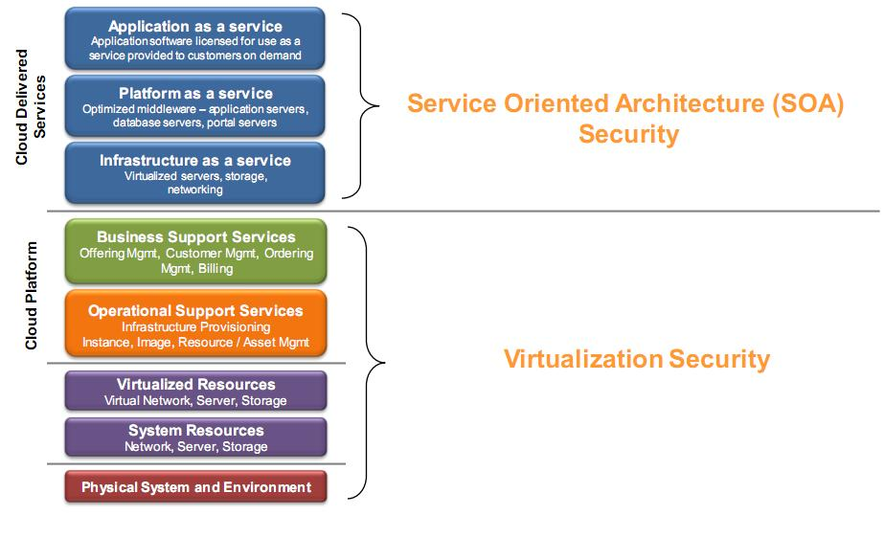
Cloud Security = SOA Security + Virtualization Security

Slide 5
Cloud Data Storage Services
Challenges
Data multi-tenancy
Data Mobility and Control
Data Remanence
Data Privacy

Slide 6
Solving The Cloud Security Challenges
Easy deployment
Secure key management
Industry standard encryption
Granular control
Custody of encryption keys
Reporting

Slide 7
An Elastic Data Store
Elasticity of resources is major factors to success
Underlying database is not very elastic and scalable
2 spectrum:
IaaS providers
Compute cycles, storage, network bandwidth , ….
PaaS providers :
Microsoft’s Azure and Google’s AppEngine

Slide 8
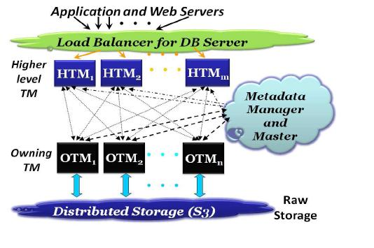
Overview of the ElasTraS system
Distributed Storage
Owning Transaction Managers
Metadata Manager and Master
Higher level Transaction Managers

Slide 9
Cloud Processing Infrastructure
Challenges
Application multi-tenancy
Reliance on hypervisors
Process isolation

Slide 10
Challenges for Cloud Networking Security
performance of some applications running in the cloud depends heavily on the :
network connecting the different cloud sites
connecting the user to the cloud
number of known vulnerabilities
obtain computing services for free
steal information from cloud users
penetrate the infrastructure remaining in client premises
Information Security in Clouds:
Confidentiality , Integrity , availability

Slide 11
Cloud Physical Infrastructure Architecture

Slide 12
Dynamic Virtual Networks Connecting a Distributed Service

Slide 13
Cloud Network and Perimeter Security
Challenges
Isolation between Virtual Machines
Information Theft through Malicious Use of Hypervisor
Untrusted Hypervisors
Untrusted Virtual Machines
Untrusted Virtual Machines Misusing Hardware Virtualization Functionality
Unsecure Network Transfer on Inter Device Migrations

Slide 14
Cloud Network and Perimeter Security

Slide 15
Elasticity Securing Challenges

Slide 16
Solving Security issues with ACPS
One of the key issues of cloud computing is loss of control
Some of the security issues Of a cloud are:
Privileged user access
Data segregation
Privacy
Bug Exploitation
Recovery
Accountability

Slide 17
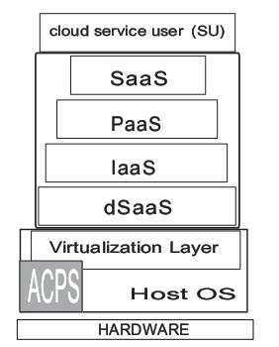
Advanced Cloud Protection System
Possible attacks against cloud systems are :
Resource attacks against CPs
Resource attacks against SPs
Data attacks against CPs
Data attacks against SPs
Data attacks against Sus
Advanced Cloud Protection
System (ACPS)

Slide 18
Other Elasticity Securing Challenges
one is able to traverse from one VM (virtual machine) client environment to other client environments being managed by the same hypervisor
ability to provide ﬁne-grained access and predeﬁned security controls across the entirety of a virtual customer environment
how to enforce proper conﬁguration and change management in this more dynamic and elastic model

Slide 19
Elasticity Securing Challenges-cont
Encryption for data-at-rest

Slide 20
Requirements for Building Elastic Cloud Services
Heterogeneous Systems Support
Service Management
Dynamic Workload and Resource Management
Reliability, Availability and Security
Integration with Datacenter Management Tools
Visibility and Reporting
Administrator, Developer and End User Interfaces

Slide 21
References
Chiu, B. D. Elasticity in the Cloud. www.acm.org/crossroads, City, 2010.
Micro, T. Addressing Data Security Challenges in the Cloud(july 2010 2010).
Peter Schoo, V. F., Victor Souza, Márcio Melo, Paul Murray,Hervé Debar, Houssem Medhioub, Djamal Zeghlache Challenges for Cloud Networking Security. ICST Conference on Mobile Networks and Management(October 6, 2010 2010), 17.
Dustin Owens, B. A. Securing Elasticity in the Cloud. City, 2010.
Sudipto Das, D. A., Amr El Abbadi ElasTraS: An Elastic Transactional Data Store in the Cloud2010), 5.
VMOps Cloud Computing:Elastic, Scalable, On-Demand IT Services for Everyone(April 2010 2010), 7.

Slide 22
Thanks

