Slide 1
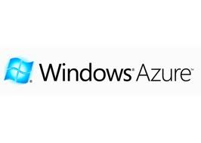
Mostafa Abdollahi
Mazandaran University Of Science And Technology
m.abdollahi@ustmb.ac.ir
January 2011

Slide 2
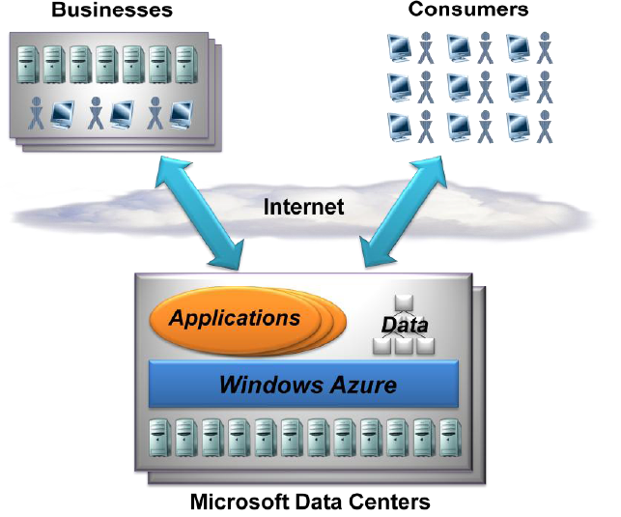
AN OVERVIEW OF WINDOWS AZURE
Windows Azure applications run in Microsoft data centers and are accessed via the Internet. Customers use it to run applications and store data on Internet-accessible machines owned by Microsoft.
2/20

Slide 3
Applications that can be built on Windows Azure
An ISV might create a SaaS application that targets consumers
Enterprises might use Windows Azure to build and run applications that are used by their own employees
3/20

Slide 4
Windows Azure Benefits
Easy to build
Easy to maintain
High scalability
High security
Reliable environment
Pay as you go
Support multiple programming languages
4/20

Slide 5
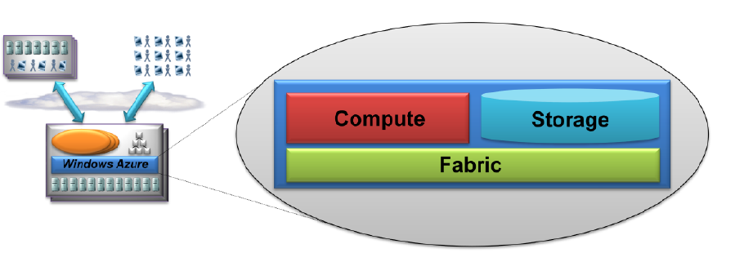
Windows Azure Architecture
5/20

Slide 6
The Compute Service
Run many different kinds of applications
Support applications that have a very large number of simultaneous users
Microsoft would build its own SaaS applications on Windows Azure
Windows Azure is designed to support applications that scale out, not scale up
6/20

Slide 7
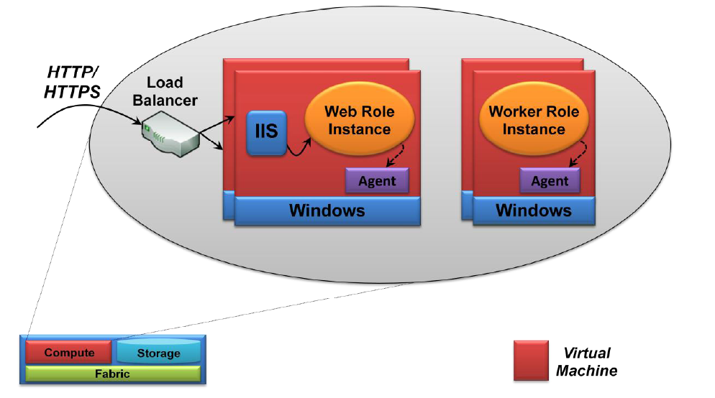
The Compute Service(Cont’d)
7/20

Slide 8
Web Role
A Web role instance can accept incoming HTTP or HTTPS requests
It runs in a VM that includes Internet Information Services (IIS) 7
Developers can create Web role instances using ASP.NET, Windows Communication Foundation (WCF), or another .NET technology that works with IIS.
Using the .NET Framework isn’t required. This means that developers can upload and run other technologies as well, including PHP and the Java-based Tomcat
Web role instances must be stateless
8/20

Slide 9
Worker Role
Worker role instances are similar to, but not quite the same as their Web role cousins
Worker role instances don’t have IIS configured
Running a Web server like Apache Web Server is allowed
Worker role instance is more likely to function like a background job
9/20

Slide 10
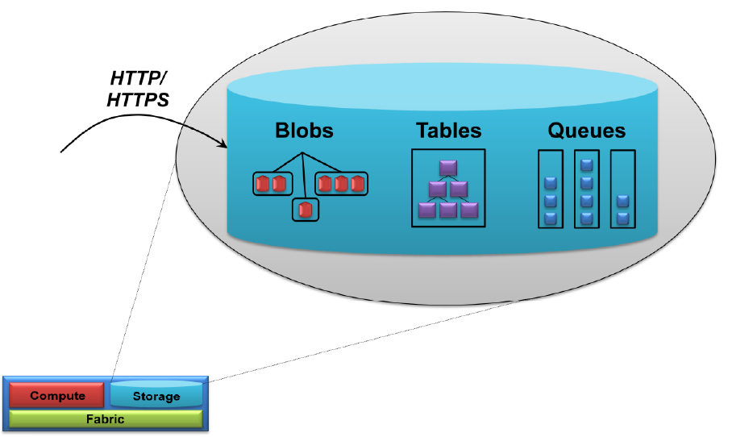
The Storage Service
10/20

Slide 11
The Storage Service(Cont’d)
Blobs
A blob contains binary data
A storage account can have one or more containers, each of which holds one or more blobs
Information about where a JPEG photograph was taken or who the singer is for an MP3 file
Block or Page Blobs
Private or Public
Tables
These aren’t relational tables
the data each one holds is actually stored in a group of entities that contain properties
11/20

Slide 12
The Storage Service(Cont’d)
The reason for this apparently idiosyncratic approach is that it allows scale-out storage
a single Windows Azure table can contain billions of entities holding terabytes of data
Queues
Blobs and tables are both focused on storing and accessing data
provide a way for Web role instances to communicate asynchronously with Worker role instances
12/20

Slide 13
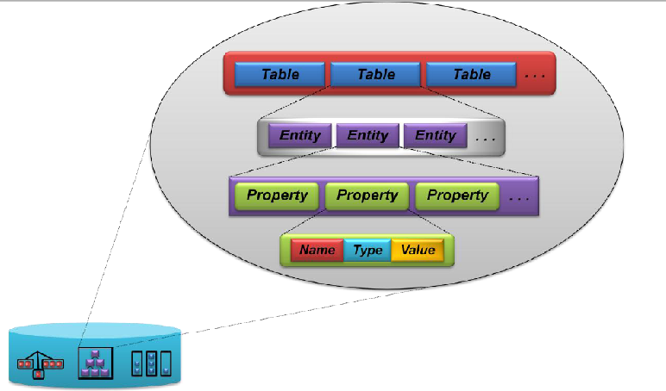
Tables
13/20

Slide 14
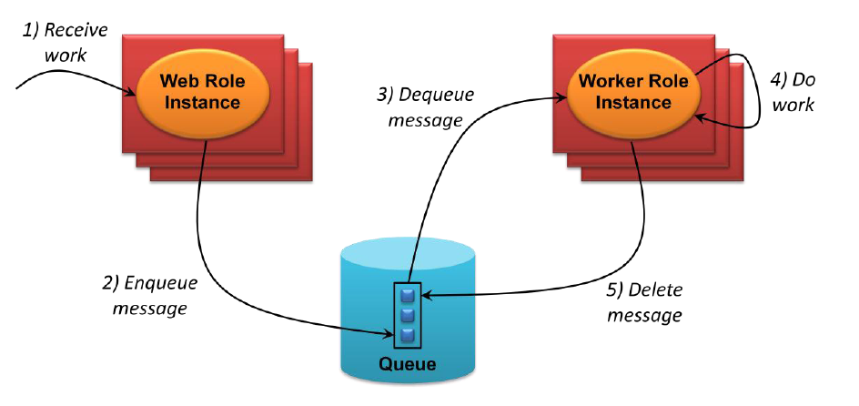
Queues
14/20

Slide 15
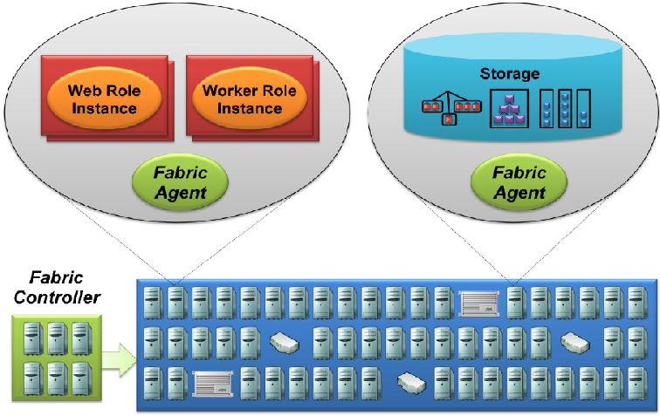
The Fabric
15/20

Slide 16
The Fabric(Cont’d)
Windows Azure Fabric consists of a (large) group of machines, all of which are managed by software called the fabric controller
The fabric controller is replicated across a group of five to seven machines
It can communicate with a fabric agent on every computer, so it’s also aware of every Windows Azure application in this fabric
16/20

Slide 17
Duties Of Fabric Controller
Monitors all running applications
Manages operating systems
Taking care of things like patching the version of Windows Server that runs in Windows Azure VMs
Decides where new applications should run
…
17/20

Slide 18
Where should new applications run
Fabric controller depends on a configuration file that is uploaded with each Windows Azure application
An XML-based description of what the application needs
How many Web role instances
How many Worker role instances
And more
Fabric controller then monitors each of them
If one of Web role instances dies, the fabric controller will automatically restart a new one
18/20

Slide 19
References
D. Chappell, "Introducing windows azure," Microsoft, Dec, 2009.
D. l Augustyn and L. Warcha, "Cloud Service Solving N-Body Problem Based on Windows Azure Platform," 2010, p. 84.
H. Li, Introducing Windows Azure: Springer, 2009.
A. Mackey, "Windows Azure," Introducing. NET 4.0, pp. 411-448, 2010.
T. Redkar, "Introducing Cloud Services," Windows Azure Platform, pp. 1-51, 2009.
Windows Azure Platform Home Page http://www.microsoft.com/windowsazur
19/20

Slide 20
?
20/20

