Slide 1
Advanced Topic in Information Systems: Cloud Computing
Hadi Salimi
Distributed Systems Lab,
School of Computer Engineering,
Iran University of Science and Technology,
Tehran, Iran
hsalimi@iust.ac.ir

Slide 2
What is Cloud Computing
Cloud Computing refers to both the applications delivered as services over the Internet and the hardware and systems software in the datacenters that provide those services.

Slide 3
Definitions
When a Cloud is made available in a pay-as-you-go manner to the public, we call it a Public Cloud;
The service being sold is Utility Computing.
Current examples of public Utility Computing include:
AmazonWeb Services,
Google
AppEngine,
Microsoft Azure.

Slide 4
Definitions
We use the term Private Cloud to refer to internal datacenters of a business or other organization that are not made available to the public.
Thus, Cloud Computing is the sum of SaaS and Utility Computing, but does not normally include Private Clouds.

Slide 5
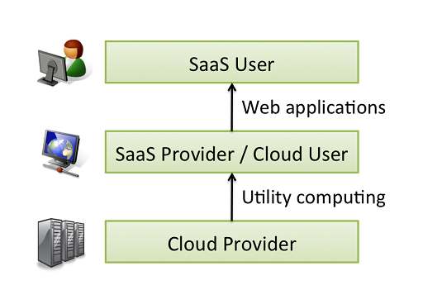
Cloud Layers
Users and Providers of Cloud

Slide 6
An Example
Just as the emergence of semiconductor foundries gave chip companies the opportunity to design and sell chips without owning a fab, Cloud Computing allows deploying SaaS — and scaling on demand — without building or provisioning a datacenter.

Slide 7
X as a service (XaaS)
X may be:
Infrastructure
Hardware
Platform
Application
Software
And …
Think of PayPal ☺

Slide 8
New Application Opportunity
Mobile interactive applications
Parallel batch processing
The rise of analytics
Extension of compute-intensive desktop applications

Slide 9
Models of Utility Computing
In Infrastructure
Amazon
In Platform
Windows Azure
In Applications
GoogleApp

Slide 10
X Models in Cloud
Computational Model
Storage Model
Communication Model
Programming Model

Slide 11
Challenges
Availability of a Service
Data Lock-In
Data Conﬁdentiality and Auditability
Data Transfer Bottlenecks
Performance Unpredictability
Scalable Storage
Bugs in Large-Scale Distributed Systems
Scaling Quickly
Reputation Fate Sharing
Software Licensing

