Slide 1
Distributed Systems Meet Economics: Pricing in Cloud Computing
Hadi Salimi
Distributed Systems Lab,
School of Computer Engineering,
Iran University of Science and Technology,
hsalimi@iust.ac.ir
Fall 2010

Slide 2
Topics
Pricing
Pricing fairness
Pay as you go model
Two intertwined aspect in pricing
Pricing plans in Amazon
Two approachs for evaluations
Popular applications in cloud
Methodology on Amazon EC2
Methodology on the Spring System
Setup in Amazon EC2
Setup in spring
Hardware configuration of machines in Spring
ROI
Time for Hadoop
Cost for Hadoop
User Optimizations on EC2
failures

Slide 3
Pricing
Pricing is an important role in the marketplace that has been considered in economics.
Two factors that impact pricing are:
Fairness
Competition

Slide 4
Pricing fairness
Pricing fairness consists of two aspects:
Personal fairness Subjective
Social fairness Objective

Slide 5
Pay as you go model
Lets users to utilize a public cloud instead of using dedicated private cloud at a slice of the cost.
Allowing providers to benefit from users by serving a public cloud.
The pricing plan becomes an important bridge between users and provider

Slide 6
Two intertwined aspects in pricing
Pricing has it’s root in system design and optimization.
Pricing has it’s root in economics.

Slide 7
Amazon pricing plans
Singh et al
Jimenez et al
Napper et al and Walker

Slide 8
Two approaches for evaluations
Black Box Approach whit Amazon EC2
Spring

Slide 9
Popular applications in cloud
postmark
PARSEC
Hadoop

Slide 10
Methodology on Amazon EC2
We calculate users’ expenses when they execute a task in Amazon:
Cost _{user} =Price × t
The price per virtual machine hour
The total running time of the task in hours

Slide 11
Methodology on the spring system
Spring virtualized the basic physical data center and provides virtual machines to user.
Spring have two major modules:
VMM(Virtual Machine Monitors)
An Auditor

Slide 12
Hamilton’s Estimations
we calculate the total cost of the full burdened power consumption
Cost _{full} =(ρ - P _{raw}-PUE)
The PUE value of data center
Electricity Price(dollars per kWh)
The total energy consumption of IT equipments(kWh)

Slide 13
The total provider cost :
Cost _{provider} =(Cost _{full} + Cost _{amortized}) × Scale
Total amortized server cost
Ratio of the estimated total cost to the sum of the cost of full burdened and power consumption and Cost _{amortized}

Slide 14
We estimate the amortized cost per server:
Cost _{amortized} = (C _{amortizedUnit} × t_{server})
the elapsed time on the server (hours)
the amortized cost per hour per sever

Slide 15
We estimating the energy consumption based on resource utilization:
P _{server} =P _{idle} +U _{cpu} × C₀ + U _{io} × C₁
the coefficients in the model
CPU utilization
I/O bandwidth

Slide 16
Setup in Amazon EC2
The two default on-demand virtual-machine types provided by EC2:
Small instances
medium instances
These virtual machines run Fedora Linux and are located in California, USA

Slide 17
The configurations and prices on different VM types on Amazon (Linux, California, America, Jan-2010)
Instance type | CPU(#Virtual core) | RAM (GB) | Storage (GB) | Price($/h)
Small | 1 | 1.7 | 160 | 0.095
Medium | 2 | 1.7 | 350 | 0.19

Slide 18
Set up in spring
We use VirtualBox to implement a virtual machine in Spring.
The host OS is Windows Server 2003
The guest OS is Fedora 10

Slide 19
Hardware configuration of machines in Spring
 | Eight- core machine | Four- core machine
CPU | Intel Xeon E5335 8- way 2.00GHz | Intel Xeon X3360 Quad 2.83GHz
RAM(GB) | 32 | 8
Disk | RAID 5 (SCSI disks) | RAID 0 (SATA disks)
Network | 1 Gigabit | 1 Gigabit
Power Model | p _{idle} = 299, c0 = 0:46, _{C1} = 0:16 | p _{idle} = 250, c0 = 0:4, _{C1} = 0:14

Slide 20
ROI
we calculate the efficiency of a provider’s investment using ROI (Return onInvestment)

Slide 21
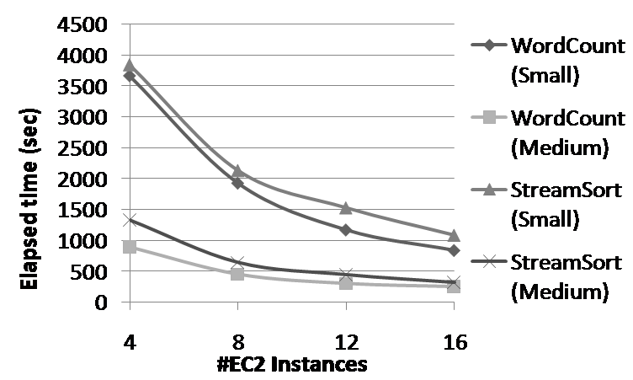
Performance and costs for Hadoop vs. the number of same-type instances on EC2
(a) Time for Hadoop

Slide 22
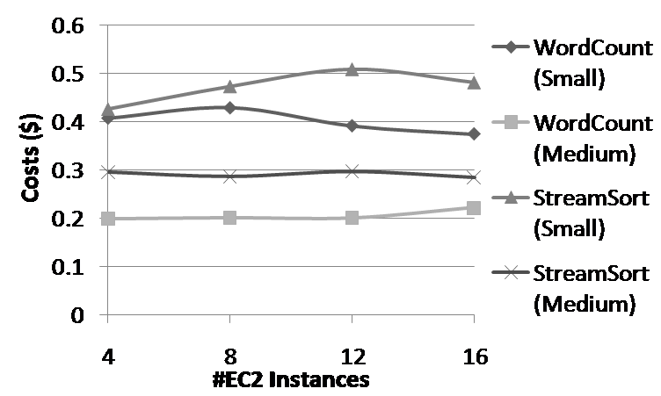
(b) Costs for Hadoop

Slide 23
the elapsed times and costs of optimized single-machine benchmarks
 | On a small instance |  | On a medium instance
 | Elapsed time (sec) | Cost ($) | Elapsed time (sec) | Cost ($)
Postmark | 204.0 | 0.0054 | 203.2 | 0.0106
Dedup | 45 | 0.0012 | 14 | 0.0008
BlackScholes | 934 | 0.0246 | 215 | 0.0113

Slide 24
User Optimizations on EC2
User optimizations on EC2 include application-level optimizations for a fixed instance type
choosing the suitable instance type
tuning the number of instances

Slide 25
Failures
Bugs are not the only cause of failures
transient failures in the cloud infrastructure also occur
Transient failures in the underlying infrastructure could be a significant
factor for provisioning user costs

Slide 26
Conclusion
Our preliminary study has revealed
interesting issues as a result of the tensions between users and providers and between distributed systems and economics

Slide 27
Reference
[1] Hongyi Wang, Qingfeng Jing, Rishan Chen◦ Bingsheng He, Zhengping Qian, Lidong Zhou,
“Distributed Systems Meet Economics: Pricing in the Cloud”, In Proceeding of the USENIX workshop on hot topics in Cloud Computing, 2010, Boston, MA, USA.

