Slide 1
FOS (Factored Operating System) An Operating System for Multicore and Clouds
Hadi Salimi
Distributed Systems Labaratory,
School of Computer Engineering,
Iran University of Science and Technology,
hsalimi@iust.ac.ir
Fall 2010

Slide 2
Topics Covered
Introduction
Definition
Current Cloud Systems’ challenges
Benefits of a Single System Image (SSI)
Challenges of Multicore & Cloud operating systems
Architecture of fos
File System
Conclusion
Related Works

Slide 3
Introduction
Nowadays Users have proceeded from using mainframes to personal computers to laptops, and most recently, to multicore and cloud computers.
Two emergent classes of computational hardware that have the potential to provide novel compute capacity to the average user are cloud computers (CC) and multicore processors (MP).
In order for the user to effectively Control all of this computational power, we need an operating systems for these new hardware platforms.

Slide 4
Definition
In this presentation we describe the mechanisms and implementation of a factored operating system named fos.
fos is a single system image operating system across both multicore and Infrastructure as a Service (IaaS) cloud systems.
fos deals with OS scalability challenges by factoring the OS into its component system services.

Slide 5
Current Cloud Systems’ challenges
Current IaaS systems present a fractured and non-uniform view of resources to the programmer.
Existing operating systems handle scheduling within a machine, but the user must often build or buy server load balancers for scheduling across machines.

Slide 6
Benefits of a Single System Image (SSI)
Definition of a SSI
Benefits:
Ease of administration
Transparent sharing
Informed optimizations
Consistency
Fault tolerance

Slide 7
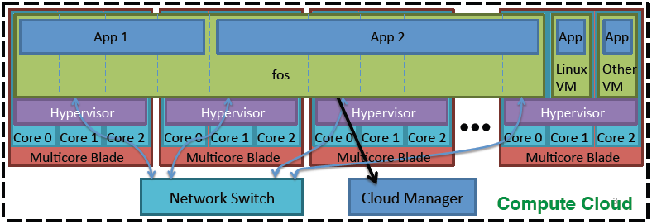
Benefits of a Single System Image (SSI)
Continued
fos provides a single system image across all the cloud nodes:

Slide 8
Challenges of Multicore & Cloud operating systems
Cloud computing infrastructure and multicore processors present many common challenges with respect to the operating system, such as:
Scalability
Variability of Demand
Faults
Programming Challenges

Slide 9
Scalability
The major concern for future OSes in both single machine and cloud systems is Scalability.
The number of transistors which fit onto a single chip microprocessor is exponentially increasing.
Therefore, multicore OSes need to embrace scalability and make it a first order design constraint.

Slide 10
Variability of Demand
The load on a manycore system translates into number of cores being used.
Thus, the system must manage the number of live cores to match the demand of the user.

Slide 11
Faults
As the hardware industry is continuously decreasing the size of transistors and increasing their count on a single chip, the chance of faults is rising.
Managing software and hardware faults is another common challenge for future multicore and cloud systems.

Slide 12
Programming Challenges
Developing cloud applications composed of several components deployed across many machines is a difficult task.
Furthermore, there is not a uniform programming model for communicating within a single multicore machine and between machines.

Slide 13
Architecture of fos
fos is an operating system which takes scalability and adaptability as the first order design constraints.
Design principles used to achieve the goal of scaling over multiple orders of magnitude in core count:
Space multiplexing replaces time multiplexing.
OS is factored into function-specific services.
OS adapts resource utilization to changing system needs.
Faults are detected and handled by OS.

Slide 14
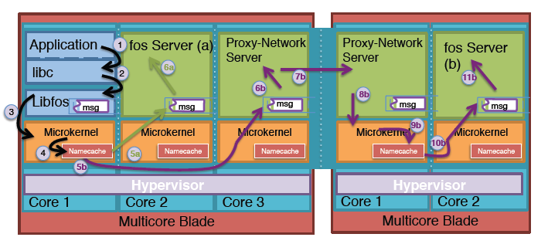
Architecture of fos
Continued
An overview of the fos server architecture:

Slide 15
Architecture of fos
Continued
Specifications:
Microkernels
Messaging
Naming
OS Services

Slide 16
File System
An example of the interaction between the different servers in fos is the fos file server.
Proper authentication and credential verification for each operation is performed by the messaging layer in the microkernel.

Slide 17
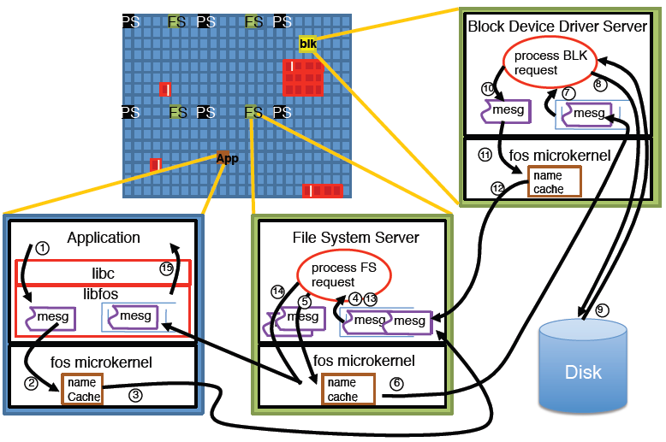
Anatomy of a File System Access

Slide 18
Conclusion
Cloud computing and multicores have created new classes of platforms for application development;
Fos seeks to surmount these issues by presenting a single system interface to the user and by providing a programming model that allows OS system services to scale with demand;
Fos is scalable and adaptive;

Slide 19
Related Works
There are several classes of systems which have similarities to fos:
Traditional microkernels.
Like: Mach, L4, …
Distributed Oses.
Like: Amoeba, Sprite, and Clouds
Cloud computing infrastructure.
Like: Google AppEngine, and MS Azure

Slide 20
References
An operating system for multicore and clouds: mechanisms and implementation. David Wentzlaff, Charles Gruenwald, III, Nathan Beckmann, Kevin Modzelewski, Adam Belay, Lamia Youseff, Jason Miller, Anant Agarwal. SOCC 2010.

