Slide 1
Orleans: A framework for cloud computing
Hadi Salimi
Distributed Systems Lab,
Computer Engineering School,
Iran University of Schience and Technology,
Tehran, Iran
halimi@iust.ac.ir
Winter 2011

Slide 2
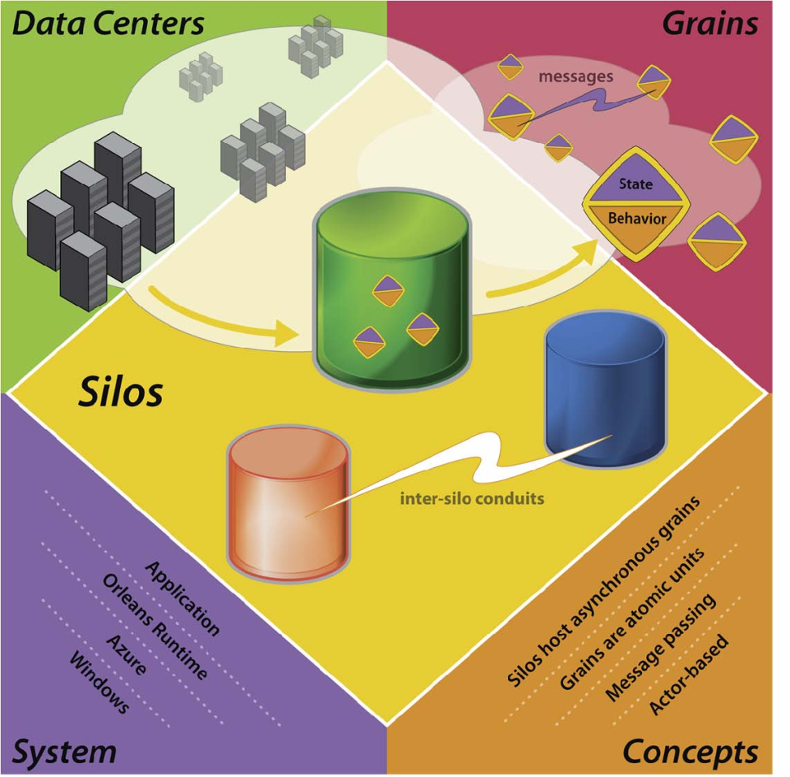
Introduction
The scope?
Client + Cloud computing
Combine diverse client devices
Ubiquitous computing
What is the challenge?
Highly parallel and distributed
Should be highly available, reliable and secure
The key challenge is scale

Slide 3
What is Orleans?
A software framework for building Cloud applications
Offers a simple programming model
Built around grains
Imposes restriction on concurrency

Slide 4
Grain
Logical units of computation with private state that communicate by sending messages
A service is constructed from grains running on the server
At any time, may have zero, one or multiple activations

Slide 5
Grain (cont’d)
Activation
The physical instantiation of a grain on a server
Processes an external request to completion before turning to the subsequent request
Are completely isolated
Cannot share memory or invoke each others methods directly
Can place independently on any server
Can migrate between servers

Slide 6
Grain (cont’d)
Security
Communicate only through a reference to another
A logically isolated workspace called grain domain
Delimits the set of grains it can directly access
Domains are hierarchical and nested
Orleans consider s a grain domain for each customer

Slide 7
Transactions
Orleans offers transactions for three reasons:
Isolate concurrent computations
Replication of data and computation
Reduce the need for explicit error handling code

Slide 8
Communications
Occurs through asynchronous messages between grains
Most messages follow request/reply pattern
May designate certain messages as event notification
In future will use single request, multiple-reply pattern
Are exposed at method calls
Unlike traditional RPC model, these calls return immediately with a promise

Slide 9
Asynchrony and Promises
Orleans uses promises as asynchrony primitives
Promises are fully integrated with the .NET async models.
Promises have a simple lifecycle

Slide 10
Asynchrony and Promises (cont’d)
A caller that invokes an asynchronous operation do one or more of the following:
Synchronously wait for the promise to resolve
Schedule a continuation action with the continueWith() method

Slide 11
Asynchrony and Promises (cont’d)
Return the promise, if the caller itself is an asynchronous method with a compatible return type
Join the promise with other promises, producing another promise
Explicitly ignore the outcome of promise resolution with the ignore() method

Slide 12
Grain interfaces
A grain class implements one or more public grain interfaces that define service contracts.
A grain interface is an interface that adheres to the following rules:
A grain interface must directly or indirectly inherit from the Igrain marker interface
All methods and property getters must be asynchronous
No property setters and no subscribe/unsubscribe to events

Slide 13
Grain interfaces (cont’d)
Method arguments must be grain interface types
For example:

Slide 14
Grain references
A grain reference is a proxy object that provides access to a grain
A grain reference is the only way that a client, whether another grain or a non-grain client, can access a grain
A grain reference can be in one of the three possible states: unresolved, fulfilled or broken

Slide 15
Grain state
The state of a grain is managed by the Orleans runtime
May be in the state of:
Initialization
Persistence
Replication
Migration

Slide 16
Conclusion
Orleans borrows many concepts from prior systems.
Actor models
A well-known model for concurrent programming
Forms the basis for many programming languages such as: Erlang, Ptolemy and E
Orleans differ from classic actor in:
Mutability of grain state
Its asynchronous communication and promises
Its message ordering guarantees
Its support for replication
Its transactional model
Consistency guarantees
Distributed object model

Slide 17
Reference
[1] Sergey Bykov, Alan Geller, Gabriel Kliot, James R. Larus, Ravi Pandya, Jorgen Thelin, "Orleans: A Framework for Cloud Computing ", eXtreme Computing Group, Microsoft Research, November 2010

