Slide 1
Fundamentals of Computer Programming
IN HIS NAME

Slide 2
Course description
Instructor: Mohammad amin mehralian
Contact: mehralian@comp.iust.ac.ir
Put CP before the subject: ex: CP اعتراض به نمره
Time: Sat. & Mon., [15:30] -> [17]
Textbooks: Your own choice!
Grading Policy:
0-3 Midterms:
Final Exam:
Programming Assignments
Quizzes

Slide 3
A Computer System (Contd.)
In general, a computer is a machine which accepts data, processes it and returns new information as output.
Processing
Data
Information

Slide 4
Language of Computers
Computers only understand the electronic signals.
Either Current is flowing or not.
Current Flowing : ON
Current Not Flowing : OFF
Binary Language
ON : 1
OFF : 0
Bit, Byte, KB, MB, GB

Slide 5
Metric units

Slide 6
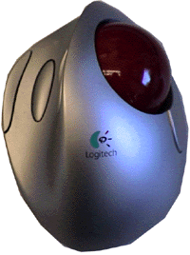
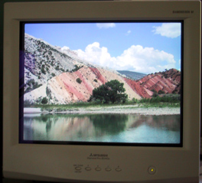
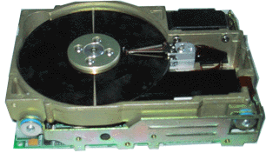
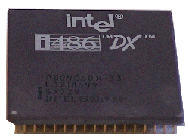
Components of a simple personal computer
Outside world
Video controller
Hard drive controller
USB controller
Network controller
CPU
Computer internals (inside the “box”)
Memory

Slide 7
A Look Inside….
Outside world
Video controller
Hard drive controller
USB controller
Network controller
CPU
Computer internals (inside the “box”)
Memory

Slide 8
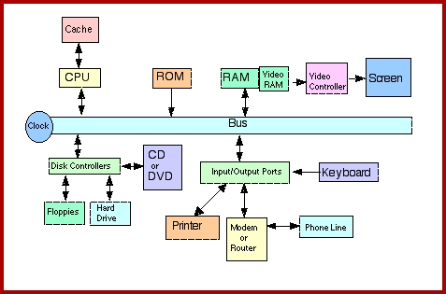
Von Neumann architecture

Slide 9
CPU
The central processing unit or (CPU) is the "brain" of your computer. It contains the electronic circuits that cause the computer to follow instructions from memory.
The CPU contains three main parts, all housed
in a single package (Chip):
Control Unit (CU)
Arithmetic Logic Unit (ALU)
Memory
CU
ALU
Memory
Registers

Slide 10
Computer
Keyboard
Mouse
Scanner
Modem
CPU
Monitor
Printer
Modem
Input Unit
Control Unit
Output Unit
ALU
Registers Bank
Cache Memory
Memory
Main Memory
RAM
ROM
Secondary Memory
HD
FD
CD
Flash
Tertiary Memory
Tape

Slide 11
Storage pyramid
Capacity
Access latency
< 1 KB
Registers
1 ns
Better
1 MB
Cache (SRAM)
2–5 ns
1 GB
Main memory (DRAM)
50 ns
200 GB
Magnetic disk
5 ms
Better
> 1 TB
Magnetic tape
50 sec
Goal: really large memory with very low latency
Latencies are smaller at the top of the hierarchy
Capacities are larger at the bottom of the hierarchy
Solution: move data between levels to create illusion of large memory with low latency

Slide 12
Software
Software is set of programs (which are step by step instructions) telling the computer how to process data.
Software needs to be installed on a computer, usually from a CD.
Softwares can be divided into two groups:
- System SW
- Application SW

Slide 13
System Software
System Software
It controls the overall operation of the system.
It is stored in the computer's memory and instructs the computer to load, store, and execute an application.
Examples:
Operating System (OS):DOS, Windows, Unix, Linux, Mac, Solaris, etc.
Drivers, Disk Managers, …

Slide 14
Computer Machine (Hardware)
Machine Language (Low Level Language)
Operating System
Human Understandable Language (High Level Language)
User / Programmer

Slide 15
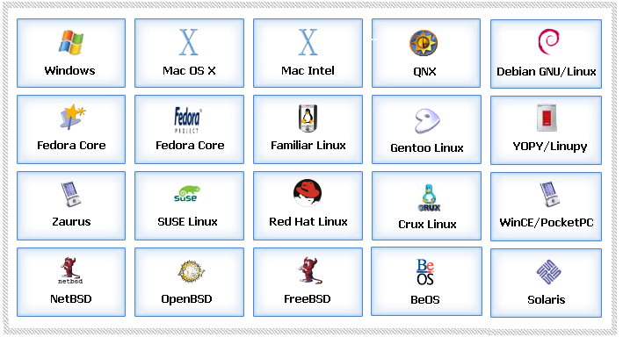
Samples of Operating Systems (continue…)

Slide 16
Application Software
Application Software
They are Softwares written to perform specific tasks.
The basic types of application software are:
word processing, database, spreadsheet, desktop publishing, and communication.
Examples: Notepad!, MS Office, Skype, Firefox

Slide 17
Machine Languages
System of instructions and data directly understandable by a computer's central processing unit.
Example:
100011 00011 01000 00000 00001 000100
000010 00000 00000 00000 10000 000001
000000 00001 00010 00110 00000 100000
Every CPU model has its own machine code, or instruction set, although there is considerable overlap between some

Slide 18
Assembly Languages
Human-readable notation for the machine language that a specific computer architecture uses representing elementary computer operations (translated via assemblers)
Example:
load hourlyRate
mul workHours
store salary
Even into the 1990s, the majority of console video games were written in assembly language.

Slide 19
Available Programming Languages
Machine Languages
Assembly Languages
High-level Languages
Pascal, BASIC (Educational)
C/C++
MATLAB, J, Fortran, R (Array processing, Mathematics)
JAVA, C#, VB.NET
Python
Scala, Haskell (Functional)
Prolog (Logic-based programming)
Special Purpose: GAMS, SQL
Hardware description Languages: (VHDL, Verilog)
Etc.

Slide 20
High-level Languages
Higher level of abstraction from machine language
Codes similar to everyday English
Use mathematical notations (translated via compilers)
Example:
salary = hourlyRate * workHours
Make complex programming simpler

Slide 21
Interpreters and Compilers
Computers cannot understand human-language. They understand machine-language.
Machine-language is all ones and zeros.
To get a computer to understand a high-level language like Python, we have to translate.

Slide 22
Interpreters
The first type of translator is an interpreter.
Interpreters read the source-code a programmer writes, parses the code, and interprets it on-the-fly.
Interpreters can be interactive.
Python is an interpreter.

Slide 23
Interpreters: Example
>>> x = 6
>>> print x
>>> y = x * 7
>>> print y

Slide 24
Compilers
Compilers need to have the entire program written into a file. It runs a process to convert the program to machine-language, and saves this for later use.
File extensions such as “.exe” (executable) and “.dll” (dynamically loadable library) are examples.
C is a compiled language.

Slide 25
Software Development Cycle
Library
Editor
Compiler
Linker
XXX.c
Source Program
XXX.obj
Object Program
XXX.exe
Executable
C:\XXX↓
Debugger

Slide 26
Why Programming using C
General-purpose computer programming language
high-level assembly
Simplicity and efficiency of the code
The most widely used programming languages
Both in academia and industry
Commonly used for writing system software
Widely used for writing applications
Hardware independent (portable)
Great influence on many other popular languages
Ease of switching to other languages

Slide 27
?

