Slide 1


MPI(Message Passing Interface)
Ali Jafari
Fall 2016
School of Computer Engineering

Slide 2
Presentation Overview
Introduction
History of MPI?
Why MPI?
MPI Implementations
Install MPI Cluster
MPI Programming: Process Model and Language Bindings
MPI Programming: Point to Point Communication
MPI Programming: MPI Broadcast and Collective Communication
The Future of MPI
MPI Tools
Conclusion

Slide 3
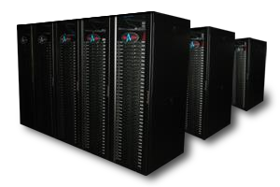
Introduction
HPC(High Performance Computing)
  Definition
    High Performance Computing most generally refers to the practice of aggregating computing power in a way that delivers much higher performance than one could get out of a typical desktop computer or workstation in order to solve large problems in science, engineering, or business
  What is the meaning of performance?
  What is the meaning of large Problem?

Slide 4
Introduction
Applications (Science and Engineering)
  Atmosphere, Earth, Environment
  Physics - applied, nuclear, particle, condensed matter, high
pressure, fusion, photonics
  Bioscience, Biotechnology, Genetics
  Chemistry, Molecular Sciences
  Geology, Seismology
  Mechanical Engineering - from prosthetics to spacecraft
  Electrical Engineering, Circuit Design, Microelectronics
  Computer Science, Mathematics

Slide 5

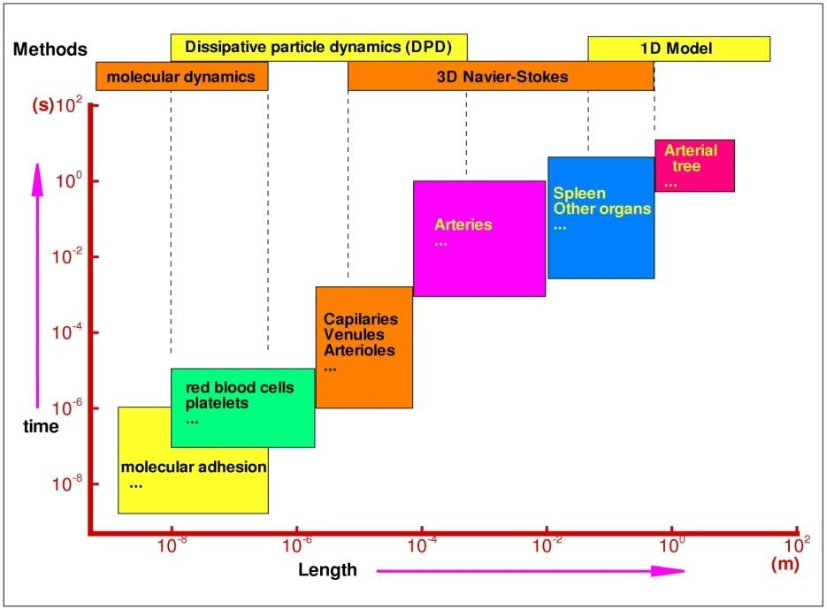
Introduction
HPC Example
Cardiovascular disease accounts for about
50% of deaths in western world
Formation of arterial disease strongly correlated to blood flow patterns
Blood flow involves multiple scales
In one minute, the heart pumps the entire blood supply of 5 quarts through 60,000 miles of vessels, that is a quarter of the distance between the moon and the earth
Computational challenges: Enormous problem size

Slide 6


Introduction
HPC Example
Earthquake simulation
Surface velocity 75 sec after
earthquake
7
Flu pandemic simulation 300 million people tracked
Density of infected population, 45 days after breakout

Slide 7
Introduction
The switch from sequential to parallel computing
  Moore’s law continues to be true, but…
    Processor speeds no longer double every 18-24 months
    Number of processing units double, instead
– Multi-core chips (dual-core, quad-core)
  Parallelism is the norm
    Lots of processors connected over a network and coordinating to solve large problems
    Used every where!

Slide 8
Introduction
Sample Parallel Programming Models
  Shared Memory Programming
    Processes share memory address space (threads model)
    Application ensures no data corruption (Lock/Unlock)
  Transparent Parallelization
    Compiler works magic on sequential programs
  Message Passing
    Explicit communication between processes (like sending and
receiving emails)

Slide 9
Introduction
The Message-Passing Model
  A process is (traditionally) a program counter and address
space
  Processes may have multiple threads (program counters and associated stacks) sharing a single address space
  MPI is for communication among processes, which have
separate address spaces
  Inter-process communication consists of
    synchronization
    movement of data from one process’s address space to another’s
MPI
Memory 1
Process 1
Process 2 Memory 2
MPI

Slide 10


Introduction
The Message-Passing Model(cont)
  an example
    Sorting Integers
8 | 23 | 19 | 67 | 45 | 35 | 1 | 24 | 13 | 30 | 3 | 5
O(N log N)
Process1
Process2
24 30
O(N/2 log N/2)
8 | 19 | 23 | 35 | 45 | 67
1 3 5 13
O(N/2 log N/2)
1 | 3 | 5 | 8 | 13 | 19 | 23 | 24 | 30 | 35 | 45 | 67
O(N)
Process1

Slide 11
History of MPI
History
  MPI-1 supports the classical message-passing
programming model
    basic point-to-point communication
    Collectives
    datatypes, etc
  MPI-1 was defined (1994) by a broadly based group of parallel computer vendors, computer scientists, and applications developers
    2-year intensive process
  Implementations appeared quickly and now MPI is taken for granted as vendor-supported software on any parallel machine
  Free, portable implementations exist for clusters and other environments (MPICH, Open MPI)

Slide 12
History of MPI
History(cont)
  MPI-2 was released in 1997
    Several additional features including MPI + threads, MPI-I/O,
remote memory access functionality and many others
  MPI-2 is an extension of MPI
    Extends the message-passing model.
      Parallel I/O
      Remote memory operations (one-sided)
      Dynamic process management
    Adds other functionality
      C++ and Fortran 90 bindings
» Similar to original C and Fortran-77 bindings
      External interfaces
      Language interoperability
      MPI interaction with threads

Slide 13
History of MPI
History(cont)
  MPI-3 was released in 2012
  Overview of New Features in MPI-3
    Major new features
      Nonblocking collectives
      Neighborhood collectives
      Improved one-sided communication interface
      Tools interface
      Fortran 2008 bindings
    Other new features
      Matching Probe and Recv for thread-safe probe and receive
      Noncollective communicator creation function
      “const” correct C bindings
      Comm_split_type function
      Nonblocking Comm_dup
      Type_create_hindexed_block function
    C++ bindings removed
    Previously deprecated functions removed

Slide 14
History of MPI
History(cont)
  MPI-2.1 (2008) and MPI-2.2 (2009) were recently released with
some corrections to the standard and small features
  The Standard itself:
    at http://www.mpi-forum.org
    All MPI official releases, in both postscript and HTML
  Other information on Web:
    at http://www.mcs.anl.gov/mpi
    pointers to lots of material including tutorials, a FAQ, other MPI pages

Slide 15
Why MPI?
Reasons for Using MPI
  Standardization
    MPI is the only message passing library which can be considered a
standard
    It is supported on all HPC platforms. Practically, it has replaced all previous message passing libraries
  Portability
    There is no need to modify your source code when you port your application to a different platform that supports (and is compliant with) the MPI standard
  Performance Opportunities
    Vendor implementations should be able to exploit native hardware features to optimize performance
  Functionality
    Rich set of features
  Availability
    A variety of implementations are available, both vendor and public domain

Slide 16
MPI Implementations
Status of MPI-3 Implementations
 | MPICH | MVAPICH | Open MPI | Cray MPI | Tianhe MPI | Intel MPI | IBM BG/Q MPI ¹ | IBM PE MPICH ² | IBM Platform | SGI MPI | Fujitsu MPI | Microsoft MPI
NB collectives | ✔ | ✔ | ✔ | ✔ | ✔ | ✔ | ✔ |  | ✔ | ✔
Neighborhood collectives | ✔ | ✔ | ✔ | ✔ | ✔ | ✔ | ✔
RMA | ✔ | ✔ | ✔ | ✔ | ✔ | ✔ | ✔
Shared memory | ✔ | ✔ | ✔ | ✔ | ✔ | ✔ | ✔
Tools Interface | ✔ | ✔ | ✔ |  |  |  | ✔
Non-collective comm. create | ✔ | ✔ | ✔ | ✔ | ✔ | ✔ | ✔ |  |  | ✔
F08 Bindings | ✔ |  | ✔ |  |  |  | ✔
New Datatypes | ✔ | ✔ | ✔ | ✔ | ✔ | ✔ | ✔ |  |  | ✔
Large Counts | ✔ | ✔ | ✔ | ✔ | ✔ | ✔ | ✔
Matched Probe | ✔ | ✔ | ✔ | ✔ | ✔ | ✔ | ✔ |  |  | ✔
¹ Open source
² Beta release
14

Slide 17
MPI Implementations
MPICH
  MPICH is a high-performance and widely portable open-
source implementation of MPI
  It provides all features of MPI that have been defined so far (including MPI-1, MPI-2.0, MPI-2.1, MPI-2.2, and MPI- 3.0)
  Active development lead by Argonne National Laboratory
and University of Illinois at Urbana-Champaign
    Several close collaborators who contribute many features, bug fixes, testing for quality assurance, etc
– IBM, Microsoft, Cray, Intel, Ohio State University, Queen’s University, Myricom and many others
  Current release is MPICH-3.1.4

Slide 18
Install MPI Cluster
SSH(Security SHell)
  Definition
    SSH is a network protocol for secure remote access to a machine over untrusted networks
  Features
    Provides a secure channel for data transmission
    Not a command interpreter
    Provides a secure pipe to open up a command interpreter
    Supports secure remote logins, secure remote command
execution, secure file transfers
    Has a client server architecture – SSH server program and client program

Slide 19

Install MPI Cluster
SSH(cont)
  History
    Created by Tatu Ylönen in July 1995, a student of Helsinki
University of Technology
    Founded SSH communications security Ltd., in late 1995 (http://www.ssh.com)
    SSH 1 version
    SSH 2 version
    OpenSSH in 1999
– As of 2005, OpenSSH was the single most popular SSH implementation

Slide 20
Install MPI Cluster
SSH(cont)
– Install OpenSSH
//In all nodes
sudo apt-get install
//In all nodes
sudo apt-get install
//In all nodes
//create a ssh directory
ls .ssh cd .ssh
openssh-server
openssh-client
//login into all slave nodes by below command
ssh “slave usrename”@”salve ip addr”
//Now you can control all slave by master machine
//Type “exit” and return to master machine
//To login without password, you need to create a key

Slide 21
Install MPI Cluster
SSH(cont)
– Install OpenSSH(cont)
//In master node
ssh-keygen –t dsa
//Press Enter
scp id_dsa.pub “slave username”@”slave ip addr”:~/.ssh/id_dsa.pub //For all slave nodes
//In all slave nodes
cat id_dsa.pub >> authorized_keys
//Now you can login into all slave nodes by master without password

Slide 22
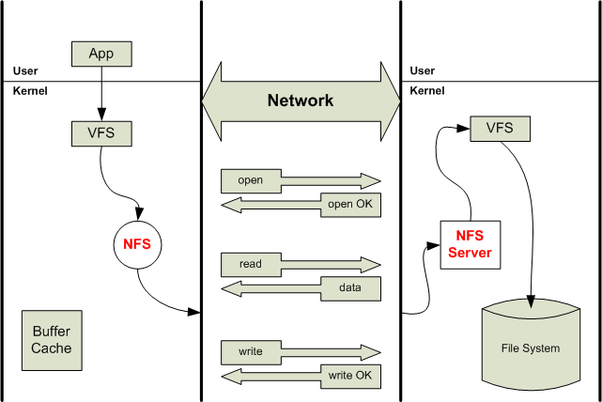
Install MPI Cluster
NFS(Network File System)
  Definition
    NFS is a distributed file system protocol that allowing a user on a client computer to access files over a network much like local storage is accessed
    Could be UDP and TCP

Slide 23
Install MPI Cluster
NFS(cont)
  History
    Created by Sun Microsystems in 1985
    Version 2 in 1989
      Slow
» Write operation is not complete until receiving ACK from the server
    Version 3 in 1995
      Faster
» Permits async writes
    Version 4 in 2000
      Supports strong security, unicode filenames, replication and migration, etc

Slide 24
Install MPI Cluster
NFS(cont)
– Install NFS
//In master node
sudo apt-get install nfs-server
//In root directory
sudo mkdir /mirror //create a share directory between all nodes
ls /mirror
chown nobody:nogroup /mirror sudo pico /etc/exports
/mirror *(rw,sync) ctrl+x
sudo exportfs –a
//In all slave nodes
sudo apt-get install nfs-client sudo mkdir –p /mirror
ls /mirror

Slide 25
Install MPI Cluster
NFS(cont)
– Install NFS(cont)
//In master node
sudo /etc/init.d/nfs-kernel-server
//In all slave nodes
//Manually mount
sudo mount “master ip addr”:/mirror
slave nodes in each system boot
//Auto mount(Recommended)
//In all slave nodes
sudo pico /etc/fstab
//Add
start
/mirror //Need to mount
“master ip addr”:/mirror
ctrl+x
sudo mount –a
/mirror

Slide 26
Install MPI Cluster
Install MPICH
  Install MPICH2(cont)
    Auto(Recommended)
//In all nodes
sudo apt-get install
mpich2
Manually
//In all nodes
//Go to mpich2.org and get last version of mpich2(also you can use
“wget” command)
//Extract downloaded file
sudo tar xvf ”file name” cd “file name”
//Before start mpich2 installation, you need install a C compiler
sudo apt-get install build-essential

Slide 27
Install MPI Cluster
Install MPICH(cont)
  Install MPICH2(cont)
    Manually(cont)
sudo ./configure –-prefix=/mirror/mpich2
--disable-f77 –-disable-fc sudo make
sudo make install
//Installation completed
//Set environment variables
export PATH=/mirror/mpich2/bin:$PATH
export LD_LIBRARY_PATH=“/mirror/mpich2/lib:
$LD_LIBRARY_PATH”
Sudo pico /etc/environment
//Add
/mirror/mpich2/bin:
//To ensure from installation, use below command
which which which
mpicc mpiexec mpirun

Slide 28
Install MPI Cluster
Compiling and Running MPI Application
//Go to mirror directory
//Create a file and insert into all nodes ip addr
sudo pico hosts ctrl+x
//To compile a mpi program, use this command
mpicc “program name.c” –o “program name” mpiexec -f hosts –n “number of nodes” ./program
//or
mpirun –f hosts –n “number of nodes” ./program
//Hosts tell mpi to run the program of the machines of hosts
//Now you can write a mpi program and run it
name

Slide 29
MPI Programming: Process Model and Language Bindings
Header File(in C)
  #include<mpi.h>
MPI Function Format
  MPI_Xxxxxx(parameter, ...)
  MPI Function return error codes or MPI_SUCCESS
Initializing MPI
  MPI_Init( int *argc, char **argv)
  Must be first MPI routine that is called
  MPI_Init takes two arguments that are not necessary
#include <mpi.h>
int main(int argc, char **argv)
{
MPI_Init(&argc, &argv);
....

Slide 30


MPI Programming: Process Model and Language Bindings
Communicator
  MPI processes can be collected into groups
  Each group can have multiple colors (some times called
context)
  Group + Color = communicator (it is like a name for the group)
  All processes of an MPI program are members of the
default communicator MPI_COMM_WORLD
  MPI_COMM_WORLD is a predefined handle in mpi.h
  Each process has its own rank in a communicator
starting with 0
ending with (size-1)
Communicator
1
2
4
6
0
3
7
5

Slide 31





MPI Programming: Process Model and Language Bindings
Rank
  The rank identifies different processes within a
communicator
  The rank is the basis for any work and data distribution
    The ranks of the processes are primarily used for identification purposes when sending and receiving messages
  MPI_Comm_rank( MPI_Comm comm, int *rank)
myank=0
myrank=1
myrank=2
myrank= (size-1)
Process 0
Process 1
Process 2
Process
size -1
Communicator

Slide 32

MPI Programming: Process Model and Language Bindings
mpiexec
-n 16 –f hosts./test_program
When you start an MPI program, there is one predefined communicator MPI_COMM_WORLD
Communicators do not need to contain all processes in the system
 | 0 | 1
0 | 12 | 23 | 3
4 | 54 | 65 | 7
 | 6 | 7
Every process in a communicator has an ID called as “rank”
Can make copies of this communicator (same group of processes, but different “aliases”)
The same process might have different ranks in different communicators
Communicators can be created “by hand” or using tools provided by MPI Simple programs typically only use the predefined communicator MPI_COMM_WORLD

Slide 33


MPI Programming: Process Model and Language Bindings
Size
  Number of processes are contained within a communicator
  MPI_Comm_size( MPI_Comm comm, int *size)
  “-n Number of Process” in execution command, represents the size
communicator
0
1 2
6
5
3
8
10
4
7
12
9 11
Size of Communicator=MAX(rank)+1=13

Slide 34
MPI Programming: Process Model and Language Bindings
Exiting MPI
  MPI_Finalize()
  Must be called last by all processes
  After MPI_Finalize
    Further MPI-calls are forbidden
    Especially re-initialization with MPI_Init is forbidden
#include <mpi.h>
int main(int argc, char **argv)
{
MPI_Init(&argc, &argv);
....
MPI_Finalize(); return 0;
}

Slide 35
MPI Programming: Process Model and Language Bindings
MPI Datatypes
MPI Datatypes | C Equivalent
MPI_CHAR | signed char
MPI_SHORT | signed short int
MPI_INT | signed int
MPI_LONG | signed long int
MPI_UNSIGNED_CHAR | unsigned char
MPI_UNSIGNED_SHORT | unsigned short int
MPI_UNSIGNED | unsigned int
MPI_UNSIGNED_LONG | unsigned long int
MPI_FLOAT | float
MPI_DOUBLE | double
MPI_LONG_DOUBLE | long double
MPI_BYTE
MPI_PACKED

Slide 36
MPI Programming: Process Model and Language Bindings
Example 1, Hello World
– If size=3, output is
#include <mpi.h>
int main(int argc, char **argv)
{
MPI_Init(&argc, &argv);
int myRank, size; MPI_Comm_size(MPI_COMM_WOLRD, &size); MPI_Comm_rank(MPI_COMM_WORLD, &myRank);
printf(“Hello World, My rank is %d and size is %d processors\n” myRank, size);
MPI_Finalize(); return 0;
}
Hello | World, | My | rank | is | 0 | and | size | is | 3
Hello | World, | My | rank | is | 1 | and | size | is | 3
Hello | World, | My | rank | is | 2 | and | size | is | 3

Slide 37


MPI Programming: Point to Point Communication
Point to Point Communication
  Communication between two processes
  Source process sends message to destination process
  Communication takes place within a communicator, e.g., MPI_COMM_WORLD
  Processes are identified by their ranks in the communicator
Communicator
1
2
Message
0
5
Destination
4
3
Source
6

Slide 38

MPI Programming: Point to Point Communication
For a communication to succeed
  Sender must specify a valid destination rank
  Receiver must specify a valid source rank
  The communicator must be the same
  Tags must match
  Message datatypes must match
  Receiver’s buffer must be large enough
Sender
Receiver
Message
From: source rank
tag Comm1 dataType
to: destination rank
tag Comm1 dataType
To:
destination rank
From:
source rank

Slide 39
MPI Programming: Point to Point Communication
Blocking Communication
  A process sending data will be blocked until data in the
send buffer is emptied
  A process receiving data will be blocked until the receive buffer is filled
  Exact completion semantics of communication generally
depends on the message size and the system buffer size
beep
ok
38

Slide 40
MPI Programming: Point to Point Communication
Sending a Message
MPI_Send(void *buf, int count, MPI_Datatype datatype, int dest, int tag, MPI_Comm comm)
Source equals destination is allowed that is, a process can send a message to itself
Arguments | Meanings
buf | Starting address of send buffer
count | # of elements
datatype | Data type of each send buffer element
dest | Processor ID (rank) destination
Tag | Message tag, can be used by the program to distinguish different types of messages
comm | Communicator

Slide 41
MPI Programming: Point to Point Communication
Receiving a Message
– MPI_Recv(void *buf, int count, MPI_Datatype datatype, int source, int tag, MPI_Comm comm, MPI_Status *status)
Arguments | Meanings
buf | Starting address of send buffer
count | # of elements
datatype | Data type of each send buffer element
source | Processor ID (rank) destination, you can use from MPI_ANY_SOURCE to receive message from any source
tag | Message tag, can be used by the program to distinguish different types of messages. Only messages with matching tag are received, you can use from MPI_ANY_TAG to receive message from any tag
comm | Communicator
status | Status object, provides information about the received message. Actual source and tag are returned in the receiver’s status parameter

Slide 42
















MPI Programming: Point to Point Communication
Tow-sided Communication
Memory
Process 0
Process 1
Memory
Memory Segment
Memory
Segment
Memory
Segment
Memory
Segment
Memory
Segment
Send
Recv
Send
Recv
MPI implementation
MPI implementation
41

Slide 43
MPI Programming: Point to Point Communication
Example 2, a simple MPI send/receive program
#include <mpi.h>
int main(int argc, char **argv)
{
MPI_Init(&argc, &argv); int myRank, size; MPI_Com
MPI_Com
 |  |  | Output
Process | 1 | received |  | number | -1 |  | from | process | 0
m_size(MPI_COMM_WOLRD, &size);
m_rank(MPI_COMM_WORLD, &myRank);
int number;
if (rank == 0) { number = -1; MPI_Send(&number,
} else if (rank == 1)
MPI_Recv(&number,
1, MPI_INT,
{
1,
1, 0, MPI_COMM_WORLD);
MPI_INT, 0, 0, MPI_COMM_WORLD,
MPI_STATUS_IGNORE);
printf("Process 1 received number %d from process 0\n", number);
}
MPI_Finalize();
return 0;
}

Slide 44
MPI Programming: Point to Point Communication
Example 3, Ping Pong program
– The major portions of the code
int ping_pong_count = 0;
int partner_rank = (world_rank + 1) % 2;
while (ping_pong_count < PING_PONG_LIMIT) {
if (world_rank == ping_pong_count % 2) {
// Increment the ping pong count before ping_pong_count++;
you send it
MPI_Send(&ping_pong_count, 1, MPI_INT, partner_rank, 0, MPI_COMM_WORLD);
printf("%d sent and incremented ping_pong_count " "%d to %d\n", world_rank, ping_pong_count, partner_rank);
} else {
MPI_Recv(&ping_pong_count, 1, MPI_INT, partner_rank, 0, MPI_COMM_WORLD, MPI_STATUS_IGNORE);
printf("%d received ping_pong_count %d from %d\n", world_rank, ping_pong_count, partner_rank);
}
}

Slide 45
MPI Programming: Point to Point Communication
Example 3, Ping Pong program(cont)
– The output of the example code will look something like this
0 | sent and | incremented ping_pong_count | 1 | to | 1
0 | received | ping_pong_count 2 from 1
0 | sent and | incremented ping_pong_count | 3 | to | 1
0 | received | ping_pong_count 4 from 1
0 | sent and | incremented ping_pong_count | 5 | to | 1
0 | received | ping_pong_count 6 from 1
0 | sent and | incremented ping_pong_count | 7 | to | 1
0 | received | ping_pong_count 8 from 1
0 | sent and | incremented ping_pong_count | 9 | to | 1
0 | received | ping_pong_count 10 from 1
1 | sent and | incremented ping_pong_count | 1 | to | 0
1 | received | ping_pong_count 2 from 0
1 | sent and | incremented ping_pong_count | 3 | to | 0
1 | received | ping_pong_count 4 from 0
1 | sent and | incremented ping_pong_count | 5 | to | 0
1 | received | ping_pong_count 6 from 0
1 | sent and | incremented ping_pong_count | 7 | to | 0
1 | received | ping_pong_count 8 from 0
1 | sent and | incremented ping_pong_count | 9 | to | 0
1 | received | ping_pong_count 10 from 0

Slide 46
MPI Programming: Point to Point Communication
Example 4, Ring program
– The major portions of the code
int token;
if (world_rank != 0) {
MPI_Recv(&token, 1, MPI_INT, world_rank - 1, 0,
MPI_COMM_WORLD, MPI_STATUS_IGNORE);
token %d fr orld_rank -
printf("Process %d received
Output
om process
%d\n",
world_rank, token, w 1);
the token's value if you are process 0
-1;
token, 1, MPI_INT, (world_rank + 1) % world_size,
} else {
// Set token
}
MPI_Send(&
Process 1 received token Process
-1 from process 0
2 received token |  |  | -1 | from | process | 1
3 received token |  |  | -1 | from | process | 2
4 | received | token | -1 | from | process 3
0 | received | token | -1 | from | process 4
₌ Process
Process
Process
0, MPI_COMM_WORLD);
// Now process 0 can if (world_rank == 0) MPI_Recv(&token,
receive from the last process.
{
1, MPI_INT, world_size - 1, 0,
MPI_COMM_WORLD, MPI_STATUS_IGNORE);
printf("Process %d received token %d from process
world_rank, token, world_size - 1);
%d\n",
}

Slide 47
MPI Programming: Point to Point Communication
The MPI_Status structure
  The MPI_Recv operation takes the address of an MPI_Status
structure as an argument
    Can be ignored with MPI_STATUS_IGNORE
  Status object, provides information about the received message
    Three primary pieces of this information include
– The rank of the sender
» The rank of the sender is stored in the MPI_SOURCE element of the structure
» The rank can be accessed with status.MPI_SOURCE if we declare an
MPI_Status status variable

Slide 48
MPI Programming: Point to Point Communication
The MPI_Status structure(cont)
  The MPI_Recv operation takes the address of an MPI_Status
structure as an argument
  Status object, provides information about the received message
    Three primary pieces of this information include(cont)
      The rank of the sender
      The tag of the message
» The tag of the message is stored in the MPI_TAG element of the structure
» The tag can be accessed with status.MPI_TAG if we declare an
MPI_Status status variable

Slide 49
MPI Programming: Point to Point Communication
The MPI_Status structure(cont)
  The MPI_Recv operation takes the address of an MPI_Status
structure as an argument
  Status object, provides information about the received message
    Three primary pieces of this information include(cont)
      The rank of the sender
      The tag of the message
      The length of the message
» Does not have a predefined element in the status structure
» Use MPI_Get_Count
» MPI_Get_count(MPI_Status* status,MPI_Datatype
datatype,int* count)
» The count variable is the total number of datatype elements that were received

Slide 50
MPI Programming: Point to Point Communication
The MPI_Status structure(cont)
  The MPI_Recv operation takes the address of an MPI_Status
structure as an argument
  Status object, provides information about the received message
  Why would any of this information be necessary?
    If we use from MPI_ANY_SOURCE or MPI_ANY_TAG, the MPI_Status structure is the only way to find out the actual sender and tag of the message
    MPI_Recv is not guaranteed to receive the entire amount of elements, it receives the amount of elements that were sent to it
– The MPI_Get_count function is used to determine the actual receive
amount of elements

Slide 51
MPI Programming: Point to Point Communication
Example 5, a simple status_check program
– The major portions of the code
const int MAX_NUMBERS = 100; int numbers[MAX_NUMBERS]; int number_amount;
if (world_rank == 0) {
 | Output is similar to this
d(time(NULL)); sent 92 numbers to 1 received 92 numbers from |  | 0. | Message | source |  | = | 0, | tag | = | 0
sran numb MPI_
er_amount = (rand() / (float)RAND_MAX) * MAX_NUMBERS; Send(numbers, number_amount, MPI_INT, 1, 0, MPI_COMM_WORLD)
;
printf("0 sent %d numbers
} else if (world_rank == 1) { MPI_Status status;
to 1\n", number_amount);
MPI_Recv(numbers, MAX_NUMBERS, MPI_INT, 0, 0, MPI_COMM_WORLD,
&status);
MPI_Get_count(&status, MPI_INT, &number_amount);
printf("1 received %d numbers from 0. Message source = %d, " "tag = %d\n",
number_amount, status.MPI_SOURCE, status.MPI_TAG);
}

Slide 52
MPI Programming: Point to Point Communication
Non Blocking Communication
  Non-blocking (asynchronous) operations return (immediately) ‘‘request handles” that can be waited on and queried
  Non-blocking operations allow overlapping computation
and communication
beep
ok
51

Slide 53
MPI Programming: Point to Point Communication
Sending a Message
– MPI_Isend(void *buf, int count, MPI_Datatype datatype, int dest, int tag, MPI_Comm comm, MPI_Request *req)
Arguments | Meanings
buf | Starting address of send buffer
count | # of elements
datatype | Data type of each send buffer element
dest | Processor ID (rank) destination
tag | Message tag, can be used by the program to distinguish different types of messages
comm | Communicator
req | A communication request handle is returned for handling the pending message status

Slide 54
MPI Programming: Point to Point Communication
Receiving a Message
– MPI_Irecv(void *buf, int count, MPI_Datatype datatype, int source, int tag, MPI_Comm comm, MPI_Request *req)
Arguments | Meanings
buf | Starting address of send buffer
count | # of elements
datatype | Data type of each send buffer element
source | Processor ID (rank) destination, you can use from MPI_ANY_SOURCE to receive message from any source
tag | Message tag, can be used by the program to distinguish different types of messages. Only messages with matching tag are received, you can use from MPI_ANY_TAG to receive message from any tag
comm | Communicator
status | Status object, provides information about the received message. Actual source and tag are returned in the receiver’s status parameter
req | A communication request handle is returned for handling the pending message status

Slide 55
MPI Programming: Point to Point Communication
Non Blocking Communication(cont)
MPI_Test(MPI_Request *req, int *flaq, MPI_Status *status)
  Tests for the completion of a send or receive
MPI_Wait(MPI_Request *req, MPI_Status *status)
  Waits for an MPI send or receive to complete
Anywhere you use MPI_SEND or MPI_RECV, you can use the pair of MPI_ISEND/MPI_WAIT or MPI_IRECV/MPI_WAIT
The program should not modify the application buffer until subsequent calls to MPI_Wait or MPI_Test indicate that the non-blocking send has completed

Slide 56
MPI Programming: Point to Point Communication
Non Blocking Communication(cont)
– It is sometimes desirable to wait/test multiple requests
MPI_Waitall(int count,MPI_Request array_of_requests[],MPI_Status array_of_statuses[])
MPI_Waitany(int count, MPI_Request array_of_requests[],int *index,MPI_Status *status)
MPI_Waitsome(int incount,MPI_Request array_of_requests[],int *outcount,int array_of_indices[],MPI_Status array_of_statuses[])
MPI_Testall(int count,MPI_Request array_of_requests[],int
*flag,MPI_Status array_of_statuses[])
MPI_Testany(int count,MPI_Request array_of_requests[],int
*index, int *flag,MPI_Status *status)
MPI_Testsome(int incount,MPI_Request array_of_requests[],int *outcount,int array_of_indices[],MPI_Status array_of_statuses[])

Slide 57
MPI Programming: Point to Point Communication
MPI_Probe
  Using MPI_Probe to find out the message size
  Use from MPI_Probe to query the message size before
actually receiving it
  Function Prototype
MPI_Probe(int source,int tag,MPI_Comm comm,MPI_Status* status)
you can think of MPI_Probe as an MPI_Recv that does everything but receive the message
Similar to MPI_Recv, MPI_Probe will block for a message

Slide 58
MPI Programming: Point to Point Communication
Example 5, Probe program
– The major portions of the code
int number_amount;
if (world_rank == 0) {
const int MAX_NUMBERS = 100;
int numbers[MAX_NUMBERS];
srand(time(NULL)); number_amount = (rand
() / (float)RAND_MAX) *
Output is similar to this _{MAX_NUMBERS;}
MPI_Send(num printf("0 se
bers, number_amount, MPI_INT, 1, 0, MPI_COM nt %d numbers to 1\n", number_amount);
M_WORLD);
sent 93 numbers to 1
dynamically received 93 numbers from 0
} else if (world_rank == 1) { MPI_Status status;
MPI_Probe(0, 0, MPI_COMM_WORLD, &status);
MPI_Get_count(&status, MPI_INT, &number_amount);
int* number_buf = (int*)malloc(sizeof(int) * number_amount); MPI_Recv(number_buf, number_amount, MPI_INT, 0, 0,
MPI_COMM_WORLD, MPI_STATUS_IGNORE);
printf("1 dynamically received %d numbers from 0.\n", number_amount);
free(number_buf);
}

Slide 59
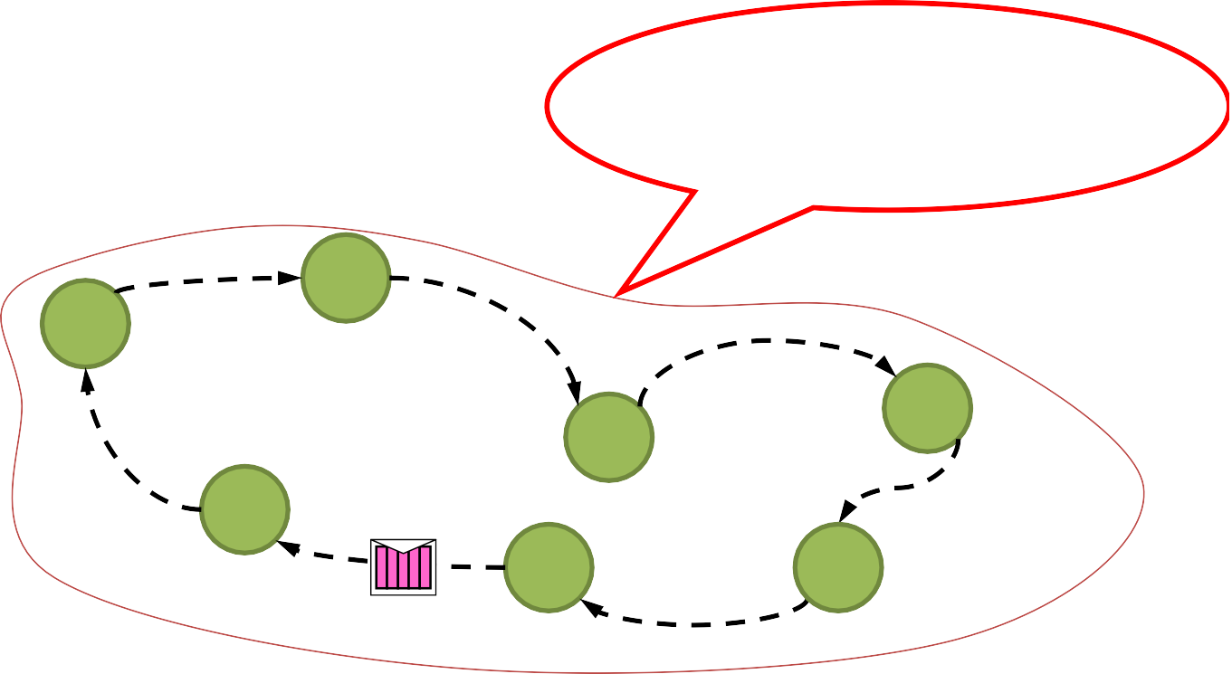



MPI Programming: Point to Point Communication
Blocking Communication and Deadlocks
– deadlock "refers to a specific condition when two or more processes are each waiting for the other to release a resource, or more than two processes are waiting for resources in a circular chain”
Example 1
  Code in each MPI process
MPI_Send(…, right_rank, …) MPI_Recv( …, left_rank, …)
Will block and never return, because MPI_Recv cannot be called in the right-hand MPI process
1
0
Don’t
3
2
6
5
4

Slide 60


MPI Programming: Point to Point Communication
Blocking Communication and Deadlocks(cont)
– Example 1
MPI_Send(…,1,…) MPI_Recv(…,1,…)
MPI_Send(…,0…) MPI_Recv(…,0,…)
Don’t
Solutions
  Order the operations more carefully
MPI_Send(…,1,…) MPI_Recv(…,1,…)
Use non-blocking operations
MPI_ISend(…,1,…) MPI_IRecv(…,1,…)
MPI_Recv(…,0,…) MPI_Send(…,0,...)
MPI_ISend(…,0…) MPI_IRecv(…,0,…)

Slide 61




MPI Programming: Point to Point Communication
Message Order Preservation
  Messages do not overtake each other
  This is true even for non-synchronous sends
  Rule for messages on the same connection,
same communicator, source, and destination rank
2
0 1₁
2
2
1
5
4₄
3₃
5
6₆

Slide 62
MPI Programming: Point to Point Communication
How big is the MPICH library?
– Basic (6 Function)
MPI_Init
MPI_Finalize
MPI_Comm_rank
MPI_Comm_size
MPI_Send
MPI_Recv
For performance, however, you need to use other MPICH features
  390 Function

Slide 63
MPI Programming: Point to Point Communication
MPI Primitives
– Some of the most intuitive message passing primitives of
MPI
Primitives | Meanings
MPI_Bsend | Append outgoing message to a local send buffer
MPI_Ssend | Send a message and wait until receipt starts
MPI_Sendrecv | Send a message and wait for reply
MPI_Issend | Pass reference to outgoing message, and wait until receipt starts

Slide 64
MPI Programming: MPI Broadcast and Collective Communication
Collective Communication
  Collective communication is a method of communication
which involves several processes in a communicator
  Collective communication routines are higher level routines
  Collective action over a communicator, i.e. all processes must call the collective routine
  No tags
  Receive buffers must have exactly the same size as send buffers

Slide 65



MPI Programming: MPI Broadcast and Collective Communication
MPI_Barrier
  Synchronize processes
  MPI has a special function that is dedicated to synchronizing
processes
  Processes in the communicator can pass the barrier until all of them call the function
all here?

Slide 66
MPI Programming: MPI Broadcast and Collective Communication
MPI_Barrier(cont)
– Function Prototype
MPI_Barrier(MPI_Comm comm)
MPI_Barrier is normally never needed
  All synchronization is done automatically by the data communication
    A process cannot continue before it has the data that it needs
  If used for debugging
    Please guarantee, that it is removed in production

Slide 67

MPI Programming: MPI Broadcast and Collective Communication
MPI_Bcast
  One process sends the same data to all processes in a
communicator
    One to many communication pattern
  Reduction Operations
    Combine data from several processes to produce a single result

Slide 68




MPI Programming: MPI Broadcast and Collective Communication
MPI_Bcast(cont)
– Function prototype
MPI_Bcast(void* data,int count,MPI_Datatype datatype,int root,MPI_Comm communicator)
Although the root process and receiver processes do different jobs,
they all call the same MPI_Bcast function
  When the root process calls MPI_Bcast, the data variable will be sent to all other processes
  When all of the receiver processes call MPI_Bcast, the data variable will be filled in with the data from the root process
Before bcast
r e d
0
1
2
3
4
After bcast
r | e | d
r e d
r e d
r | e | d
r | e | d
0
1
2
3
4

Slide 69
MPI Programming: MPI Broadcast and Collective Communication
Example 6, a simple Broadcast program
– The major portions of the code
int root=0; if (rank == 0) { int number = 100; MPI_Bcast(&number, 1, MPI_INT,root, MPI_COMM_WORLD); } else if (rank != 0) { int number; MPI_Bcast(&number, 1, MPI_INT,root, MPI_COMM_WORLD); printf("Process %d received number %d from process %d\n", rank, number, root); }
 |  | Output
 | Process 1 received number 100 from process 0 Process 2 received number 100 from process 0 Process 3 received number 100 from process 0 Process 4 received number 100 from process 0

Slide 70


MPI_Bcast(cont)
MPI Programming: MPI Broadcast and Collective Communication
– Broadcasting with MPI_Send and MPI_Recv
void my_bcast(void* data, int count, MPI_Datatype MPI_Comm communicator) {
int world_rank; MPI_Comm_rank(communicator, &world_rank); int world_size; MPI_Comm_size(communicator, &world_size); if (world_rank == root) {
int i;
for (i = 0; i < world_size; i++) { if (i != world_rank) {
datatype,
int root,
Don’t
MPI_Send(data, count, datatype, i, 0, communicator);
}
}
} else {
MPI_Recv(data, count, datatype, root, 0, communicator, MPI_STATUS_IGNORE);
}
}

Slide 71







MPI_Bcast(cont)
MPI Programming: MPI Broadcast and Collective Communication
Our function is only using one network link from process
zero to send all the data
Smarter implementation
  Tree-based communication algorithm
The MPI_Bcast implementation utilizes a similar tree
broadcast algorithm for good network utilization
0
0
0
4
2
1
…
1
2
1
3
6
3
5
70

Slide 72


MPI Programming: MPI Broadcast and Collective Communication
MPI_Bcast(cont)
  Comparison of MPI_Bcast with MPI_Send and MPI_Recv
    The major portions of the code
for (i = 0; i < num_trials; i++) {
// Time my_bcast
// Synchronize
before starting timing
PI_COMM_WORLD);
Output(if Data Size=400000 and Trials=10 )
MPI_Barrier(M
bcast_time -= MPI_ data, num_elements
Wtime();
, MPI_INT, 0, MPI_
COMM_WORLD);
total_my_ my_bcast(
// Synchr MPI_Barri total_my_
// Time M MPI_Barri total_mpi
MPI_Bcast(data, num_elements, MPI_INT, 0, MPI_COMM_WORLD); MPI_Barrier(MPI_COMM_WORLD);
total_mpi_bcast_time += MPI_Wtime();
}
Process | Our_Bcast | MPI_Bcast
2 | 0.0344 | 0.0344
4 | 0.1025 | 0.0817
8 | 0.2385 | 0.1084
16 | 0.5109 | 0.1296
onize again before
obtaining final t
ime
er(MPI_COMM_WORLD)
bcast_time += MPI_
;
Wtime();
PI_Bcast
er(MPI_COMM_WORLD)
_bcast_time -= MPI
;
_Wtime();

Slide 73




MPI Programming: MPI Broadcast and Collective Communication
MPI_Scatter
  MPI_Scatter is very similar to MPI_Bacst, BUT
    MPI_Bcast sends the same piece of data to all processes while
MPI_Scatter sends chunks of an array to different processes
  MPI_Scatter takes an array of elements and distributes the elements in the order of process rank
MPI_Bcast
MPI_Scatter
0
0
0
1
2
3
0
1
2
3

Slide 74


MPI Programming: MPI Broadcast and Collective Communication
MPI_Scatter(cont)
  Function prototype
    MPI_Scatter(void* send_data,int send_count,MPI_Datatype send_datatype,void* recv_data,int recv_count,MPI_Datatype recv_datatype,int root,MPI_Comm communicator)
      send_data, is an array of data that resides on the root process
      send_count and send_datatype, dictate how many elements of a
specific MPI Datatype will be sent to each process
      The recv_data is a buffer that can hold recv_count elements that have a datatype of recv_datatype
      root is process that is scattering the array of data
Before scatter
0
12 | 10 | 98
2
1
Aftar
scatter
12
10
98
0
1
2
73

Slide 75




MPI Programming: MPI Broadcast and Collective Communication
MPI_Gather
  MPI_Gather is the inverse of MPI_Scatter
    Many to one communication pattern
  MPI_Gather takes elements from many processes and gathers them to one single process
    The elements are ordered by the rank of the process from which
they were received
MPI_Gather
0
0
1
2
3

Slide 76


MPI Programming: MPI Broadcast and Collective Communication
MPI_Gather(cont)
– Function prototype
MPI_Gather(void* send_data,int send_count,MPI_Datatype send_datatype,void* recv_data,int recv_count,MPI_Datatype recv_datatype,int root,MPI_Comm communicator)
Only the root process needs to have a valid receive buffer. All other
calling processes can pass NULL for recv_data
The recv_count parameter is the count of elements received per
process
Before
gather
12
98
0
10
2
1
After gather
12
10
98
0
1
2
12 | 10 | 98

Slide 77
MPI Programming: MPI Broadcast and Collective Communication
Example 7, Computing average of numbers with MPI_Gather and MPI_Scatter
– The major portions of the code
if (world_rank == 0) {
rand_nums = create_rand_nums(elements_per_proc * world_size);
}
// Create a buffer that will hold a subset of the random numbers float *sub_rand_nums = malloc(sizeof(float) * elements_per_proc);
// Scatter the random numbers to all processes
MPI_Scatter(rand_nums, elements_per_proc, MPI_FLOAT, sub_rand_nums,
elements_per_proc, MPI_FLOAT, 0, MPI_COMM_WORLD);
// Compute the average of your subset
float sub_avg = compute_avg(sub_rand_nums, elements_per_proc);
// Gather all partial averages down to the root process float *sub_avgs = NULL;
if (world_rank == 0) {
sub_avgs = malloc(sizeof(float) * world_size);
}
MPI_Gather(&sub_avg, 1, MPI_FLOAT, sub_avgs, 1, MPI_FLOAT, 0, MPI_COMM_WORLD);
// Compute the total average of all numbers. if (world_rank == 0) {
float avg = compute_avg(sub_avgs, world_size);
}

Slide 78
MPI_Allgather
MPI Programming: MPI Broadcast and Collective Communication
MPI_Allgather will gather all of the elements to all the
processes
– many-to-many communication pattern
The most basic sense, MPI_Allgather is an MPI_Gather
followed by an MPI_Bcast
MPI_Allgather
0
1
2
3
…
0
1
2
3

Slide 79
MPI Programming: MPI Broadcast and Collective Communication
MPI_Allgather(cont)
– Function prototype
MPI_Allgather(void* send_data,int send_count,MPI_Datatype send_datatype,void* recv_data,int recv_count,MPI_Datatype recv_datatype,MPI_Comm communicator)
The elements from each process are gathered in order of their rank
There is no root process in MPI_Allgather
Before
12
10
98
Allgather
0
1
2
After Allgather
12
10
98
0
1
2
12 10 98
12 | 10 | 98
12 | 10 | 98

Slide 80


MPI Programming: MPI Broadcast and Collective Communication
MPI_Reduce
  Reduce is a classic concept from functional programming
    Reducing a set of numbers into a smaller set of numbers via a
function
  Takes an array of input elements on each process and returns an array of output elements to the root process
  Function prototype
    MPI_Reduce(void* send_data,void* recv_data,int count,MPI_Datatype datatype,MPI_Op op,int root,MPI_Comm communicator)
3 7
0
8 2
1
12 1
2
MPI_Reduce
MPI_SUM
3 7
8 2
12 1
0
1
23 8
2

Slide 81
MPI Programming: MPI Broadcast and Collective Communication
MPI_Reduce(cont)
– Predefined Reduction Operation Handles
Function | Meaning
MPI_MAX | Returns the maximum element
MPI_MIN | Returns the minimum element
MPI_SUM | Sums the elements
MPI_PROD | Multiplies all elements
MPI_LANG | Performs a logical AND across the elements
MPI_LOR | Performs a logical OR across the elements
MPI_BAND | Performs a bitwise AND across the bits of the elements
MPI_BOR | Performs a bitwise OR across the bits of the elements
MPI_LXOR | Performs a Logical exclusive Or across the elements
MPI_BXOR | Performs a bitwise exclusive OR across the elements
MPI_MAXLOC | Returns the maximum value and the rank of the process that owns it
MPI_MINLOC | Returns the minimum value and the rank of the process that owns it

Slide 82
MPI Programming: MPI Broadcast and Collective Communication
Example 8, Computing average of numbers with MPI_Reduce
– The major portions of the code
// Sum the numbers locally float local_sum = 0;
int i;
for (i = 0; i < num_elements_per_proc; i++) { local_sum += rand_nums[i];
}
// Print the random numbers on each process
printf("Local sum for process %d - %f, avg = %f\n",
world_rank, local_sum, local_sum / num_elements_per_proc);
// Reduce all of the local sums into the global sum float global_sum;
MPI_Reduce(&local_sum, &global_sum, 1, MPI_FLOAT, MPI_SUM, 0, MPI_COMM_WORLD);
// Print the result
if (world_rank == 0) {
printf("Total sum = %f, avg = %f\n", global_sum, global_sum / (world_size * num_elements_per_proc));
}

Slide 83



MPI Programming: MPI Broadcast and Collective Communication
MPI_Allreduce
  MPI_Allreduce is the equivalent of doing MPI_Reduce followed
by an MPI_Bcast
  There is no root process in MPI_Allreduce
  Function prototype
    MPI_Allreduce(void* send_data,void* recv_data,int count,MPI_Datatype datatype,MPI_Op op,MPI_Comm communicator)
MPI_Allreduce
3 7
0
8 2
1
12 1
2
MPI_SUM
3 7
8 2
12 1
0
1
23 8
2

Slide 84
MPI Programming: MPI Broadcast and Collective Communication
Example 9, Computing standard deviation with MPI_Allreduce
– The major portions of the code
rand_nums = create_rand_nums(num_elements_per_proc); float local_sum = 0;
int i;
for (i = 0; i < num_elements_per_proc; i++) { local_sum += rand_nums[i];
}
float global_sum;
MPI_Allreduce(&local_sum, &global_sum, 1, MPI_FLOAT, MPI_COMM_WORLD);
MPI_SUM,
float mean = global_sum / (num_elements_per_proc * world_size); float local_sq_diff = 0;
for (i = 0; i < num_elements_per_proc; i++) {
local_sq_diff += (rand_nums[i] - mean) * (rand_nums[i] - mean);
}
float global_sq_diff;
MPI_Reduce(&local_sq_diff, &global_sq_diff, 1, MPI_FLOAT, MPI_SUM, 0, MPI_COMM_WORLD);
if (world_rank float stddev
== 0) {
= sqrt(global_sq_diff /
(num_elements_per_proc * world_size));
- %f, Standard deviation = %f\n", mean, stddev);
printf("Mean
}

Slide 85

The Future of MPI
Best Supercomputing Site in World
  TIANHE-2
• 33,862.7 TFlop/s
    MPICH

Slide 86












The Future of MPI
Exasclae Computing
  Growth of computing power
  Exaflop = 10¹⁸ floating point operations per second
  Represents a factor of 100-1000x from current state
  Goal – Reach Exaflop levels by 2018-2020
ZETTA
₂21
2020-2022
EXA
₂18
2018-2020
PETA ₂15
TERA ₂12
2016-2018
2014

Slide 87
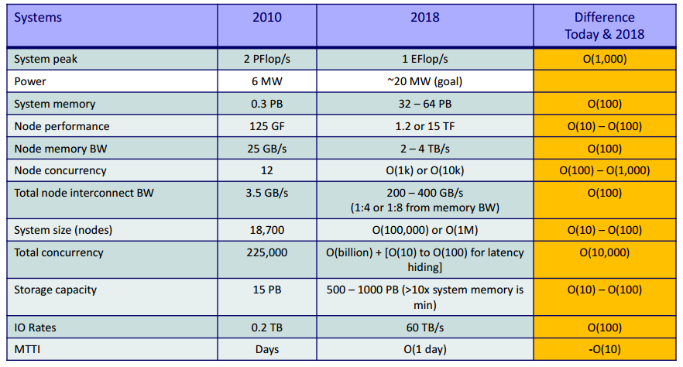
The Future of MPI
Exasclae Computing(cont)
– Exascale system target

Slide 88

The Future of MPI
Exasclae System Challenge
  Energy and Power Challenge
    Supercomputers and Datacenters require a lot of energy
      Power consumption by processors for computation
      Power required by memory and other devices to move data
      Power required to cool the system
    Power requirement by current generation is already high
    Design constraint on Exaflop systems: must reach exaflops using a total of around 20MW of power

Slide 89
The Future of MPI
Exasclae Challenge(cont)
  Memory and Storage Challenge
    Hard to achieve high capacity and high data rate
  Concurrency and Locality Challenge
    Management of very large amount of concurrency (billion threads)
  DARPA Exascale Report – Peter Kogge, Editor and Lead
  How does MPI plan to meet these challenges?

Slide 90
The Future of MPI
MPI plan to meet these challenges
  Power required for data movement operations is one of
the main challenges
  Plan for Exascale system
    Non-blocking collectives
» Enables overlap of computation with communication
    One-sided communication(RMA)
    Topology-aware Communication
    Support GPU to GPU communication through standard MPI interfaces

Slide 91



The Future of MPI
One-sided communication models
  Should be able move data without requiring that the remote
process synchronize
  Each process exposes a part of its memory to other processes
  Other processes can directly read from or write to this memory
Process 0
Process 1
Process 2
Process 3
Global Address Space
Remotely Accessible Memory
Private Memory
Remotely Accessible Memory
Private Memory
Remotely Accessible Memory
Private Memory
Remotely Accessible Memory
Private Memory
Private
Memory
Private
Memory
Private
Memory
Private
Memory
90

Slide 92











The Future of MPI
Memory
Process 0
Process 1
Memory
Memory Segment
Memory Segment
Memory Segment
Memory Segment
Send
Recv
Send
Recv
MPI implementation
MPI implementation
91

Slide 93
The Future of MPI
Process 0
Process 1
SEND(data)
Even the sending process is delayed
D E L A Y
RECV(data)
Process 0
Process 1
PUT(data)
D E L A Y
Delay in process 1 does not affect process 0
GET(data)
92

Slide 94
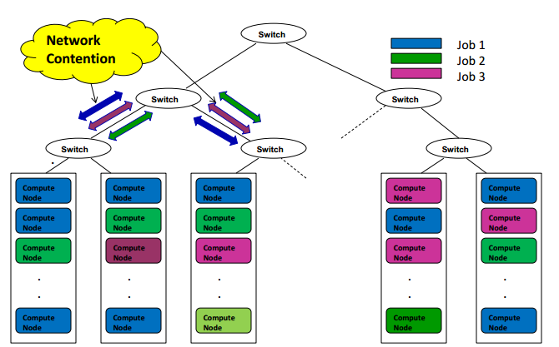
The Future of MPI
Topology-aware Communication

Slide 95
The Future of MPI
GPU to GPU Communication
  GPU-GPU communication is still costly and programming is
harder
    Steps in Data movement in clusters with GPUs
      From GPU device memory to main memory at source process, using CUDA
      From source to destination process, using
MPI
      From main memory to GPU device memory at destination process, using CUDA
  Can this be done within MPI Library?
    Enable MPI_Send, MPI_Recv from/to GPU memory

Slide 96
The Future of MPI
How does MPI plan to meet these challenges?(cont)
  Plan for Exascale(cont)
    Performance and Memory scalability toward 500K-1M cores
    Enhanced Multi-rail Designs
    Automatic optimization of collectives
    Checkpoint-Restart and migration support with incremental
checkpointing
    Fault-tolerance with run-through stabilization
    QoS-aware I/O and checkpointing

Slide 97
MPI Tools
Some of MPI tools(cont)
  PyPAR
    Efficient and easy to use MPI binding for Python
  PALM_MP
    A computational Framework for assembling High performance Computing Applications
  PMPIO
    A portable implementation of MPI-IO developed at NASA Ames
  MPBench
    benchmark for some important MPI functions
  AutoMap/AutoLink
    A tools for working with MPI datatypes
  MPIMap
    Displays the structure of MPI datatypes

Slide 98
MPI Tools
Some of MPI tools
  MPI-CHECK
    This tool developed to aid in the debugging of MPI programs that are written in free or fixed format Fortran 90 and Fortran 77
    Can detect many situations where actual and potential deadlocks occur
  mpC
    A programming environment for a wide range of distributed memory computer systems (especially for heterogeneous networks of computers)
  mpitest
    A program for measuring the performance of an MPI implementation
  SKaMPI
    measures the performance of most MPI operations

Slide 99
Conclusion
Presented an overview From MPI
Overview of MPI-1 and MPI-2 Features
Presented challenges for designing Exascale systems
How MPI is planning to address some of these challenges
MPI will be continue…

Slide 100
References
https://www.mpich.org/
https://www.mpitutorial.com/
http://www.mpi-forum.org/
Rajeev Thakur, Pavan Balaji, Darius Buntinas, Jim Dinan, Dave Goodell, Bill Gropp, Rusty Lusk, Rob Ross, Marc Snir, “Challenges in scaling mpi to exascale”, Argonne National Laboratory 2012.
Dhabaleswar K. DK Panda, "MPI: advanced topics and future trends“, HPC Advisory Council Workshop, Lugano 2012.

