Slide 1
By : Mahrad Hanaforoosh

Slide 2
Agenda
History
What is Apache CloudStack?
Service models
What can Apache CloudStack do?
Deployment Architecture Overview
Management Server Overview
Multi-Node Management Server
Cloud Infrastructure Overview
About Regions
About Zones
About Pods
About Clusters
About Hosts
About Primary Storage
About Secondary Storage

Slide 3
History
began as a project of a start-up known as VMOps in 2008.
The company eventually changed its name to Cloud.com
and it released much of the source to CloudStack in May 2010 under the GPLv3.
Cloud.com was purchased in July 2011 by Citrix.
Citrix released CloudStack 3.0 in early 2012.
In April 2012, Citrix re-licensed CloudStack under the Apache Software License 2.0 (ASLv2) and submitted CloudStack to the Apache Incubator.
CloudStack 4.0.0 released on November 6th, 2012.
Apache CloudStack graduated from the Incubator on March 20, 2013.

Slide 4
What is Apache CloudStack?
Apache CloudStack is an open source Infrastructure-as-a-Service platform that manages and orchestrates pools of storage, network, and computer resources to build a public or private IaaS compute cloud.
With CloudStack you can:
Set up an on-demand elastic cloud computing service.
Allow end-users to provision resources
Notes:
1-On-demand self-service
2-rapid elasticity
3-resource pooling
4-broad network access
5-measured service

Slide 5
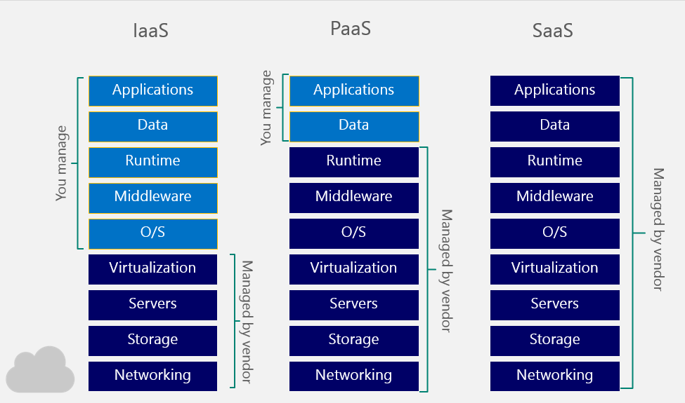
Service models

Slide 6
What can Apache CloudStack do?
Multiple Hypervisor Support
Massively Scalable Infrastructure Management
Automatic Cloud Configuration Management
Graphical User Interface
API
AWS EC2 API Support
High Availability

Slide 7
What can Apache CloudStack do?
Multiple Hypervisor Support
Massively Scalable Infrastructure Management
Automatic Cloud Configuration Management
Graphical User Interface
API
AWS EC2 API Support
High Availability
CloudStack works with a variety of hypervisors and hypervisor-like technologies. A single cloud can contain multiple hypervisor implementations. As of the current release CloudStack supports:
BareMetal (via IPMI)
Hyper-V
KVM
LXC
vSphere (via vCenter)
Xenserver
Xen Project

Slide 8
What can Apache CloudStack do?
Multiple Hypervisor Support
Massively Scalable Infrastructure Management
Automatic Cloud Configuration Management
Graphical User Interface
API
AWS EC2 API Support
High Availability
CloudStack can manage tens of thousands of physical servers installed in geographically distributed datacenters.
Maintenance or other outages of the management server can occur without affecting the virtual machines running in the cloud.

Slide 9
What can Apache CloudStack do?
Multiple Hypervisor Support
Massively Scalable Infrastructure Management
Automatic Cloud Configuration Management
Graphical User Interface
API
AWS EC2 API Support
High Availability
CloudStack automatically configures the network and storage settings for each virtual machine deployment.
a pool of virtual appliances support the operation of configuration of the cloud itself.
These appliances offer services such as firewalling, routing, VPN, storage access, and storage replication.

Slide 10
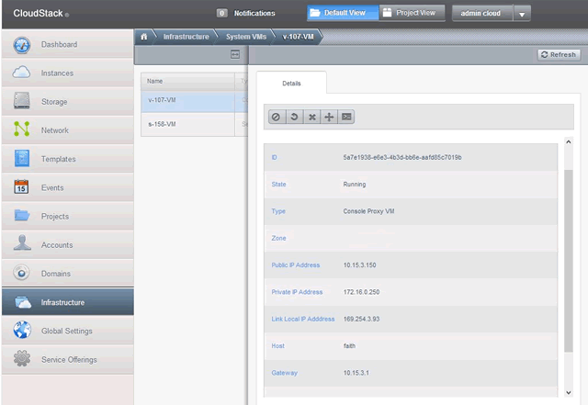
What can Apache CloudStack do?
Multiple Hypervisor Support
Massively Scalable Infrastructure Management
Automatic Cloud Configuration Management
Graphical User Interface
API
AWS EC2 API Support
High Availability

Slide 11
What can Apache CloudStack do?
Multiple Hypervisor Support
Massively Scalable Infrastructure Management
Automatic Cloud Configuration Management
Graphical User Interface
API
AWS EC2 API Support
High Availability
CloudStack provides a REST-like API for the operation, management and use of the cloud.
Example:
assignVirtualMachine: Change ownership of a VM from one account to another

Slide 12
What can Apache CloudStack do?
Multiple Hypervisor Support
Massively Scalable Infrastructure Management
Automatic Cloud Configuration Management
Graphical User Interface
API
AWS EC2 API Support
High Availability
CloudStack provides an EC2 API translation layer to permit the common EC2 tools to be used in the use of a CloudStack cloud.

Slide 13
What can Apache CloudStack do?
Multiple Hypervisor Support
Massively Scalable Infrastructure Management
Automatic Cloud Configuration Management
Graphical User Interface
API
AWS EC2 API Support
High Availability
The Management Server itself may be deployed in a multi-node installation where the servers are load balanced.
MySQL may be configured to use replication to provide for failover in the event of database loss
For the hosts, CloudStack supports NIC bonding

Slide 14
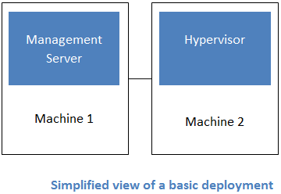
Deployment Architecture Overview
most CloudStack deployments consist of the management server and the resources to be managed.
The minimum installation consists
of one machine running the
CloudStack Management Server
and another machine to act as the
cloud infrastructure.

Slide 15
Management Server Overview
The management server typically runs on a dedicated machine or as a virtual machine.
The management server orchestrates and allocates the resources in your cloud deployment.
It controls allocation of virtual machines to hosts and assigns storage and IP addresses to the virtual machine instances.
The Management Server runs in an Apache Tomcat container and requires a MySQL database for persistence.

Slide 16
Management Server Overview (Cont’d)
Provides the web interface for both the administrator and end user.
Provides the API interfaces for both the CloudStack API as well as the EC2 interface.
Manages the assignment of guest VMs to a specific compute resource
Manages the assignment of public and private IP addresses.
Allocates storage during the VM instantiation process.
Manages snapshots, disk images (templates), and ISO images.
Provides a single point of configuration for your cloud.

Slide 17
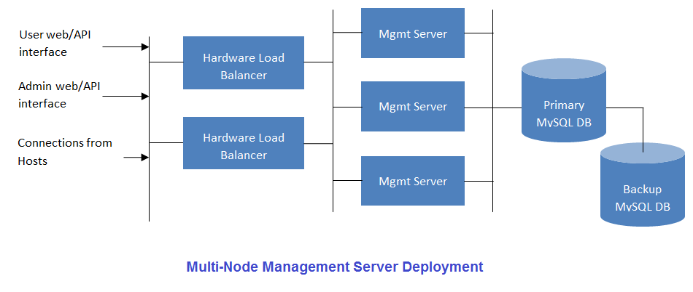
Multi-Node Management Server

Slide 18
Cloud Infrastructure Overview
Resources within the cloud are managed as follows:
Regions
Zones
Pods
Clusters
Host
Primary Storage
Secondary Storage

Slide 19
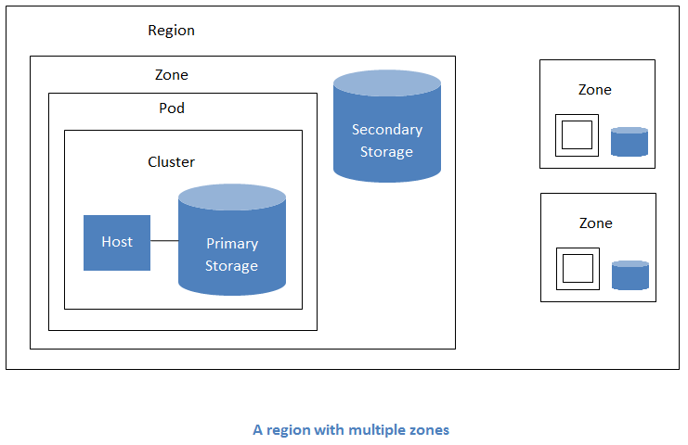
About Regions
A collection of one or more geographically proximate zones managed by one or more management servers.
Regions are a useful technique for providing fault tolerance and disaster recovery.
By grouping zones into regions, the cloud can achieve higher availability and scalability.
the latency of communications within the cloud is reduced
Regions are visible to the end user.
Notes:
Scalablity:
1-Size
2-Geographically
3-Administrative

Slide 20
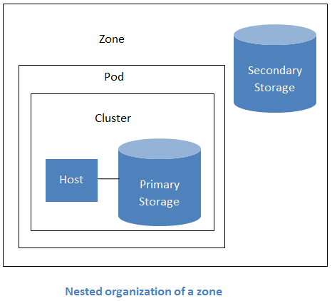
About Zones
A zone typically corresponds to a single datacenter, although it is permissible to have multiple zones in a datacenter.
The benefit of organizing infrastructure into zones is to provide physical isolation and redundancy.
A zone consists of:
One or more pods.
A zone may contain one or more primary storage servers, which are shared by all the pods in the zone.
Secondary storage, which is shared by all the pods in the zone.

Slide 21
About Zones (Cont’d)
Zones are visible to the end user.
Zones can be public or private
Public zones are visible to all users.
Private zones are reserved for a specific domain.
For each zone, the administrator must decide the following:
How many pods to place in each zone.
How many clusters to place in each pod.
How many hosts to place in each cluster.
(Optional) How many primary storage servers to place in each zone and total capacity for these storage servers.
How many primary storage servers to place in each cluster and total capacity for these storage servers.
How much secondary storage to deploy in a zone.

Slide 22
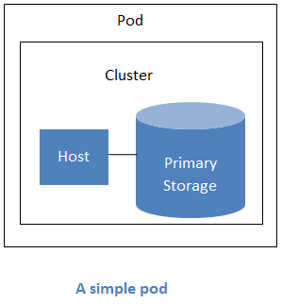
About Pods
A pod often represents a single rack.
A pod consists of one or more clusters of hosts and one or more primary storage servers.
Pods are not visible to the end user.

Slide 23
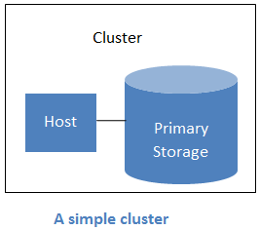
About Clusters
A cluster consists of one or more hosts and one or more primary storage servers.
A cluster provides a way to group hosts
To be precise, a cluster is a XenServer server pool, a set of KVM servers, , or a VMware cluster preconfigured in vCenter.
The hosts in a cluster all have identical hardware, run the same hypervisor, are on the same subnet, and access the same shared primary storage.
Virtual machine instances (VMs) can be live-migrated from one host to another within the same cluster, without interrupting service to the user.

Slide 24
About Hosts
A host is a single computer.
Hosts provide the computing resources that run guest virtual machines.
Each host has hypervisor software installed on it to manage the guest VMs.
For example, a host can be a Citrix XenServer server, a Linux KVM-enabled server, an ESXi server, or a Windows Hyper-V server.
Hosts in a CloudStack deployment:
Provide the CPU, memory, storage, and networking resources needed to host the virtual machines
Interconnect using a high bandwidth TCP/IP network and connect to the Internet
May reside in multiple data centers across different geographic locations
May have different capacities (different CPU speeds, different amounts of RAM, etc.), although the hosts within a cluster must all be homogeneous

Slide 25
About Hosts (Cont’d)
CloudStack automatically detects the amount of CPU and memory resources provided by the hosts.
Hosts are not visible to the end user.
For a host to function in CloudStack, you must do the following:
Install hypervisor software on the host
Assign an IP address to the host
Ensure the host is connected to the CloudStack Management Server.

Slide 26
About Primary Storage
Primary storage is associated with a cluster.
it stores virtual disks for all the VMs running on hosts in that cluster.
You can add multiple primary storage servers to a cluster or zone. At least one is required.
it is typically located close to the hosts for increased performance.
Zone-wide or Cluster-based?
CloudStack manages the allocation of guest virtual disks to particular primary storage devices.

Slide 27
About Secondary Storage
Secondary storage stores the following:
Templates — OS images that can be used to boot VMs and can include additional configuration information, such as installed applications
ISO images — disc images containing data or bootable media for operating systems
Disk volume snapshots — saved copies of VM data which can be used for data recovery or to create new templates
The items in secondary storage are available to all hosts in the scope of the secondary storage.

Slide 28
Thank you
By : Mahrad Hanaforoosh
Iran University of Science and Technology

