Slide 1
Introduction to eyeOS
By mehdi moradi

Slide 2
Agenda
Introduction
definition
History
Technology and trends
Technology
security
features
Classification
Architecture design
Architecture overview
Operational flow
Application domain
Application areas
Research and development
Scope
conclusion

Slide 3
Table of contents
Developer manual
Introduction
Basic services
System libraries
How an application works
The eyeOS Toolkit
Groups
Aliases
Listener service calls
Full screen
Message tables
Important eyeOS libraries
Extras directory
How sessio works with eyeSessions
Sharing your work with eyeOS community
conclusion

Slide 4
Introduction - definition
EyeOS is an open source web desktop following the cloud computing concept.
It is mainly written in PHP, XML and JavaScript.
It acts as a platform for web applications written using the EyeOS Toolkit.
It is accessible by portable devices via its mobile front end.
EyeOS lets you upload your files and work with them no matter where you are.
It contains applications like Word Processor, Address Book, PDF reader, and many more developed by the community.

Slide 5
Introduction - definition
It looks like a regular PC operating system, but the "trick" is that it can be accessed from anywhere.
If you travel all the time, or you don't own a PC or laptop or move often, then you can access EyeOS from an Internet Cafe.
All you need is a web browser, Internet access and EyeOS is there for you, always, all the time.
EyeOS is one of the few that is not only provided for free as a service complete with online storage, but is also open source under AGPL3, so you can install it on your own server.

Slide 6
Introduction - definition
EyeOS is built on PHP and uses a combination of web standard technologies such as HTML, JavaScript and CSS to create the UI.
This means that it will run on any standards compliant browser.
By itself, it doesn’t require any extra plugins in order to work.
All it needs is a PHP 5 capable server, which is the common denominator for just about any hosting package – it doesn’t even require a database.

Slide 7
Introduction - definition
Centering work and entertainment in a single place

Slide 8
Introduction - definition
EyeOS is about removing compatibility issues between applications and operating systems and taking your life everywhere.
EyeOS is available in 30 translations. And is used privatively and professionally throughout the world rather it is used for public environments, schools, small and large companies alike or a way to share data with your family.

Slide 9
Introduction - history
Establishment: In 2005, a group of young people worked together and put all their efforts in a new project, a new open source web desktop, EyeOS.
August 1, 2005: The first publicly available EyeOS version was released as EyeOS 0.6.0. At the time, it greatly participated in creating the definition of a web operating system and acted as a concept. Quickly, a worldwide community of developers took part in the project and helped improve it by translating, testing and developing it.

Slide 10
Introduction - history
June 4, 2007: After two years of development, the EyeOS Team published EyeOS 1.0. Compared with previous versions, EyeOS 1.0 introduced a complete reorganization of the code and some new web technologies, like eyeSoft, a portage-based web software installation system. Moreover, EyeOS also included the EyeOS Toolkit, a set of libraries allowing easy and fast development of new web Applications.
July 2, 2007: With the release of the 1.1 version, EyeOS changed its license and migrated from GNU GPL Version 2 to Version 3.

Slide 11
Introduction - history
October 29,2007:1.2 version was launched with full integration compatibility with Microsoft Word files.
January 15, 2008: EyeOS 1.5 Gala was liberated. The first version that supported both Microsoft Office and OpenOffice.org file formats for documents, presentations and spreadsheets. It also had the ability to import and export documents in both formats using server side scripting.
April 25, 2008: EyeOS 1.6 included many improvements such as synchronization with local computers, drag and drop, a mobile version and more.

Slide 12
Introduction - history
January 7, 2009: EyeOS 1.8 Lars featured a completely rewritten file manager and a new sound API to develop media rich applications.
April 1, 2009: 1.8.5 version incorporated a new default theme and some rewritten apps like the Word Processor and the Address Book.
September 2011: eyeOS Professional Edition is launched. A redesigned interface with advanced web productivity functionalities serves as the basis for the current for eyeOS Workplace.
April 2013: After years of R&D, eyeOS showcases the HTML5 web client which enables virtualization of applications in a high performance browser.

Slide 13
Technology and trends - technology
With so many different Web operating systems either currently available or in development, it should come as no surprise that programmers use different approaches to achieve the same effect.
While the goal of a Web OS is to provide an experience similar to using a desktop OS, there are no hard and fast rules for how to make that happen.
two most popular approaches rely on Flash technologies or Asynchronous JavaScript and XML (AJAX) technologies.

Slide 14
Technology and trends - technology
Flash is a set of technologies that enable programmers to create interactive Web pages. It's a technology that uses vector graphics.
Vector graphics record image data as a collection of shapes and lines rather than individual pixels, which allows computers to load Flash images and animation faster than pixel-based graphics.
Flash files stream over the Internet, which means the end user accessing the file doesn't have to wait for the entire file to download to his or her computer before accessing parts of it.
With Flash-based programs like online streaming video player, this means you can start watching a film clip without having to download it first.

Slide 15
Technology and trends - technology
More than 98 percent of all computers connected to the Internet have a Flash player installed.
That makes Flash an attractive approach for many programmers.
They can create a Web OS knowing that the vast majority of computer users will be able to access it without having to download additional software.
AJAX technologies rely on hypertext markup language (HTML), the JavaScript programming language ,Cascading Style Sheets (CSS) and extensible Markup Language (XML).

Slide 16
Technology and trends - technology
The "asynchronous" aspect of AJAX means that AJAX applications transfer data between servers and browsers in small bits of information as needed.
The alternative is to send an entire Web page to the browser every time something changes, which would significantly slow down the user's experience.
With sufficient skill and knowledge, a programmer can create an AJAX application with the same functions as a desktop application.

Slide 17
Technology and trends - technology
Like Flash, most computers can run AJAX applications.
That's because AJAX isn't a new programming language but rather a way to use established Web standards to create new applications.
As long as an application programmer includes the right information in an application's code, it should run fine on any major Web browser.
Some well known Web applications based on AJAX include Google Calendar and Gmail.

Slide 18
Technology and trends - technology
A Sample of Web Operating Systems: There are more than a dozen Web operating systems in various stages of completion. They include:
eyeOS
AstraNOS
DesktopOnDemand
Goowy
YouOS

Slide 19
Technology and trends - security
This service stands out primarily for its tight security, which has earned an average growth of 400 users per day.
Some of its security measures involve the use of firewalls, backups every 24 hours total.
As additional precaution, all communication is made within the site, and all content stored by users is fully encrypted and no access by their administrators, which gives an additional advantage in terms of use privacy.

Slide 20
Technology and trends - features
eyeOS features : eyeOS tries to provide:
most of the functionality that we are accustomed to in any operating system.
A powerful, highly configurable access control system, with heavily customisable ACLs (access control lists), and
support for user groups and a user management system.
Support for assigning user quotas for disk space.
An inbuilt configurable cache system.
Support for office document formats using OpenOffice.

Slide 21
Technology and trends - featues
eyeOS features : eyeOS tries to provide:
A file association management system.
Support for auto-launching application on startup.
Fully theme-able, and comes with a few themes with its default installation.
For an organisation, having an EyeOS installation on an intranet server can mean everyone has access to the same resources and interface, where everyone is working on the same environment and there’re no compatability concerns comes with its own GUI builder!
An application called eyeDesigner allows you to design application GUI straight from EyeOS.

Slide 22
Technology and trends - features
Managing files
Uploading multiple files simultaneously.
File management and visual interface.
Download entire folders as ZIP.
Utility to compress and decompress ZIP.
Photo viewer with slideshow.
Personal information manager (PIM)
Multiple calendars.
Export and import from vCard.
System
Packages Installer.
System of ports and repositories.
Control system for users and administrators.
Text Utilities. Several instances of an application.

Slide 23
Technology and trends - features
Office
Word processor. Spreadsheets.
Presentations.
Support for MS Office formats and OpenOffice.
Network
E-mail client. Internal messaging.
Classified memos.
FTP client with proxy support.
RSS newsreader.
Desktop
Completely customizable.
Autoload of desired applications.
Themes.

Slide 24
Technology and trends - requirements
Server:
Apache Web Server 1.3.x / 2.x.
PHP 5 or higher.
Safe Mode = Off.
Browser

Slide 25
Technology and trends - What is a process inside EyeOS?
Every time an application is executed, an entry in the process table of a user is created.
This entry is an associative array that contains information about the name, Process ID (pid), checknum, tty , currentUser (the name of the user who launched the process) and the time it was launched.
In the default installation, the process table is a session variable named 'ProcessTable'.

Slide 26
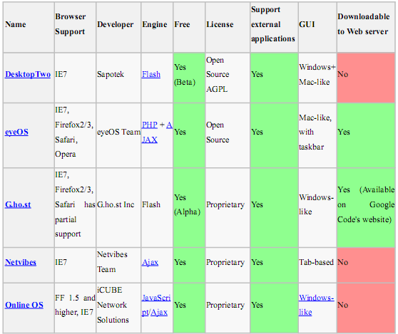
Technology and trends - classification

Slide 27
Technology and trends - classification
WEBOS in three categories:
Remotely Hosted WebOS.
Self-Hosted WebOS, and
Remote Desktops
Under the remotely hosted we can find systems such as:
EyeOS - One of the most popular weblops on the planet, EyeOS boasts tons of apps, a booming community, and a lot more features.
Fenestela - There s still quite a few bugs to be ironed out in this French WebOS, but you get cool XP interface and basic PHP apps.
Under the Desktop hosted we can find systems such as:
DesktopOnDemand - A fully featured Linux-based desktop with Gnome,Gaim. AbiWord,Evolution,GIMP, WebDAV. VNC, web login, and much more.
Free Live OS Zoo - Java applet

Slide 28
Technology and trends - classification
Webtop versus Desktop
Software Management:
Ensures all users are running the same current versions of all applications
Updates and patches need only be applied to the server - no need to update multiple clients
No need for software to distribute software over the network
Security:
Less prone to typical attacks, viruses, worms, unpatched clients, vulnerabilities
Sensitive data stored on secure servers rather than scattered across multiple potentially unprotected and vulnerable clients (e.g. smart phones and laptops).
Encrypted transmission of all data between server and clients (e.g. https).
Software Management features (above) accommodate quick and easy application of security advisories on server side
Webtop administrator can control which applications and data each user is allowed to access

Slide 29
Technology and trends - classification
High Availability:
From a single device access Windows, UNIX, Linux, and Mainframe applications, all at the same time.
Minimal hardware requirements for client devices.
Less downtime - robust server system more easily protected and less likely to fail than multiple client desktops.
Fault tolerance - if a client device fails for any reason simply replace it with any other supported client device without loss of data, configuration, preferences, or application access

Slide 30
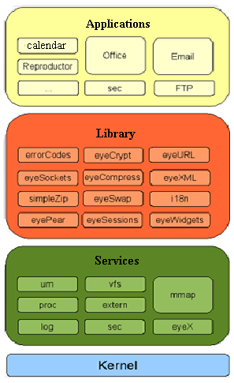
Architecture design – architecture overview

Slide 31
Architecture design – architecture overview
EyeOS kernel uses a structure divided into 4 layers:
Kernel: unified system services.
Services: lower-level functions.
library services: higher-level functions
Applications: can call functions from any layer
Service – MMAP
Vital component in the communications of the application.
route messages to the client application.
Automated service .
Service –VFS
It is the EyeOS file system.
implement security systems.
Concatenate 32 random characters.
virtual and real functions.
Provides application development.

Slide 32
Architecture design – architecture overview
Service - VFS (implementation)Internally creates two files for each file (virtual functions):
file content.
File information
Service – Eyex
Get the XML messages and respond in the same format to the browser
Service - Proc
Process Management:
Launch.
Finish.
List.
etc.
For each process defines:myPid:
Linux equivalent to PID.
checksum: identifies the process in the

Slide 33
Architecture design – architecture overview
Client-side
EyeOS makes use of several technologies on the client (browser) side:
XHTML and CSS are used to display the user interface. The content, however, is created and changed dynamically by the local JavaScript engine, which uses the DOM for this task.
The local engine handles communication with the server asynchronously, using AJAX. Client and server communicate via XML requests/responses. The client always initiates communication (i.e. no reverse AJAX is used). Each server response specifies a series of tasks to the client engine (e.g. creating a widget, changing a value of a component, executing JavaScript code embedded in the message, etc.).
Not all interactions require communication with the server. JavaScript is used to provide client-side-only interactions

Slide 34
Architecture design – architecture overview
Server side
EyeOS is written in PHP on the server side, and provides multiple high level abstractions (e.g. file system, user management, window services).
The goal of these is to make it easy to write new applications, and avoid dealing with low-level primitives.
In this sense, EyeOS is also a web application development framework

Slide 35
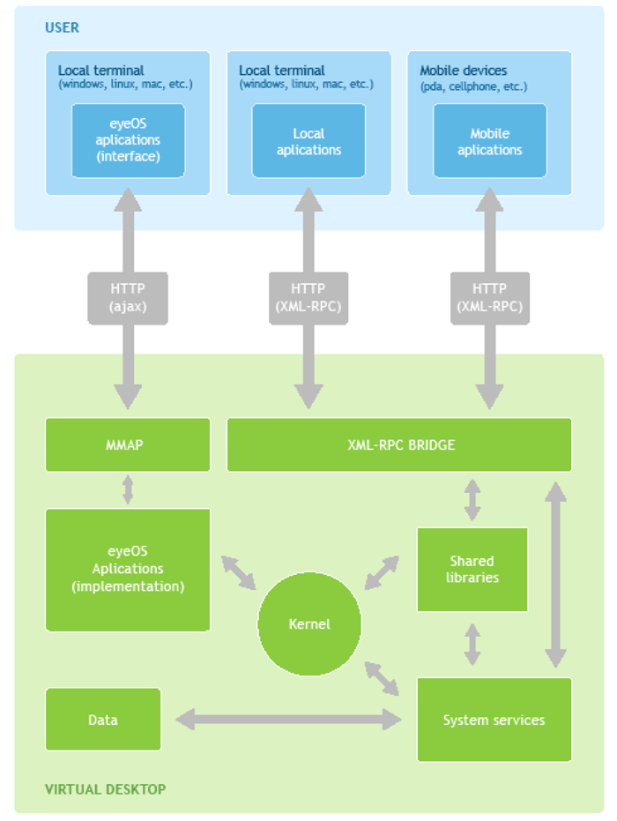
Architecture design – operational flow
LOGICAL SYSTEM ARCHITECTURE

Slide 36
Architecture design – architecture overview
The results of the actions in the native applications end with a message response consisting of data in XML form and containing the information required on the form and manner in which the graphical interface should EyeOS changed.

Slide 37
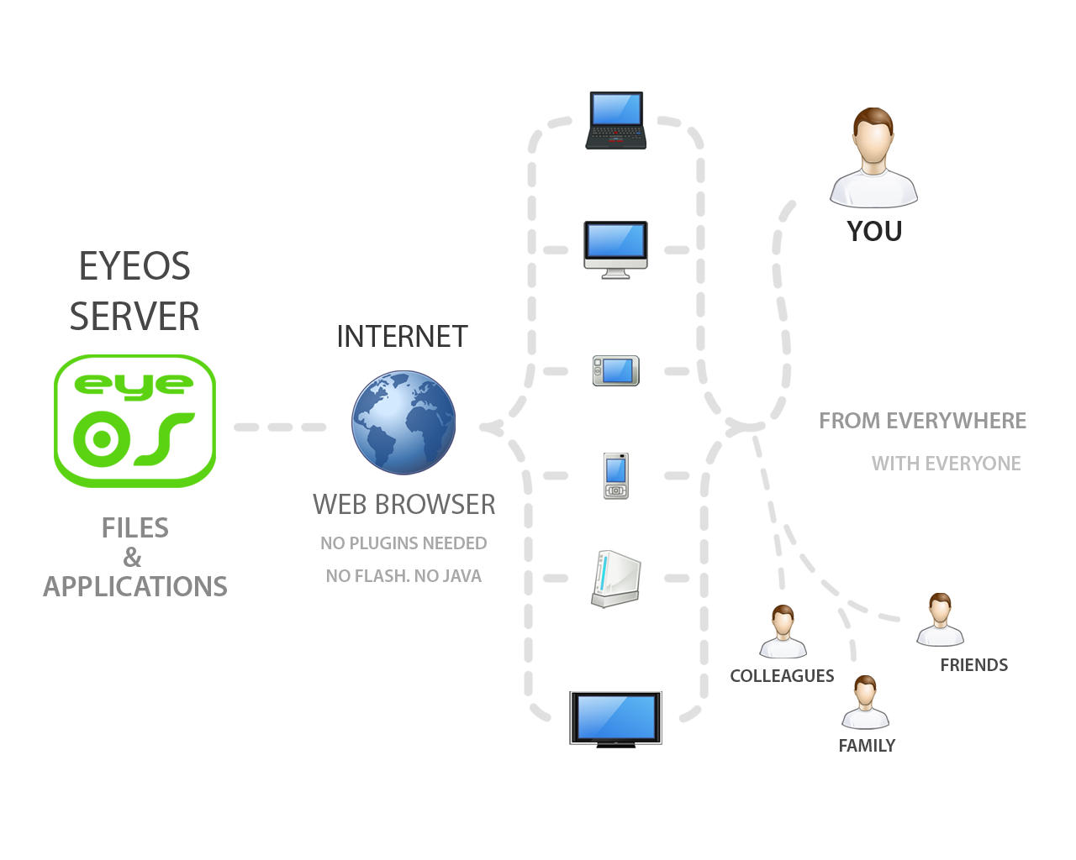
Application domain – application areas

Slide 38
Application domain – application areas
EyeOS provides system for the users where they work with EyeOS and all its applications, including Office and PIM ones. EyeOS provides a toolkit to create new applications easily.
EyeOS can provide schools and universities with a full web platform where students, teachers and parents will have a personal yet collaborative desktop to work and, communicate between themselves and get organized inside and outside the school.
With a private server, EyeOS can provide city councils, public library networks, free Internet points and other public environments the perfect system for their users to have a web place to work and communicate with the network managers, registering once and using it from every point.

Slide 39
Architecture design – architecture overview
One of the main triggers and great acceptance of people with regard to this service is its availability online, which has no dependencies and has a strong security system, achieving thus be an ideal application for storing content.
This action may be useful for those who travel frequently, for schools that want a centralized storage and available for intranets and business in general and so on.
Even could be used in any future as a service to replace the need for a hard disk

Slide 40
Architecture design – architecture overview
Among the most typical uses are highlighted
Schools: There is a Web system that brings a personal space for each teacher and student, which can be leveraged to work collaboratively. Also it is best accessed from anywhere you have Internet access.
Public places may be in libraries or on points that have open WiFi, allowing users to connect to have the same meeting place on the Web.
Social Organizations and Companies: Contacts, personal files and communications to which members can access businesses and organizations large and small.

Slide 41
Research and development - scope
The Goals of EyeOS:
Being able to work from everywhere, regardless of whether or not you are using a full-featured, modern computer, a mobile gadget, or a completely obsolete PC.
Sharing resources easily between different work centres at company, or working from different places and countries on the same projects.
Always enjoying the same applications with the same open formats, and forgetting the usual compatibility problems between office suites and traditional operating systems.
Being able to continue working if you have to leave your local computer or if it just crashes, without losing data or time: Just log in to your EyeOS from another place and continue working.

Slide 42
conclusion
is designed for developers without experience to develop web applications.
communication with the user through events.
Creation of the interface using widgets.
Advantages: Portability, decentralization, availability.
Disadvantages: safety, need for fast connection performance, isolation of the host system.
Worldwide availability: As it’s available through internet
Requires only browser

Slide 43
conclusion
Dynamic content and design: Interface can be customized according your needs, windows are floating so that they can be repositioned
Extensive list applications: Office applications, multimedia applications, network applications and chat applications etc. are available.
Remote storage facility: Through the file browser you can store files over the internet and edit them as you want.
Browser and Platform independent: All browsers and all operating systems are supported.
Rich text editing facility .

Slide 44
Thank you

Slide 45
Research and development - scope
cc

