Slide 1
By: Hamid Reza Ahmadi

Slide 2
High Volume:
Over 1.4 trillion messages per day
175 terabytes per day
650 terabytes of messages consumed per day
Over 433 million users
High Velocity:
Peak 13 million messages per second
2.75 gigabytes per second
High Variety:
Multiple RDBMS (Oracle, MySQL, etc.)
Multiple NoSQL (Espresso, Voldemort)
Hadoop, Spark, etc.

Slide 3
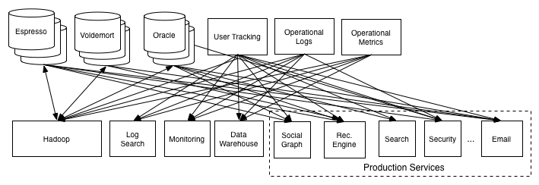
Linkedin Data Architecture without kafka…

Slide 4
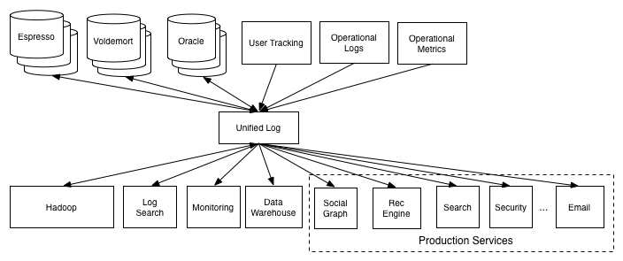
What Linkedin needed…

Slide 5
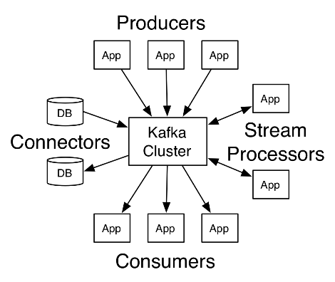
Kafka has four core APIs
Producer API
Consumer API
Stream API
Connector API

Slide 6
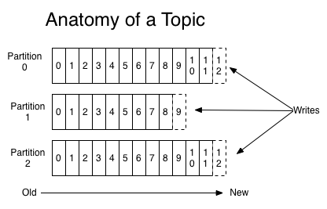
Topics and Logs
A topic is a category or feed name to which records are published.
Topics in Kafka are always multi-subscriber.

Slide 7
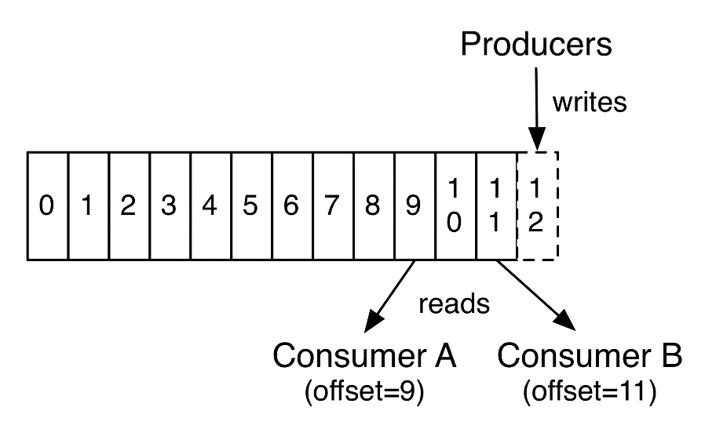
Topics and Logs…
The records in the partitions are each assigned a sequential id number called the offset that uniquely identifies each record within the partition.
Each record consists of a key, a value, and a timestamp.
This offset is controlled by the consumer.

Slide 8
Message Retention Policy
Apache Kafka retains all published messages regardless of consumption
Retention period is configurable
Default is 168 hours or seven days
Retention period is defined on a per-topic basis
Physical storage resources can constrain message retention

Slide 9
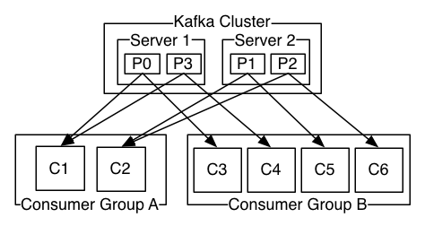
Consumers
Consumers label themselves with a consumer group name.
If all the consumer instances have the same consumer group, then the records will effectively be load balanced over the consumer instances.
If all the consumer instances have different consumer groups, then each record will be broadcast to all the consumer processes.

Slide 10
Kafka Replication Diagram

Slide 11
APACHE Zookeeper
Centralized service for maintaining metadata about a cluster of distributed nodes
Configuration information
Heath status
Group membership
Hadoop,HBase, Mesos, Solr, Redis, and Neo4j
Distributed system consisting of multiple nodes in an “ensemble”

Slide 12
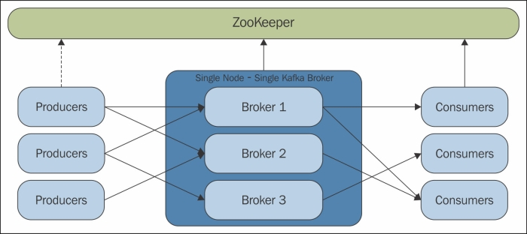
Distributed Partition Management

Slide 13
Kafka vs RabbitMQ vs Other Queuing Service
SQS (Simple Queue Service) is a service, so especially if you are using the AWS cloud, it’s an easy choice: good performance and no setup required
if you are using Mongo, it is easy to build a replicated message queue on top of it, without the need to create and maintain a separate messaging cluster.
HornetQ has great performance with a very rich messaging interface and routing options
if you want to have high persistence guarantees, RabbitMQ ensures replication across the cluster and on disk on message send.
Kafka offers the best performance and scalability.

Slide 14
Partitioning Trade-offs
The more partitions the greater the ZK overhead
With large partition numbers ensure proper ZK capacity
Message ordering can become complex
Single partition for global ordering
Consumer-handling for ordering
The more partitions the longer the leader fall-over time

Slide 15
Kafka vs RabbitMQ
Use Kafka if you have a fire hose of events (100k+/sec) you need delivered in partitioned order ‘at least once’ with a mix of online and batch consumers, you want to be able to re-read messages, you can deal with current limitations around node-level HA (or can use trunk code), and/or you don’t mind supporting incubator-level software yourself via forums/IRC.
Use RabbitMQ if you have messages (20k+/sec) that need to be routed in complex ways to consumers, you want per-message delivery guarantees, you don’t care about ordered delivery, you need HA at the cluster-node level now, and/or you need 24×7 paid support in addition to forums/IRC.

Slide 16
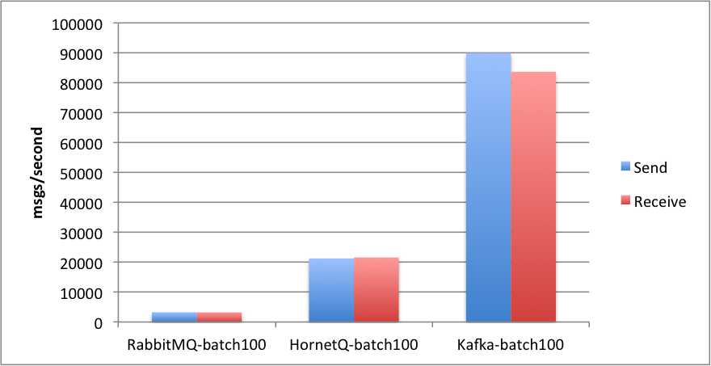
Kafka vs RabbitMQ vs HornetQ

Slide 17
Apache Kafka Adoption since 2015
Yahoo | Uber | Square | Airbnb
Etsy | Oracle | Coursera | Spotify
Microsoft | Goldman Sachs | IBM | Ancestry
Bing | Netflix | Pintrest | Linkedin
Mailchimp | PayPal | Twitter | Hotels.com

